Slide 1




Environment, Security and Health: A Comparison among EU and ASEAN regimes
Maribel Torres
Cazorla

Slide 2

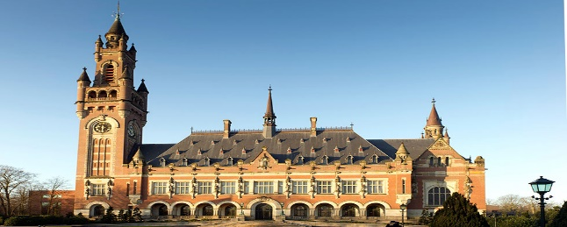
“Man and his environment became victims of the putting into practice of his deplorable and distorted vision of material progress, devoid of values. By losing sight of the demands of reason and ethics, man became a serious threat to himself and his environment”.
(Opinion of Judge A.A. Cançado Trindade in the Pulp Mills on the River Uruguay case, International Court of Justice, 2010).
“Such rights pertain at a time to each member as well as to all members collectively, the object of the protection being the same, a common good (bien común) such as the human environment, so that the observance of such rights benefits at a time each member and all members of the human collectivity, and the violation of such rights affects or harms at a time each member and all members of the human collectivity at issue. This reflects the essence of “collective” rights, such as the right to a healthy environment in so far the object of protection is concerned” (13 Revista del Instituto Iberoamericano de Derechos Humanos (1991).

Slide 3
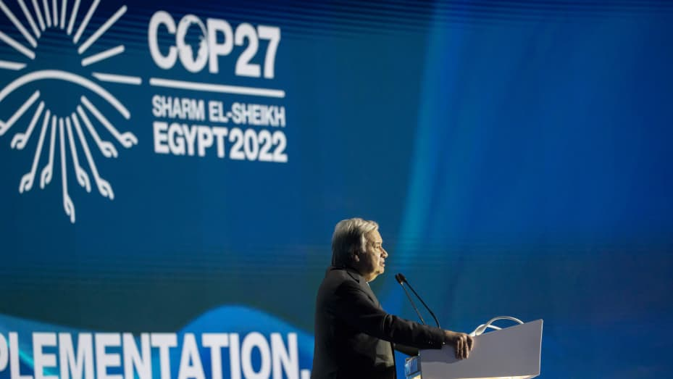
“We’re on a ‘highway to climate hell with our foot still on the accelerator,” Guterres, speaking in Sharm el-Sheikh, Egypt, says (COP-27, November 2022).
“The state of the planet is broken” (Columbia University, 2nd December 2022)

Slide 4
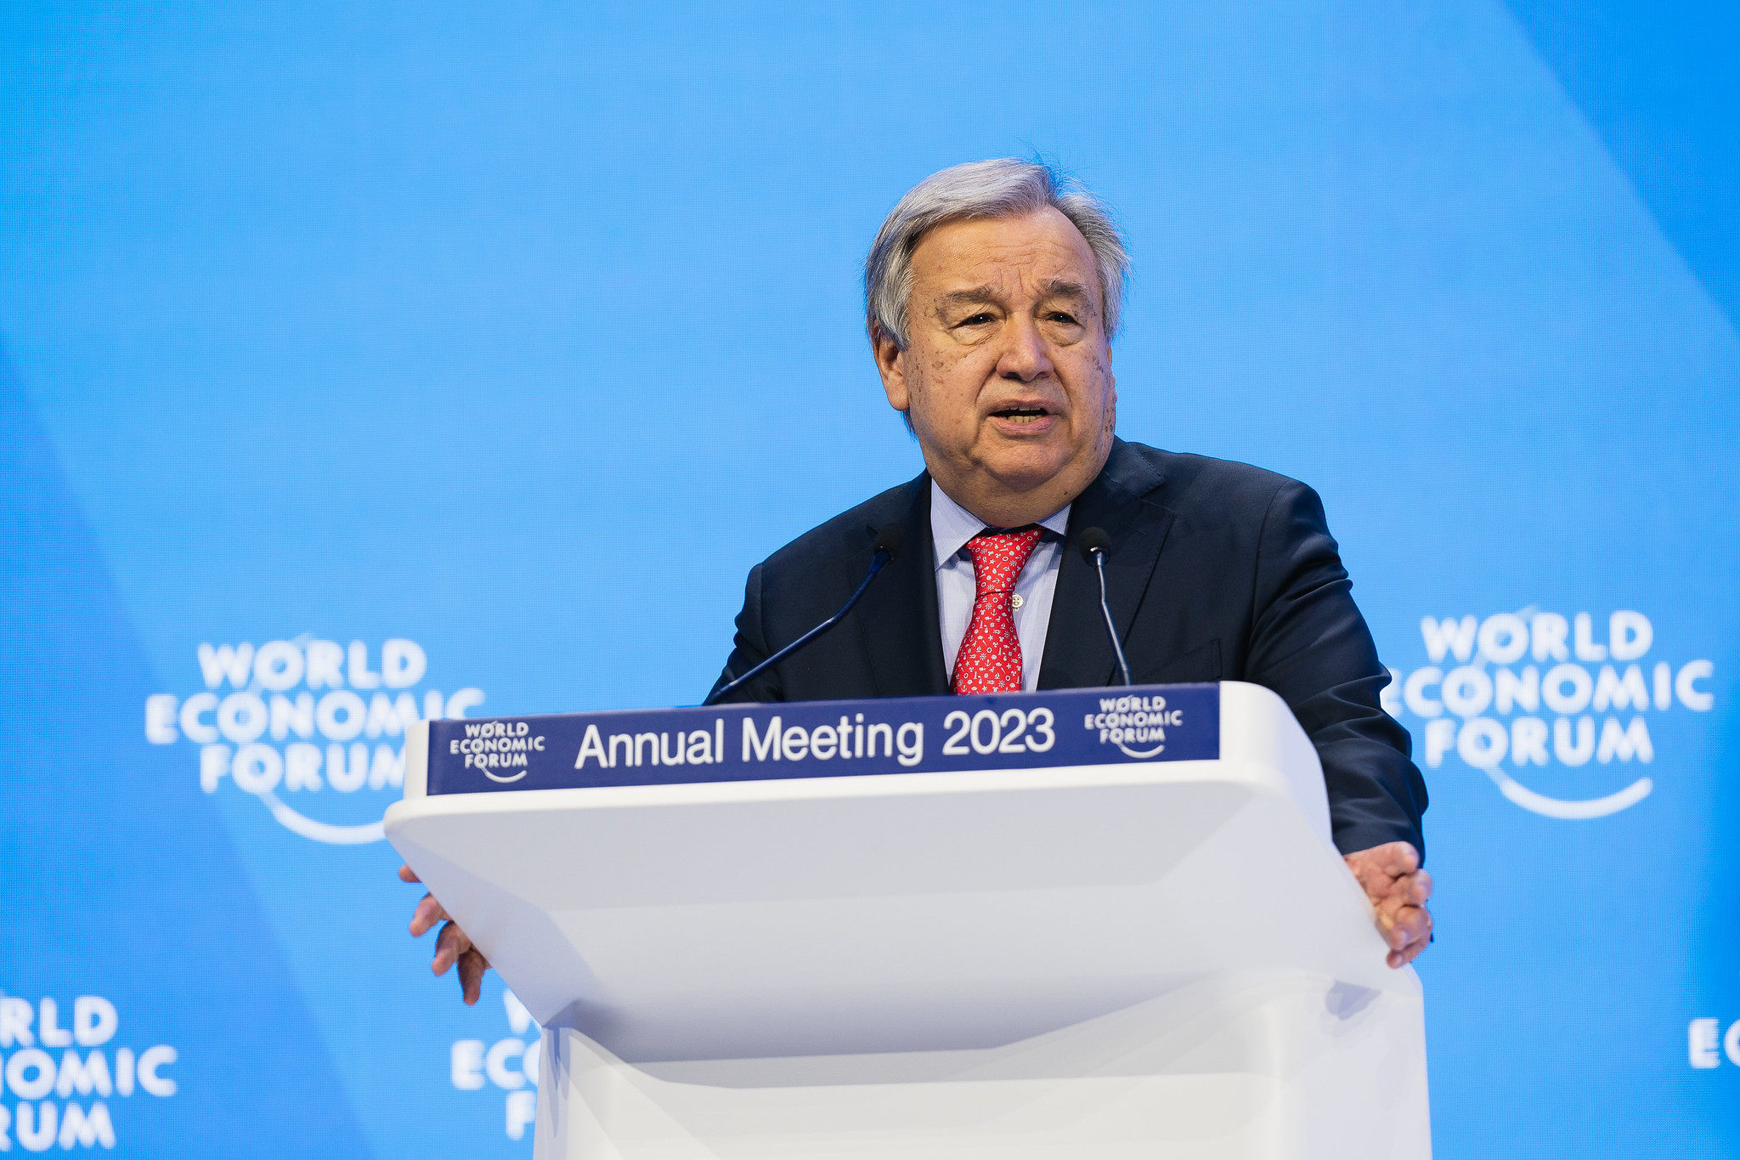
“Our world is plagued by a perfect storm on a number of fronts.
Somehow – after all we have endured – we have not learned the global public health lessons of the pandemic. We are nowhere near ready for pandemics to come. We are flirting with climate disaster. Every week brings a new climate horror story. Greenhouse gas emissions are at record levels. The commitment to limit global temperature rise to 1.5 degrees is going up in smoke. Without further action, we are headed to a 2.8 degree increase.
The consequences will be devastating. Several parts of our planet will be uninhabitable. And for many, this is a death sentence.
Big Oil peddled the big lie. And like the tobacco industry, those responsible must be held to account. Today, fossil fuel producers and their enablers are still racing to expand production, knowing full well that their business model is inconsistent with human survival”. (Davos, 18 January 2023)

Slide 5


Index:
An IntroductionIndex
An Introduction to Environmental Security and its implication on health and related aspects.
European Union and ASEAN perspectives on these topics.
A practical approach to environment, security and health: recent challenges.
Bathing waters regulation: an example to be considered.
Recent events and environmental issues: where we go?
to Environmental Security
Environment challenges: European Union and ASEAN perspectives
Environmental policies of the European Union: the normative framework
Implementation of environmental policies: some tools
Recent events and their influence in the environment: a practical approach

Slide 6
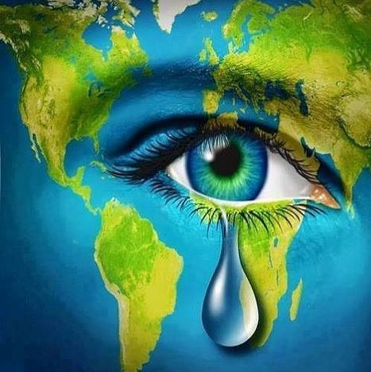
An Introduction to Environmental Security and its implication on health and related aspects
Environmental Security: a Polyhedral Concept
Human Security & Global Security
Stockholm Conference (1972): “Only One Earth”
Security and environment: from the Westphalian perspective to the contemporary approach
1994 United Nations Human Development Report
Some Resolutions of the Commission on Human Rights (1994 and 1995) on Human Rights and the Environment.
Initiatives at the Human Rights Council (Malé Declaration, 2007; Resolution 7/23 on human rights and climate change). Active role of the Philippines.

Slide 7
8 October 2021: Resolution of the Human Rights Council recognizing a new universal human right: the right to a clean, healthy and sustainable environment (Resolution 48/13) (https://documents-dds-ny.un.org/doc/UNDOC/GEN/G21/289/50/PDF/G2128950.pdf?OpenElement).
The same date: Resolution 48/14. Mandate of the Special Rapporteur on the promotion and protection of human rights in the context of climate change (https://documents-dds-ny.un.org/doc/UNDOC/GEN/G21/285/48/PDF/G2128548.pdf?OpenElement).
The Philippines voted in favour of these resolutions.
Resolution of the UNGA adopted the 28 July 2022 (A/RES/76/300): The human right to a clean, healthy and sustainable environment: (par. 4) 161 votes in favour and 8 abstentions.
  “Calls upon States, international organizations, business enterprises and other relevant stakeholders to adopt policies, to enhance international cooperation, strengthen capacity-building and continue to share good practices in order to scale up efforts to ensure a clean, healthy and sustainable environment for all” (https://documents-dds-ny.un.org/doc/UNDOC/GEN/N22/442/77/PDF/N2244277.pdf?OpenElement ).

Slide 8

Following the ideas of John Knox (first independent Expert/Special Rapporteur on Human Rights and Environment of the Human Rights Council), “the obligations of States to respect, protect and fulfil a globally recognized human right to a healthy environment have evolved along three paths: the recognition of the right to a healthy environment at the regional and national levels; the application of other human rights, such as the rights to life and health, to environmental issues; and the inclusion of procedural rights in environmental treaties”.

Slide 9

Good practices in the implementation of the right to a healthy environment from more than 170 States (David R. Boyd, Special Rapporteur on Human Rights and Environment, after Knox): https://documents-dds-ny.un.org/doc/UNDOC/GEN/G19/355/14/PDF/G1935514.pdf?OpenElement (UN DOC A/HRC/43/53, 30 December 2019).

Slide 10
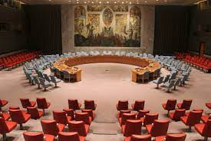
And, what about security and… the UN Security Council?
Year 2007 (open debate under the Presidency of the UK): the impact of climate change on security issues. 55 speakers, 40 non members of the SC.
What is the role that the SC must play on this subject? Division of the international community.
Res. GA 63/281 (2009): climate change and its possible security implications.
SG Report on this issue (11 September 2009): “Climate change is a global challenge that can only be tackled at a global level”.

Slide 11
2011 (open debate under the Presidency of Germany at the SC). “The impact on climate change on the maintenance of peace and security”.
Declaration of the Presidency:
“The Security Council expresses its concern that possible adverse effects of climate change may, in the long run, aggravate certain existing threats to international peace and security.”
“The Security Council expresses its concern that possible security implications of loss of territory of some States caused by sea-level-rise may arise, in particular in small low-lying island States.“
“The Security Council notes that in matters relating to the maintenance of international peace and security under its consideration, conflict analysis and contextual information on, inter alia, possible security implications of climate change is important, when such issues are drivers of conflict, represent a challenge to the implementation of Council mandates or endanger the process of consolidation of peace. In this regard, the Council requests the Secretary-General to ensure that his reporting to the Council contains such contextual information.”

Slide 12
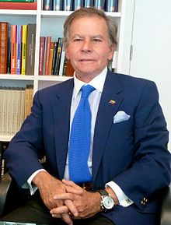
December 2021 SC session on climate and security. Absence of consensus: 12 votes in favour of a draft resolution promoted by 113 States; 2 against (Russian Federation and India) and 1 abstention (China).
And: 2013; 2015; 2017; 2018; 2022(Arria formula)
Open debate: 2013, 2016, 2018, 2019, 2020, 2021

Slide 13
Group of Friends on Climate and Security
Group of Friends for an Ambitious EU Climate Diplomacy
A. J. RODRIGUEZ CARRIÓN, “the intellectual’s mission should not be to offer a reassuring vision, but to shine a spotlight on the elements that threaten the future, not because they are the only ones, but because they are the ones that can most affect the future of the coming generations”.

Slide 14
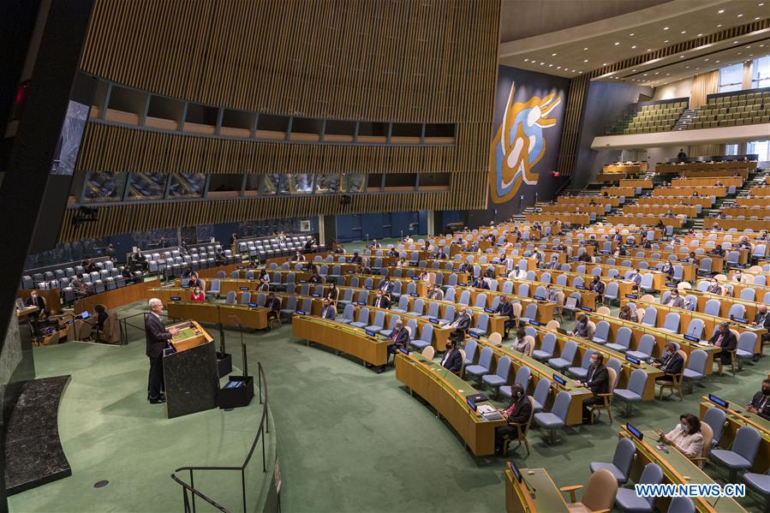
A new perspective must be adopted: the health dimensions of climate change must be taken into account. For example, a record of 60% of 194 countries focused their attention on the links between climate change and health in the 2021 UN General Debate.

Slide 15
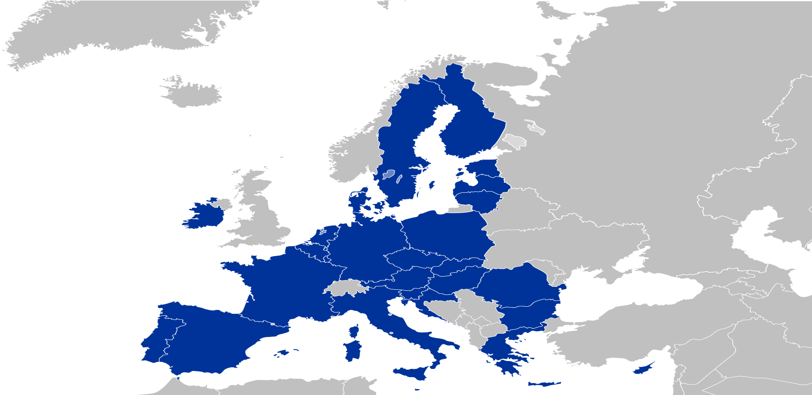
2. EU and ASEAN Perspectives: A General Approach

Slide 16
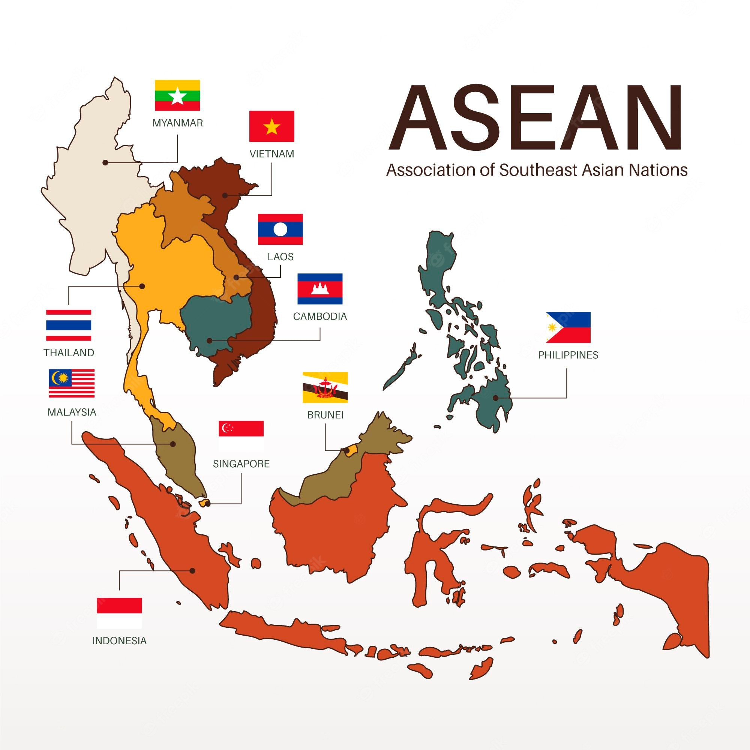

Slide 17

A crucial aspect to be considered: Characteristic regional features (using art. 197 of the UNCLOS as a basis, for the conservation and sustainable use of marine biodiversity of areas beyond national jurisdiction):
“States shall cooperate on a global basis and, as appropriate, on a regional basis, directly or through competent international organizations, in formulating and elaborating international rules, standards and recommended practices and procedures consistent with this Convention, for the protection and preservation of the marine environment, taking into account characteristic regional features”.

Slide 18

2. European Union and ASEAN perspectives on these topics.
https://ec.europa.eu/environment/international_issues/relations_asem_en.htm
https://europa.eu/!FX38yC

Slide 19
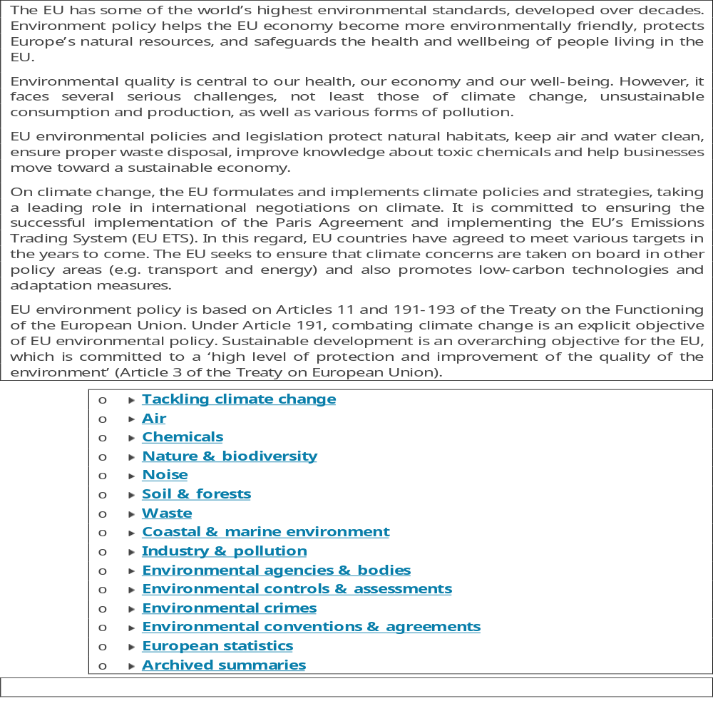

Since 1987: Single EuropeanAct

Slide 20

ASEAN, the main regional organization in Southeast Asia.
Created to achieve the limited purpose of maintaining regional order (Jones &Smith, 2007).
The governance of environment was first included in the ASEAN work programme from 1978. The body gradually developed a regional framework that included policy, legal and institutional structures.
Short video:
https://upload.wikimedia.org/wikipedia/commons/transcoded/5/55/ASEAN_explained_in_5_minutes.webm/ASEAN_explained_in_5_minutes.webm.720p.vp9.webm

Slide 21
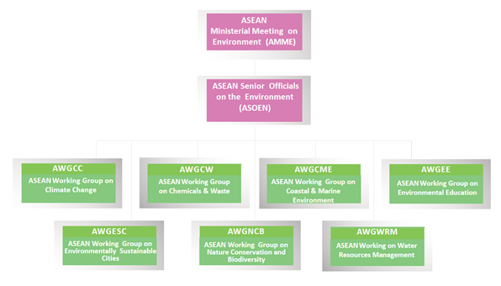

Slide 22
Remarkable: the ASEAN’s Declaration on Environmental Sustainability, that pledges to “promote the sustainable management and the use of…coastal and marine environments as part of regional and global efforts on biodiversity conservation”. (40th Anniversary of ASEAN)
Coastal and marine habitats are key ecosystems.
In the same way, see the Memorandum of Understanding on ASEAN Sea Turtle Conservation (12/09/1997), and Memoradum of Understanding on ASEAN Cooperation Mechanism for Joint Oil Spill Preparedness and Response (28/11/2014).
Agreements such as the ASEAN Agreement on the Conservation of Nature and Natural Resources (1989, not in force); ASEAN Agreement on Transboundary Haze Pollution (2002); ASEAN Petroleum Security Agreement (2009); Agreement on the ASEAN Coordinating Centre for Animal Disease and Zoonoses (2016). See additional information at: https://agreement.asean.org/home/index/16.html
The Coral Triangle Initiative: https://www.coraltriangleinitiative.org/country/philippines

Slide 23
Some ASEAN agreements referred to Environmental Issues:
Agreement on the Establishment of the ASEAN Coordinating Centre for Animal Health and Zoonoses | 07 October 2016 | This Agreement shall enter into force on the thirtieth (30th) day after the date on which all ASEAN Member States have deposited their instruments of ratification, acceptance or approval with the Depositary. | In Force (IF) 08 September 2021
And Disaster Management and Emergency Response (2005); Coordinating Center for Humanitarian Assistance (2011).

Slide 24

Environmental Policies of the European Union: the Normative Framework
Examples:
https://eur-lex.europa.eu/legal-content/EN/TXT/?uri=celex%3A02013R0525-20181224
https://eur-lex.europa.eu/legal-content/EN/TXT/?uri=legissum%3A2001_16
https://eur-lex.europa.eu/legal-content/EN/TXT/?uri=legissum%3A2001_14

Slide 25


Implementation of Environmental Policies: Some Tools
https://ec.europa.eu/environment/eir/index_en.htm
https://eur-lex.europa.eu/legal-content/EN/TXT/?uri=legissum%3A4314888
https://eur-lex.europa.eu/legal-content/EN/TXT/?uri=legissum%3Al28082
https://eur-lex.europa.eu/legal-content/EN/TXT/?uri=legissum%3Aev0019
https://www.eea.europa.eu/
https://ec.europa.eu/health/scientific_committees_en

Slide 26
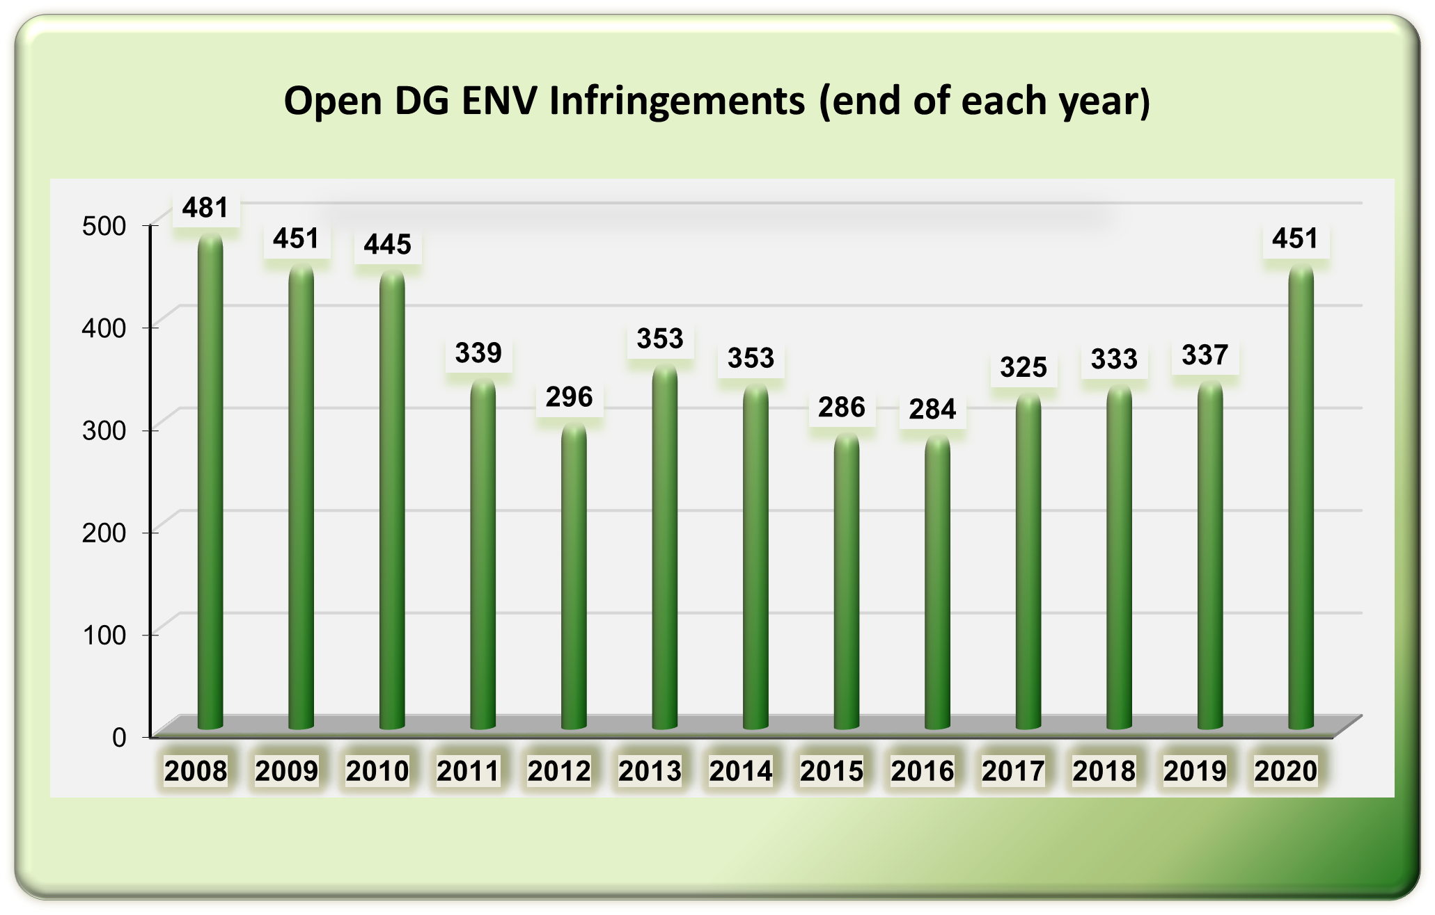

Slide 27
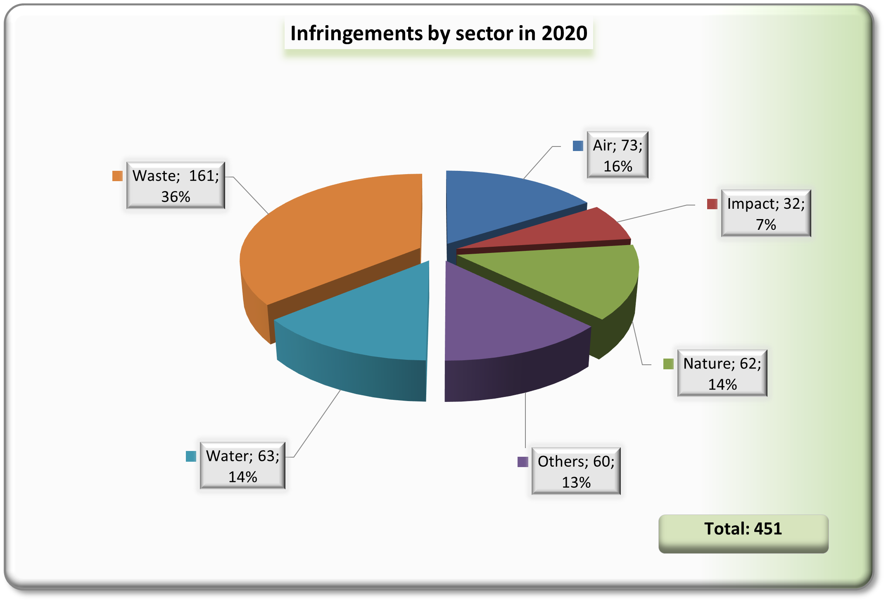

Slide 28
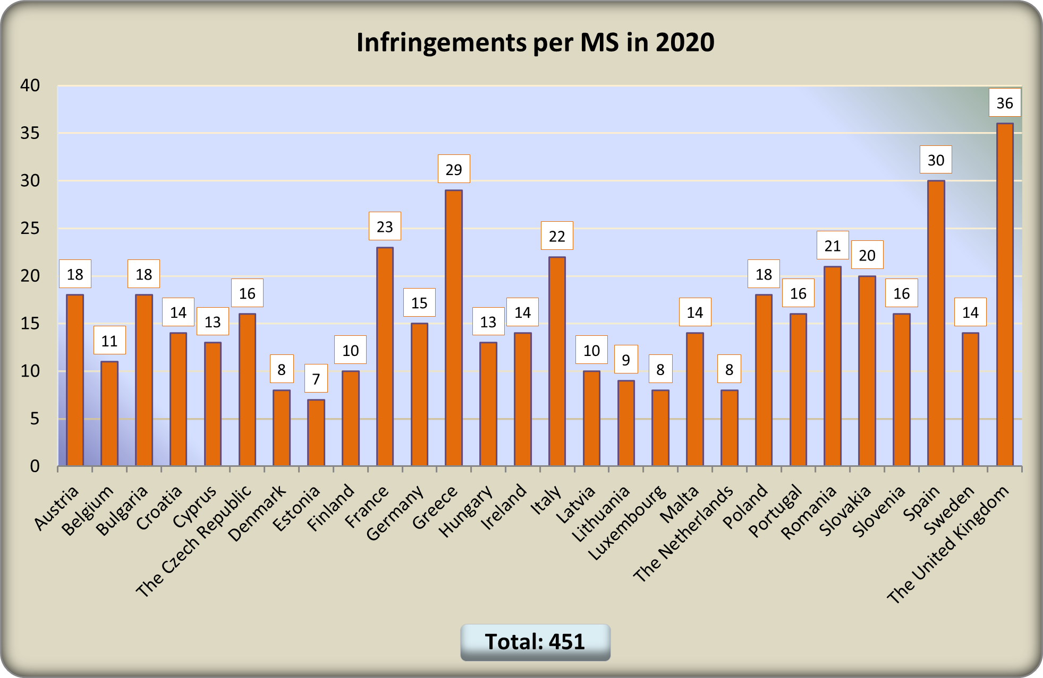

Slide 29
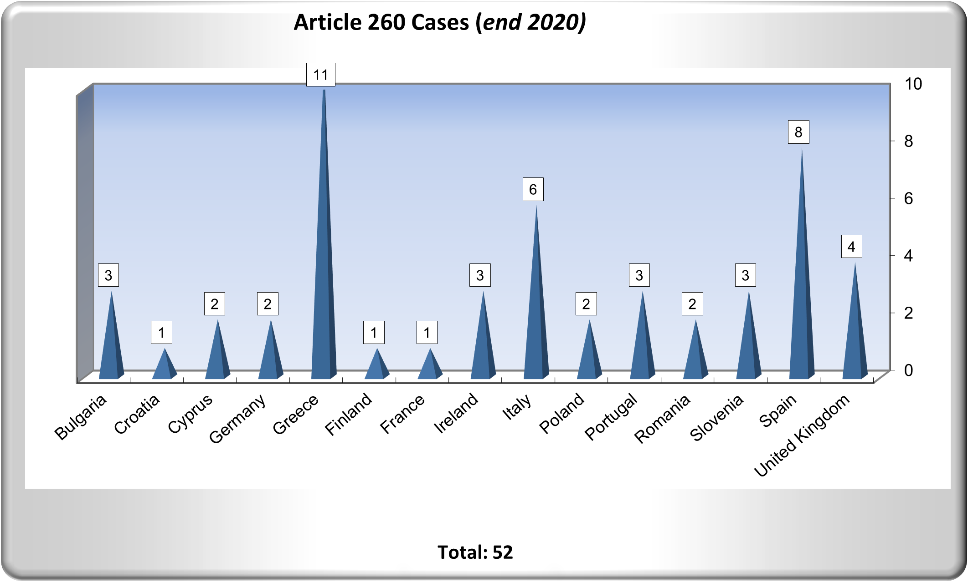

Slide 30
Some data from the 2021 Annual Report on Monitoring the application of EU Law (Environment)
Number of Infringement cases open at year (period 2017-2021)
2017: 307 cases
2018: 298 cases
2019: 327 cases
2020: 445 cases
2021: 356 cases
Concerning in particular to: Air quality Directive, Habitats and Birds Directives, Regulation on Invasive Alien Species, Water Framework Directive, Waste Water Treatment Directive, Single Use Plastics Directive

Slide 31
Country |  | Title INFRINGMENT DECISIONS ON ENVIRONMENTAL ISSUES 2021
Poland |  | AIR - Air quality - Directive (EU) 2016/2284 on the reduction of National Emission reduction Commitments Directive (NECD)
Poland |  | NATURE – Special Areas of Conservation and Special Protection Areas in Poland
Lithuania |  | NATURE–Bad application of Art. 4(4) and 6 of Dir. 92/43/EEC - designation of Special Areas of Conservation and setting of conservation objectives and measures
Czechia |  | CHEMICALS – SEVESO III DIRECTIVE – NON-CONFORMITY
Spain |  | WASTE - Non communication by Spain of transposition measures for Commission Delegated Directive (EU) 2021/647 of 15 January 2021
Belgium |  | NATURE - Failure to fulfil certain obligations following from the Invasive Alien Species Regulation by Belgium
Italy |  | Failure by Italy to comply with obligations under the Invasive Alien Species Regulation
Lithuania |  | NATURE - Failure by Lithuania to fulfil obligations under the Invasive Alien Species Regulation
Greece |  | AIR - Non-conform transposition of the Medium Combustion Plants Directive ((EU) 2015/2193) into Greek legislation
Romania |  | AIR - INDUSTRIAL EMISSIONS – Incorrect transposition and application by Romania of Directive 2010/75
Italy |  | NATURE - Failure to complete Natura 2000 sites designations in Italy
France |  | IMPACT - Manquement à la Directive 2001/42/CE relative à l'évaluation des incidences de certains plans et programmes sur l'environnement
Slovenia |  | Nature- Designation of Special Protection Areas (SPA) for the Mediterranean Shag in Slovenia
Slovenia |  | CHEMICALS – SEVESO III DIRECTIVE – NON-CONFORMITY
Malta |  | WATER - Failure by Malta to comply with its reporting obligations under the urban waste-water treatment Directive
Greece |  | NATURE - Failure by Greece to fulfil obligations under the Invasive Alien Species Regulation
Portugal |  | NATURE - Failure to fulfil certain obligations following from the Invasive Alien Species Regulation by Portugal
Slovakia |  | NATURE – Failure by Slovakia fulfil obligations under the Invasive Alien Species Regulation
France |  | AIR - Transposition non conforme par la France de la Directive (EU) 2015/2193 relative à la limitation des émissions des installations de combustion moyennes
Cyprus |  | WASTE - Bad application of the Landfill directive 1991/31/EC and of the Waste framework directive 2008/98/EC in Cyprus
Cyprus |  | NATURE - Designation of Special Areas of Conservation in Cyprus - SAC Designation

Slide 32
Greece |  | WASTE - Bad application of the Landfill directive 1991/31/EC and of the Waste framework directive 2008/98/EC
Belgium |  | WASTE - Non communication of transposition measures for Commission Delegated Directive (EU) 2021/647 of 15 January 2021
Slovakia |  | CHEMICALS – Non-conformity with Directive 2012/18/EU on the control of major-accident hazards involving dangerous substances (SEVESO III) in Slovakia
France |  | NATURE - France failed to fulfil obligations under the Invasive Alien Species Regulation
Spain |  | NATURE - Spain failed to fulfil obligations under the Invasive Alien Species Regulation
Austria |  | AIR - Non-conform transposition of the Medium Combustion Plants Directive (EU) 2015/2193 into Austrian legislation
Germany |  | IMPACT – A2J – Failure by Germany to fulfil obligations under the Environmental Impact Assessment Directive
Italy |  | WASTE - Non communication of transposition measures for Commission Delegated Directive (EU) 2021/647 of 15 January 2021 by Italy
Slovakia |  | Bad application of Council Directive 91/271/EEC on urban waste water treatment (UWWT) in Slovakia
Poland |  | CHEMICALS – SEVESO III DIRECTIVE – NON-CONFORMITY
Czechia |  | AIR- Non-conform transposition of Dir. 2010/75/EU of the Eur. Parliament and of the Council of 24 November 2010 on industrial emissions into Czech legislation
Bulgaria |  | WASTE - Application of Directive 1999/31/EC on the landfill of waste and of Directive 2008/98/EC on waste in Bulgaria
Slovakia |  | WASTE - Non communication by Slovakia of transposition measures for Commission Delegated Directive (EU) 2021/647 of 15 January 2021amending the RoHS Directive
Croatia |  | WASTE - Application of Directive 1999/31/EC on the landfill of waste and of Directive 2008/98/EC on waste in Croatia
Latvia |  | NATURE - Failure by Latvia to fulfil obligations under the Invasive Alien Species Regulation
Ireland |  | NATURE - Failure by Ireland to fulfil obligations under the Invasive Alien Species Regulation
Bulgaria |  | NATURE - Failure by Bulgaria to fulfil obligations under the Invasive Alien Species Regulation
Cyprus |  | NATURE - Failure by Cyprus to fulfil obligations under the Invasive Alien Species Regulation

Slide 33
Latvia |  | WASTE - Non communication of transposition measures for Commission Delegated Directive (EU) 2021/647 of 15 January 2021
Poland |  | WATER - Bad application of the urban waste-water treatment Directive in Poland
Slovenia |  | NATURE - Failure by Slovenia to fulfil obligations under the Invasive Alien Species Regulation
Croatia |  | NATURE - Croatia failed to fulfil obligations under the Invasive Alien Species Regulation
Estonia |  | Nature - Non-conform transposition and bad application of certain provisions of the Habitats Directive and the SEA Directive
Germany |  | NATURE - Germany failed to fulfil obligations under the Invasive Alien Species Regulation
Czechia |  | NATURE - Czechia failed to fulfil obligations under the Invasive Alien Species Regulation
Cyprus |  | AIR - Non-conform transposition of the Medium Combustion Plants Directive ((EU) 2015/2193) into Cypriot legislation
Romania |  | NATURE - Failure by Romania to fulfil obligations under the Invasive Alien Species Regulation
Poland |  | NATURE - Failure by Poland to fulfil its obligations under the Invasive Alien Species Regulation
Spain |  | NATURE - Insufficient protection and designation of SPA Delta del Llobregat (Barcelona)
Slovakia |  | WASTE - Application of Directive 1999/31/EC on the landfill of waste and of Directive 2008/98/EC on waste in Slovakia

Slide 34
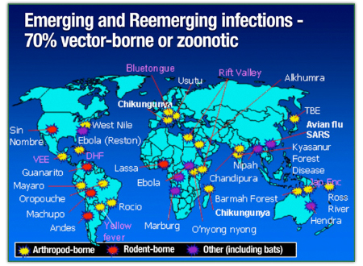
4. A practical approach to environment, security and health: recent challenges

Slide 35
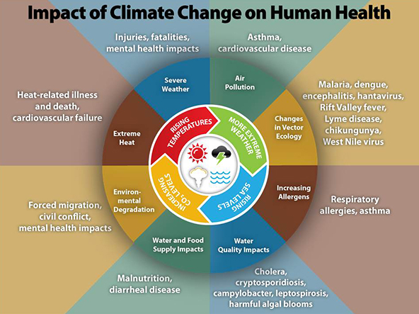
And health…
More than 12 million people around the world die every year because they live or work in unhealthy environments.

Slide 36
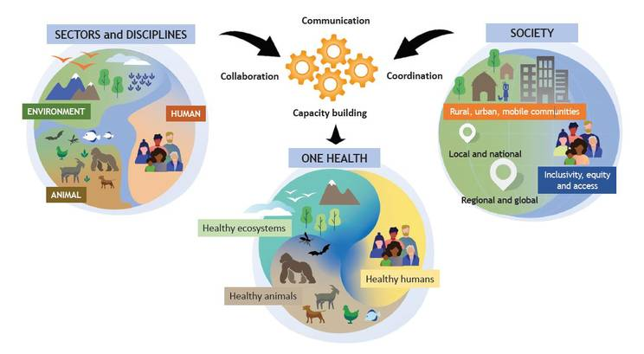
The One Health Initiative acts as the Secretariat for the One Health High-Level Expert Panel (OHHLEP), acts as the WHO Secretariat of the FAO/UNEP/WHO/WOAH (World Organization for Animal Health)(quadripartite) to support One Health related activities, coordinates interagency engagement and partnership, coordinates WHO internal One Health work-plans and facilitates interactions with multiple initiatives on One Health to reduce fragmentation.
https://youtu.be/2pyLm2j3jxI

Slide 37
Climate change affects the social and environmental determinants of health – clean air, safe drinking water, sufficient food and secure shelter.
Between 2030 and 2050, climate change is expected to cause approximately 250 000 additional deaths per year, from malnutrition, malaria, diarrhea and heat stress.
The direct damage costs to health (i.e. excluding costs in health-determining sectors such as agriculture and water and sanitation), is estimated to be between USD 2-4 billion/year by 2030.
Areas with weak health infrastructure – mostly in developing countries – will be the least able to cope without assistance to prepare and respond.
Reducing emissions of greenhouse gases through better transport, food and energy-use choices can result in improved health, particularly through reduced air pollution.
(Source: https://www.who.int/news-room/fact-sheets/detail/climate-change-and-health)

Slide 38
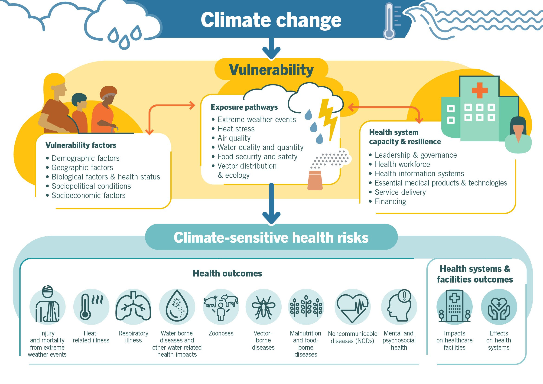

Slide 39
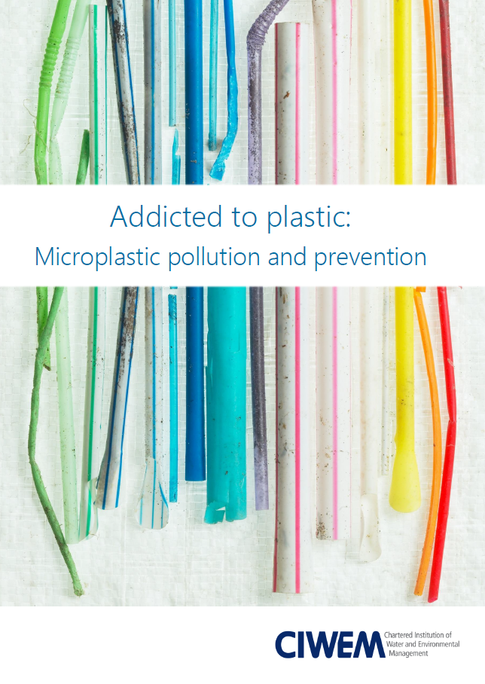
The plastic’s challenge
https://youtu.be/MAoBi9bK7c8

Slide 40
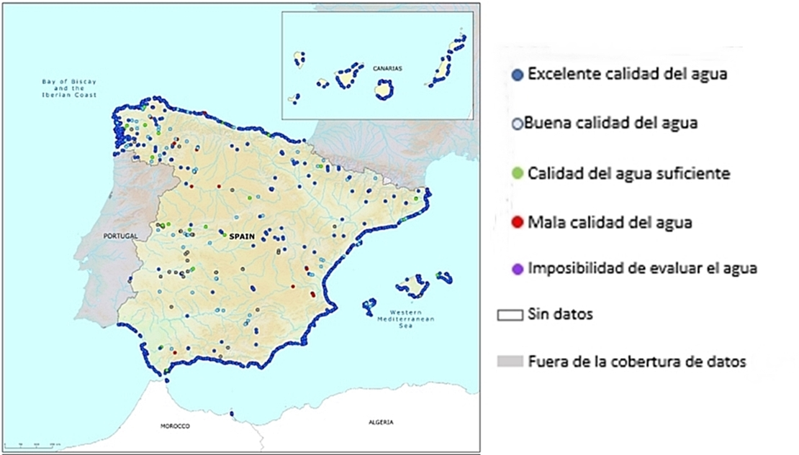
4. Bathing waters regulation: an example to be considered

Slide 41

Bathing Water Directive is a key to improve water quality in general, and the health impact in particular since it lays down quality standards for the protection of public health and the environment, and obliges Member States to take measures to ensure that bathing waters conform to these standards.

Slide 42
Initial regulation: Directive 76/160/CEE of the Council concerning the quality of bathing water (8/12/1975); transposal rule in Spain: Royal Decree 734/1988, 1 July 1988.
“Whereas, in order to protect the environment and public health, it is necessary to reduce the pollution of bathing water and to protect such water against further deterioration;
Whereas surveillance of bathing water is necessary in order to attain, within the framework of the operation of the common market, the Community's objectives as regards the improvement of living conditions, the harmonious development of economic activities throughout the Community and continuous and balanced expansion;” (…)
“Whereas public interest in the environment and in the improvement of its quality is increasing; whereas the public should therefore receive objective information on the quality of bathing water;”
Article 4.1 of the Directive:
“Member States shall take all necessary measures to ensure that, within 10 years following the notification of this Directive, the quality of bathing water conforms to the limit values set in accordance with Article 3 “.

Slide 43
Advanced regulation, control of 19 parameters (physical, chemical and biological)
Nothing is perfect; that objective has been “plagued by a long history of noncompliance on the part of Member States, a history which includes years of delay by Member States, multiple enforcement actions before the European Court of Justice (ECJ) and several adverse judgments against individual Member States” (L.W. GOODRICH, “Implementing Environmental Law in the European Union: Lessons from the Bathing Water Directive”, 16 Georgetown International Environmental Law Review (winter 2004), pp. 301-321, p. 302).
The Directive lays down quality standards to protect the public health and the marine environment, obliges Member States to take measures necessary to conform to these standards and prescribes a surveillance strategy.

Slide 44
Bathing water is…article 1…
1 . This Directive concerns the quality of bathing water, with the exception of water intended for therapeutic purposes and water used in swimming pools.
2. For the purposes of this Directive:
'bathing water' means all running or still fresh waters or parts thereof and sea water, in which :
— bathing is explicitly authorized by the competent authorities of each member State, or
— bathing is not prohibited and is traditionally practised by a large number of bathers;”.

Slide 45
Obligations under the Directive:
Member States must report monitoring results to the Commission by 31 December of each year.
The Commission compiles all these data into its annual report, which is published before the next bathing season.
The competent authorities must adopt new methods to actively inform the public about bathing water quality.
The best medium will be Internet: bathing zone profiles, maps, water quality monitoring, action programmes (on local, regional and national sites).

Slide 46
Enforcement actions before the European Court of Justice concerning the first Directive
Case | Concerned State | Judgment | Violations |  | Reference Reports
C-56/90 | United Kingdom | 14.7.1993 |  | Art. 3 | 1993, I, 4109
C-92/96 | Spain | 12.2.1998 |  | Art. 4.1 | 1998, I, 505
C-198/97 | Germany | 8.6.1999 |  | Arts. 4.1 y 6.1 | 1999, I, 3257
C-307/98 | Belgium | 25.5.2000 |  | Art. 4.1 | 2000, I, 3933
C-147/00 | France | 15.3.2001 |  | Arts. 3, 4, 5, 6 y Anexo | 2001, I, 2387
C-368/00 | Sweden | 14.6.2001 |  | Arts. 4.1 y 6.1 | 2001, I, 4605
C-427/00 | United Kingdom | 13.11.2001 |  | Art. 3 y Anexo | 2001, I, 8535
C-268/00 | Netherlands | 19.3.2002 |  | Arts. 4.1 y 6.1 | 2002, I, 2995
C-226/01 | Denmark | 30.1.2003 |  | Arts. 4.1 y 6.1 | 2003, I, 1219
C-278/01 | Spain | 25.11.2003 |  | Sentencia C-92/96 | 2003, I, 14141
C-272/01 | Portugal | 15.7.2004 |  | Art. 3, 4.1 y Anexo | 2004, I, 0000
C-26/04 | Spain | 15.12.2005 |  | Cumple Dir. 76/160/CEE | 2005, I, 11059

Slide 47
Freshwater | Belgium | Denmark | Finland | France | Germany | Greece | Italy | Netherlands | Portugal | Spain | Sweden
Years | 91-04 | 92-04 | 96-04 | 92-04 | 92-04 | 91-04 | 91-04 | 91-04 | 94-04 | 91-04 | 96-04
Total | 129 | 138 | 419 | 2728 | 2645 | 6 | 990 | 989 | 89 | 535 | 770
Suppressed | 57 | 27 | 134 | 1322 | 1084 | 2 | 211 | 439 | 16 | 365 | 358
% Suppressed | 44.18 | 19.57 | 31.98 | 48.46 | 40.98 | 33.33 | 21.31 | 44.39 | 17.98 | 68.22 | 46.49
Coastal Waters | Denmark | Finland | France | Germany | Greece | Italy | Netherlands | Portugal | Spain | Sweden
Years | 92-04 | 96-04 | 92-04 | 92-04 | 91-04 | 91-04 | 91-04 | 92-04 | 91-04 | 96-04
Total | 1390 | 140 | 2255 | 714 | 2168 | 5931 | 134 | 441 | 2136 | 543
Suppressed | 252 | 37 | 383 | 324 | 203 | 1047 | 52 | 41 | 310 | 161
%Suppressed | 18.13 | 26.43 | 16.98 | 45.38 | 9.36 | 17.65 | 38.81 | 9.3 | 14.51 | 29.65
Notes:
Data: 2004. Before the entry into forcé of the new Directive

Slide 48
Directive 2006/7/EC of the European Parliament and the Council concerning the management of bathing water quality and repealing Directive 76/160/EEC (15/02/2006)
In 2001, the European Commission began the process of reviewing this old legislation in order to increase the rigor of the Directive. The proposed changes in bacteriological sampling reflects the scientific advances that have been achieved in recent years. “This Directive should use scientific evidence in implementing the most reliable indicator parameters for predicting microbiological health risk and to achieve a high level of protection. Further epidemiological studies should be undertaken urgently concerning the health risks associated with bathing, particularly in fresh water”.
In the new directive emphasis is shifted from bathing water quality monitoring to bathing water quality management.

Slide 49
Together with…
“On 17 February 2005 the Community ratified the UNECE Convention on Access to Information, Public Participation in Decision-Making and Access to Justice in Environmental Matters (the Århus Convention). It is therefore appropriate for this Directive to include provisions on public access to information and to provide for public participation in its implementation”.

Slide 50
Art. 1
“This Directive shall apply to any element of surface water where the competent authority expects a large number of people to bathe and has not imposed a permanent bathing prohibition, or issued permanent advice against bathing (hereinafter bathing water). It shall not apply to: (a) swimming pools and spa pools;
(b) confined waters subject to treatment or used for therapeutic purposes;
(c) artificially created confined waters separated from surface water and groundwater”.

Slide 51
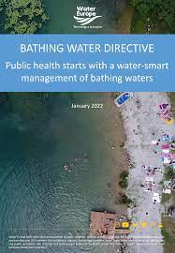
The new Directive is shifting the effective interventions from sewage treatment and outfall management to the management of bathing beaches. This is expected to be achieved through a series of measures consisting of classification of bathing waters, monitoring their quality status, establishment of bathing water profiles, timely identification of health risks and encouragement of public information and participation.
The 2006 Directive clearly intends to impose microbiological standards for coastal recreational waters aiming to be as protective of human health as reasonably posible.

Slide 52
Classification of bathing waters
Following article 5.1 this classification will be: (a) ‘poor’; (b) ‘sufficient’; (c) ‘good’; or (d) ‘excellent’.
Article 5.4 (b) says that: “If a bathing water is classified as ‘poor’ for five consecutive years, a permanent bathing prohibition or permanent advice against bathing shall be introduced. However, a Member State may introduce a permanent bathing prohibition or permanent advice against bathing before the end of the five-year period if it considers that the achievement of ‘sufficient’ quality would be infeasible or disproportionately expensive”.

Slide 53
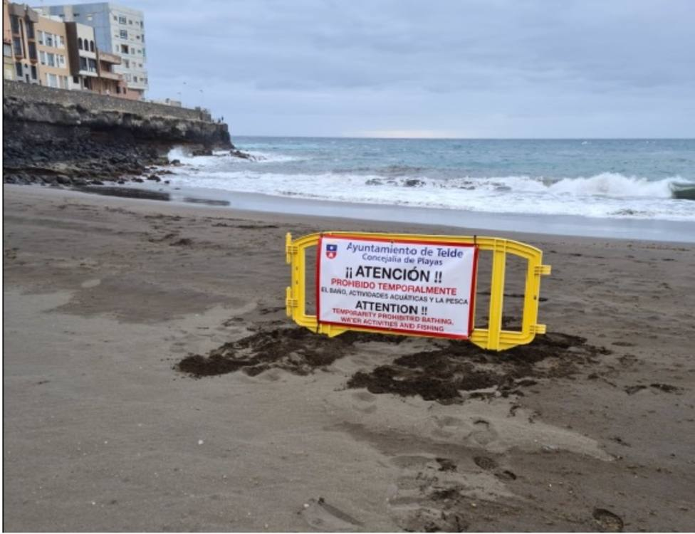
Measures to be adopted (cyanobacterial risks, macroalgae, phytoplancton, pollution…)
“When the bathing water profile indicates a potential for cyanobacterial proliferation, appropriate monitoring shall be carried out to enable timely identification of health risks”.
Information to the public is needed.
But compliance to the 2006/7/EC European Union microbiological bathing water quality criteria does not safeguard against the possibility of the presence of Salmonella or C. albicans in bathing coastal waters

Slide 54
Bathing Water Quality Report 2021
Bathing water quality in the EU remains high. Since the adoption of the Bathing Water Directive in 2006, the share of excellent sites has grown continuously; in 2021, it represented 84.8% of bathing sites in the EU. The minimum water quality standards were met at 95.2% of sites.

Slide 55
The quality of coastal sites is generally better than that of inland sites. In 2021, 88.0%, of EU coastal bathing sites were classified as being of excellent quality compared to 78.2% of inland sites.
The share of poor-quality sites has dropped since 2013. In 2021, poor bathing waters constituted 1.5% of all sites in the EU, compared to 2% in 2013. This shows improvements in the management of poor bathing sites in Europe.
The share of excellent bathing water has been stable in recent years. In the period 2015-2021, the share of bathing water having an excellent status in Europe has been stable at 85-88% for coastal bathing water; and at 77-81% for inland bathing water.
The number of bathing waters in Europe has decreased from 2020 by 417 (1.9%) amounting to 21,859 bathing sites in 2021. Compared to 2020, there is no longer information about 640 bathing sites in the UK as it is no longer reported. 223 new bathing sites have been identified in 2021 in the EU countries.

Slide 56
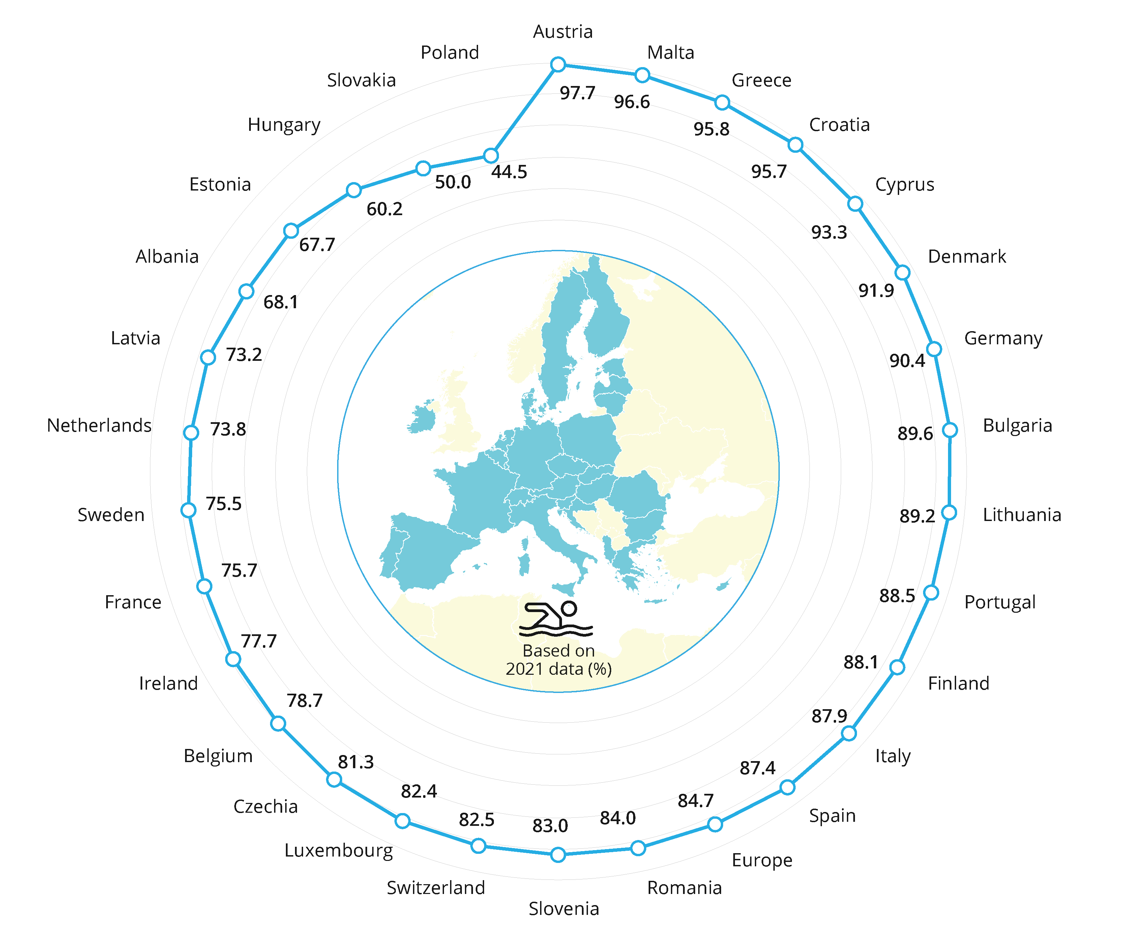
Proportion of bathing waters with excellent quality in European countries in 2021

Slide 57
Positive impact of the Directive
Out of 21,859 bathing sites in Europe in 2021, 84.7% were of excellent quality (Figure 1). In four countries, 95% or more, of bathing waters were of excellent quality: Austria, Malta, Croatia and Greece. Additionally in Malta, Bulgaria, Romania and Luxembourg, all assessed bathing water sites were of at least sufficient quality in 2021.
The percentage of European bathing waters achieving at least 'sufficient' quality (the minimum quality standard set by the Directive) increased from just 74% in 1991 to over 95% in 2003 and has remained quite stable since then.
One of the main requirements of the Directive is to ensure that all bathing water sites were at least of 'sufficient' quality by 2015. In the 2021bathing season, this minimum quality standard was met by 95.2% of all EU bathing water sites.

Slide 58
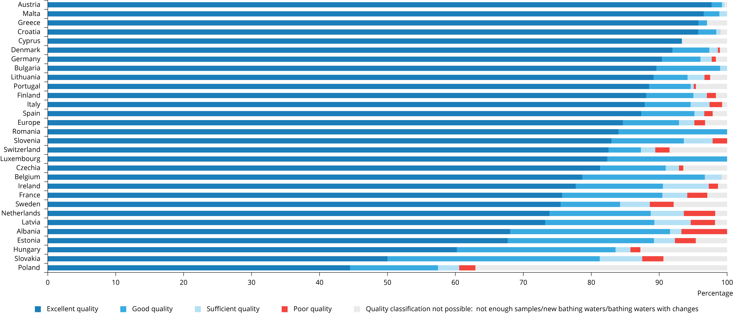

Slide 59
In the period 2015-2021, the share of bathing waters having an excellent status in Europe has been stable at 85-88% for coastal bathing waters; and at 77-81% for inland bathing waters (Figure 3). The quality of coastal sites is generally better than that of inland sites due to the higher self-purification capacity of coastal areas. Moreover, many central European inland bathing water sites are situated on relatively small lakes and ponds as well as rivers with a low flow, which, especially in the summer, are more susceptible than coastal areas to short-term pollution caused by heavy summer rains or droughts.

Slide 60
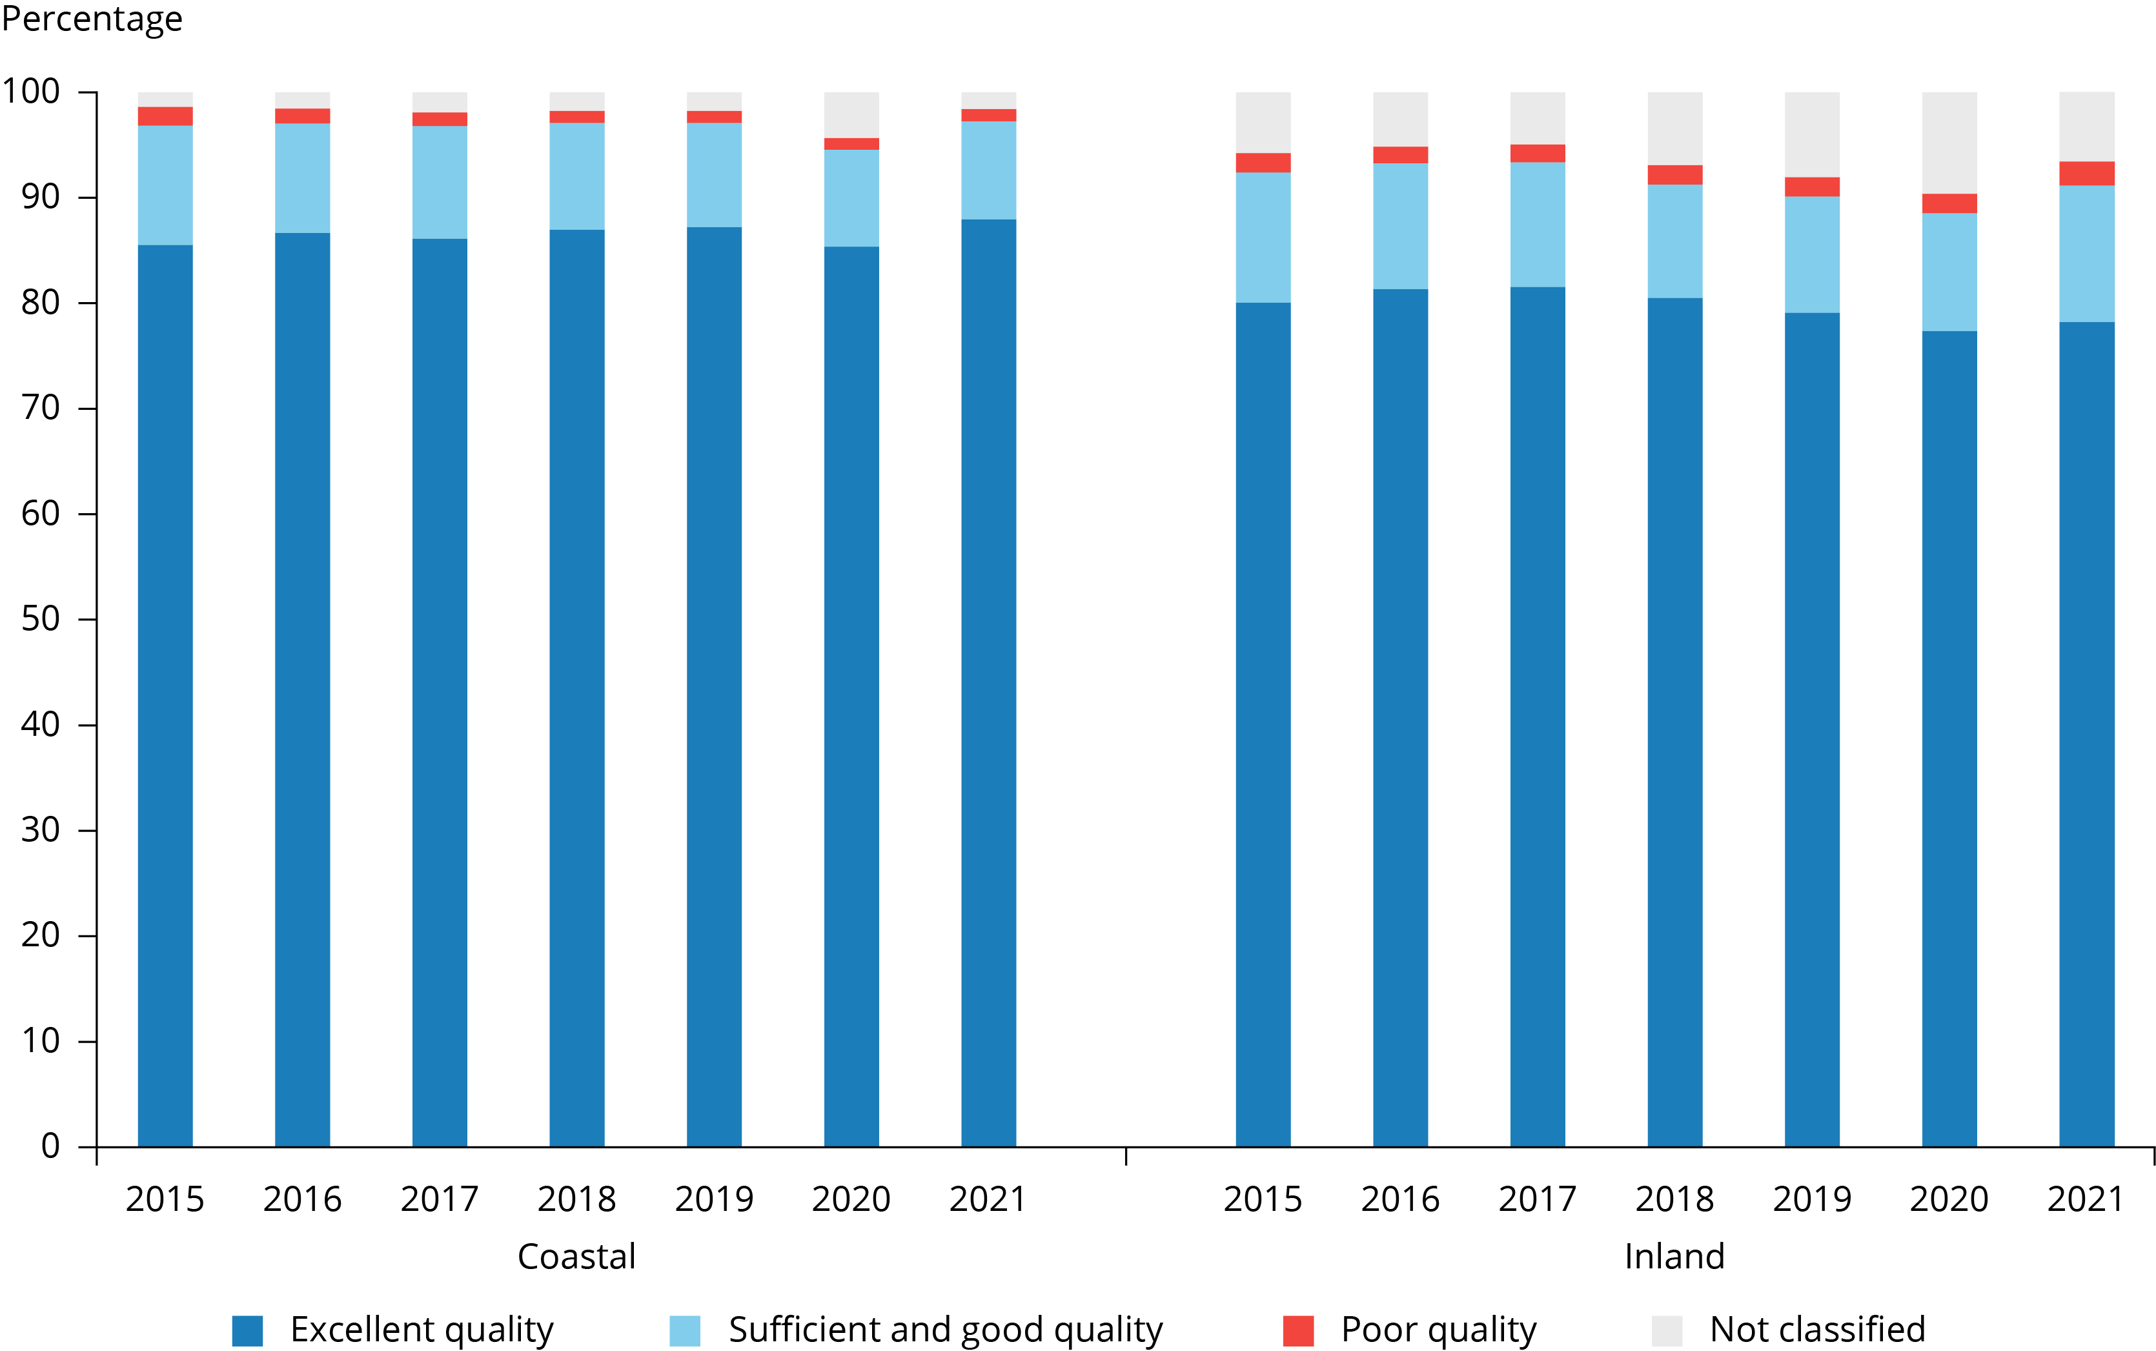
Coastal and inland bathing water quality in the EU between 2015 and 2021

Slide 61
Nothing is perfect…
In six EU countries, 3% or more of bathing waters were of poor quality: Estonia (two bathing waters or 3.1%), France (99 bathing waters or 3.0%), the Netherlands (34 bathing waters or 4.6%), Latvia (two bathing waters or 3.6%), Slovakia (one bathing water or 3.1%) and Sweden (16 bathing waters or 3.5%). In Albania, the number of poor bathing sites dropped significantly since 2015, when 31 bathing water sites (or 39.1%) were assessed as poor. In 2021, there were only eight poor bathing waters (or 6.7%) in Albania. This improvement can be linked to the construction of five wastewater treatment plants in Albania in recent years.
Swimming at bathing sites with poor water quality can result in illness. Bathing water sites classified as poor must be closed throughout the following bathing season and must have measures in place to reduce pollution and eliminate hazards to the health of bathers.

Slide 62

5. Recent events and environmental issues: where we go?
COVID-19 pandemic and resulting restrictions imposed to fight the spread of the disease have provided some short-term positive impacts on Europe’s environment, according to a European Environment Agency (EEA) briefing. These include temporary improvements in air quality, lower greenhouse gas emissions and lower levels of noise pollution. However, the assessment also stresses that there have been negative consequences such as increased use of single-use plastics, and that ways out of the pandemic should focus on reshaping our unsustainable production and consumption systems to achieve long-term environmental benefits (https://www.eea.europa.eu/highlights/impact-of-covid-19-lockdown).

Slide 63
“Countries and health systems continue to contend with the health, social and economic impacts of the COVID-19 pandemic, while Russia’s invasion of Ukraine and persistent fossil fuel overdependence has pushed the world into global energy and cost-of-living crises. At these crises unfold, climate change scalates unabated. Its worsening impacts are increasingly affecting the foundations of human health and wellbeing, exarcebating the vulnerability of the world’s populations to concurrent health threats” (The 2022 report of the Lancet Countdown on health and climate change: health at the mercy of fossil fuels).

Slide 64

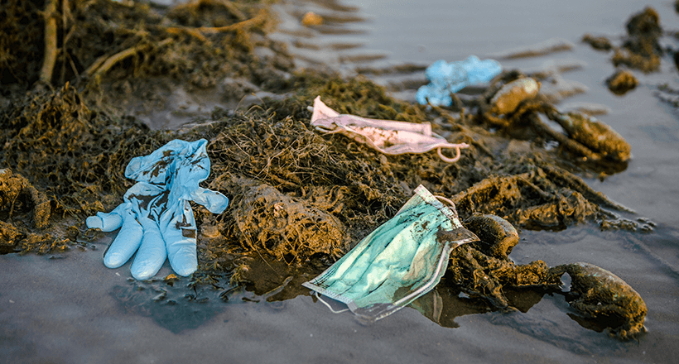
https://www.eea.europa.eu/post-corona-planet/explore/#search-the-database
https://www.eea.europa.eu/post-corona-planet/debate

Slide 65

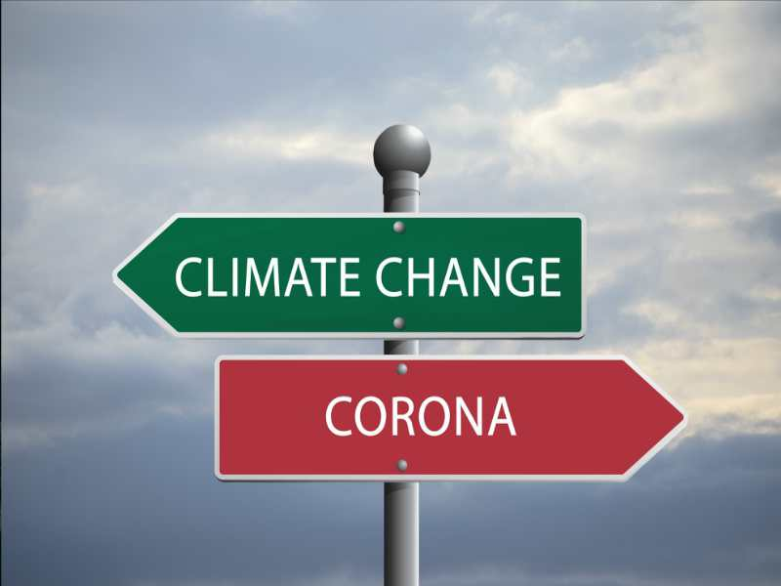
COVID-19 pandemic provoked a sense of paralysis on the question submitted to the Human Rights Council and the seminar to be launched: Is it time for UN recognition of the right to a healthy environment?

Slide 66
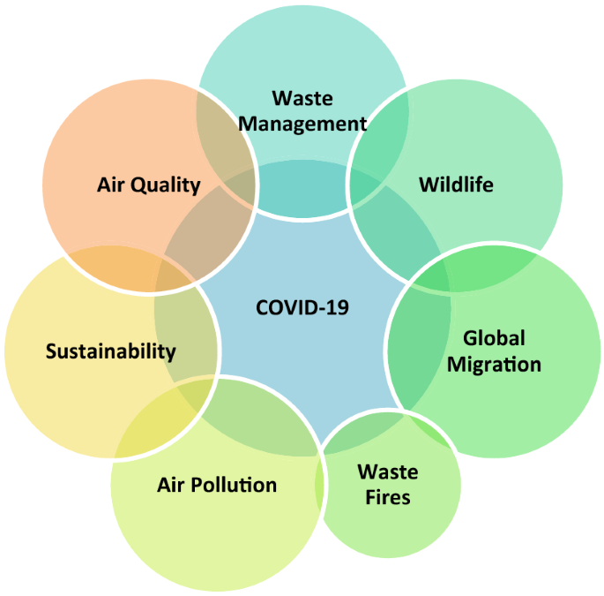

Slide 67
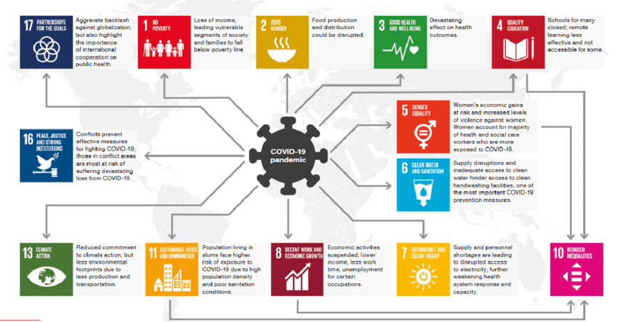

Slide 68

Health systems worldwide are debilitated by the effects of the COVID-19 pandemic and the energy and cost-of-living crises. Only 48 (51 %) of 95 countries reporting having asessed their climate change adaptation needs. And only 60 (63%) countries reported a high to very high implementation status for health emergency management in 2021. (2022 Report of the Lancet).

Slide 69

Take notice of…
https://ec.europa.eu/environment/legal/law/statistics.htm
https://ec.europa.eu/environment/legal/law/pdf/statistics%20Art.260%20from%202007%20to%202019.pdf
https://eeas.europa.eu/diplomatic-network/asia-europe-meeting-asem_en?page=1

Slide 70

"We have a great responsibility, especially with regard to the future generations. What world do we want to leave to our children and our young? Our selfishness, our indifference and our irresponsible ways are threatening the future of our children."

Slide 71

“The protection of the environment is likewise a vital part of contemporary human rights doctrine, for it is a sine qua non for numerous human rights such as the right to health and the right to life itself”.
Separate Opinion of Judge Weeramantry, ICJ, Judgment of 25 September 1997, Gabčíkovo-Nagymaros Project case (Hungary/Slovakia).

Slide 72

Together We’re Strong:
https://www.youtube.com/watch?v=5qTgjgkS10k

