Slide 1



Disaster Management in the Philippines. Some reflections after the Covid-19 pandemic within the ASEAN context
Dr. Andrés Bautista-Hernáez
Prof. Derecho Internacional Público
Universidad de Málaga
CALESA International Seminar on
Current Challenges and Common Values: Fostering Regional Integration within the ASEAN
Ateneo de Manila University | 30 January-3 February 2023

Slide 2
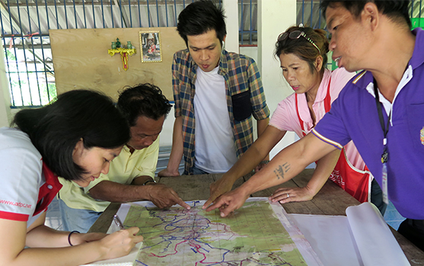
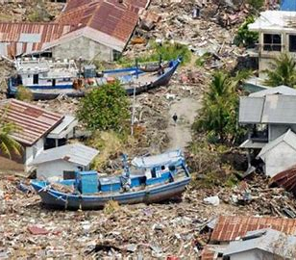
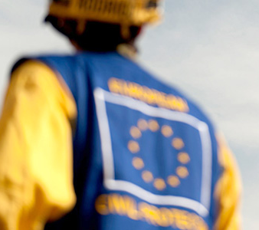
CONTENTS
Introduction: International Disaster Law and Management
Disaster management and regulation within a regional integration context
The ASEAN cooperation model and the Covid-19
Challenges of disaster management
Final remarks

Slide 3
INTERNATIONAL SECURITY: AN EVOLVING AND INCLUSIVE CONCEPT
The notion of international security has exponentially increased in recent decades.
Old fashion concept: in the Westphalian sense: “security at an internal level were focused on the protection of the territorial integrity against external attacks” (TORRES CAZORLA)
Notion of International security related to that of “human security”: “the preventive action in the face of chronic threats and specific crises with the purpose of granting stability and well-being to all people, individually considered, and with the aspiration of guaranteeing life and […] the dignity of human beings” (GALLEGO HERNÁNDEZ)
Holistic approach of security: “the idea of security from a holistic approach is linked up with Biolaw as the protection of the very essence of people and its human rights” (GARCÍA SAN JOSÉ)

Slide 4


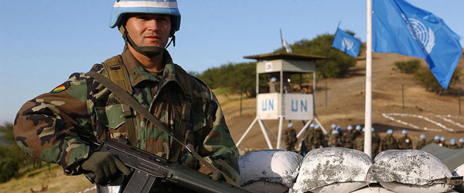
INTERNATIONAL SECURITY: AN
EVOLVING AND INCLUSIVE CONCEPT
Notion of security→ human being → human security

Slide 5
INTERNATIONAL LAW AND… DISASTERS, SECURITY, HEALTH
IDL aims to protect people, their property, and the environment, regulating the phenomenon of disasters and the activities related to their management in all its phases
*See: IPCC, Sixth Assessment Report, Climate Change 2021: The Physical Science Basis, 2021
Notion of security→ human being → human security
Human Security
Disasters
Environment (Climate Change*)
Health
Defence and security Strategies

Slide 6
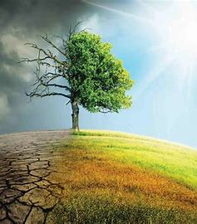
DISASTERS AND CLIMATE CHANGE
“It is common to question whether human-caused climate change caused a major weather- and climate-related disaster. When extreme weather and climate events do occur, both exposure and vulnerability play an important role in determining the magnitude and impacts of the resulting disaster. As such, it is difficult to attribute a specific disaster directly to climate change. However, the relatively new science of event attribution enables scientists to attribute aspects of specific extreme weather and climate events to certain causes. Scientists cannot answer directly whether a particular event was caused by climate change, as extremes do occur naturally and any specific weather and climate event is the result of a complex mix of human and natural factors. Instead, scientists quantify the relative importance of human and natural influences on the magnitude and/or probability of specific extreme weather events. Such information is important for disaster risk reduction planning, because improved knowledge about changes in the probability and magnitude of relevant extreme events enables better quantification of disaster risks”
IPCC, Sixth Assessment Report, Climate Change 2021: The Physical Science Basis, 2021

Slide 7
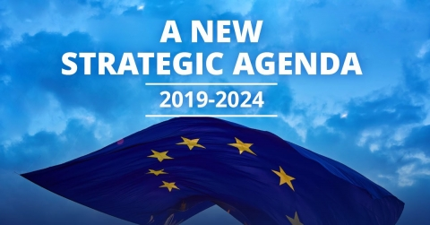
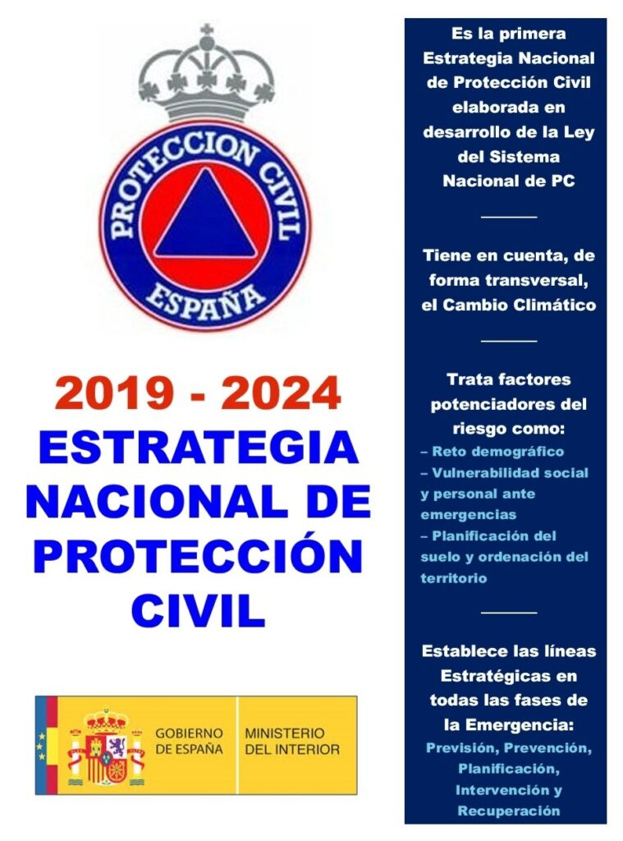
DISASTERS MANAGEMENT AND DEFENCE STRATEGIES
The protection of people in the event of a disaster is not only configured as an interest for the international community as a whole, but is also an aspect of international and national security
EUROPE:
Strategic Agenda 2019-2024 adopted by the European Council, which aims to strengthen the resilience of the EU against both natural and man-made disasters through active solidarity and the pooling of resources
SPAIN:
2017 National Security Strategy,
2019-2024 National Civil Protection Strategy
2021 Comprehensive National Security Culture Plan, approved on May 25, 2021
Notes:
At the Spanish national level, we find various instruments such as the 2017 National Security Strategy, the National Civil Protection Strategy for the period 2019-2024, approved by the National Security Council, or the Comprehensive National Security Culture Plan, approved by the Council of Ministers on May 25, 2021

Slide 8
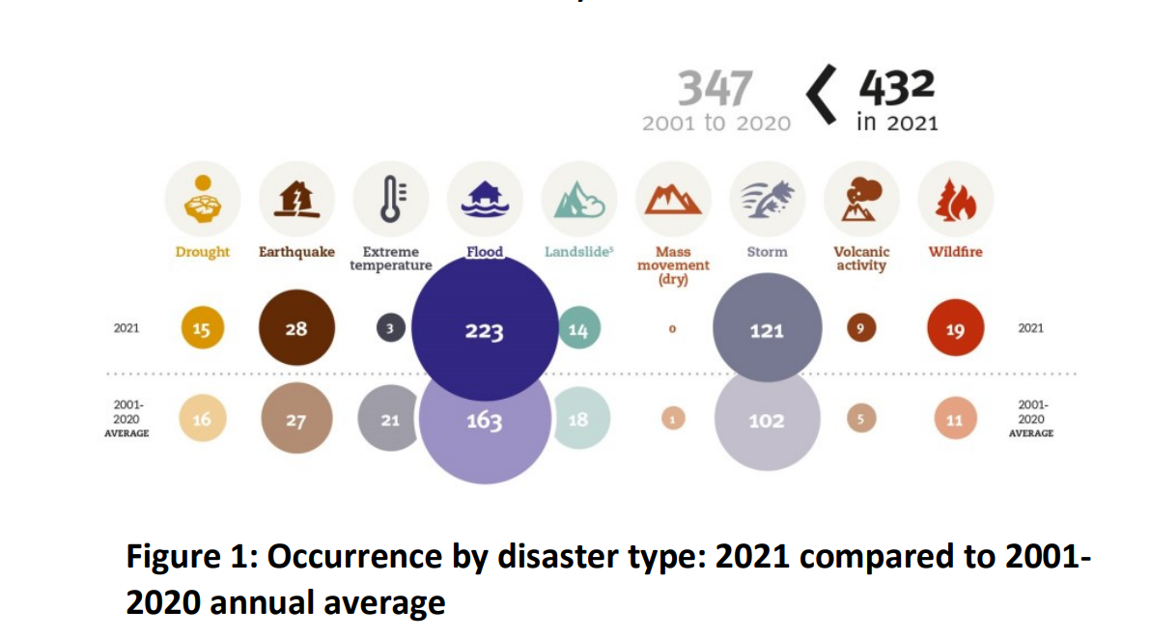
The relevance of disasters
Notes:
In 2021, the Emergency Event Database (EM-DAT) recorded 432 disastrous events related to natural hazards worldwide. Overall, these accounted for 10,492 deaths, affected 101.8 million people and caused approximately 252.1 billion US$ of economic losses . As a continent, Asia was the most severely impacted, suffering 40% of all disaster events and accounting for 49% of the total number of deaths and 66% of the total number of people affected. Globally, the number of deaths and the number of people affected were below, but in 2021 the number of disaster events increased and so the economic losses.

Slide 9
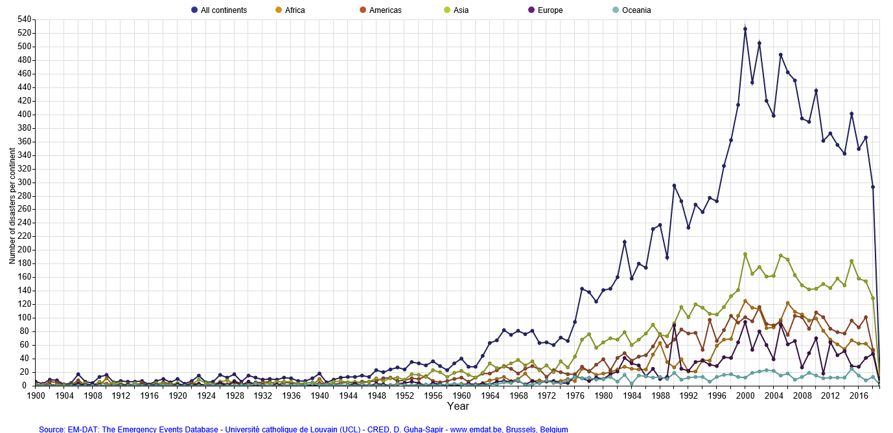
Reported natural disasters 1900-2018 (CRED)

Slide 10
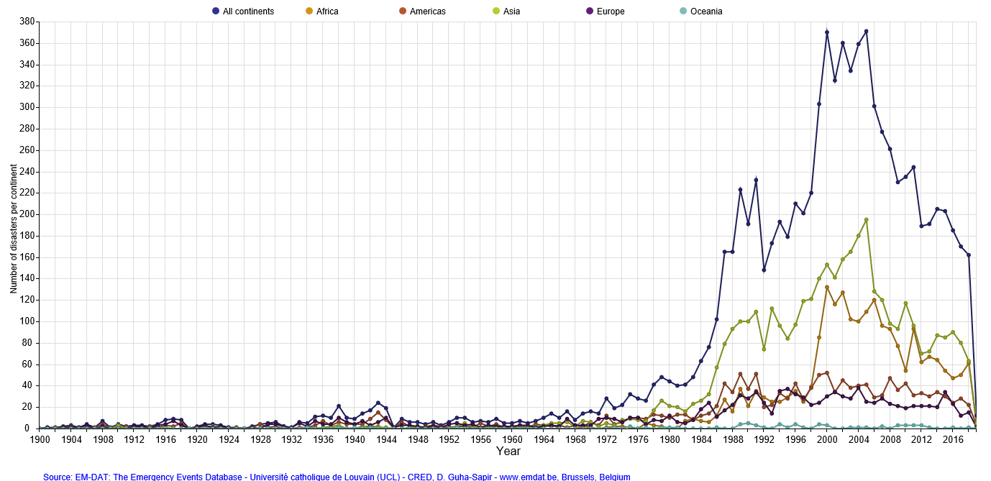
Reported Technological disasters 1900-2018

Slide 11
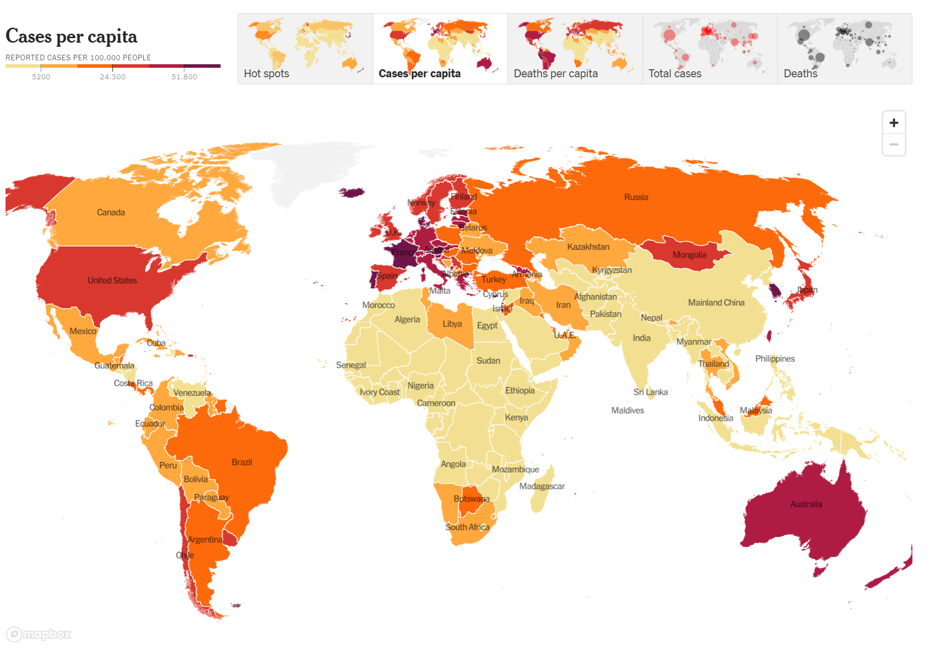
Transboundary or international consequences
Notes:
Another element that reflects the importance of disasters is their transboundary or international character. Disasters have no borders.
Here we can see the States affected by the Covid-19 pandemic.

Slide 12
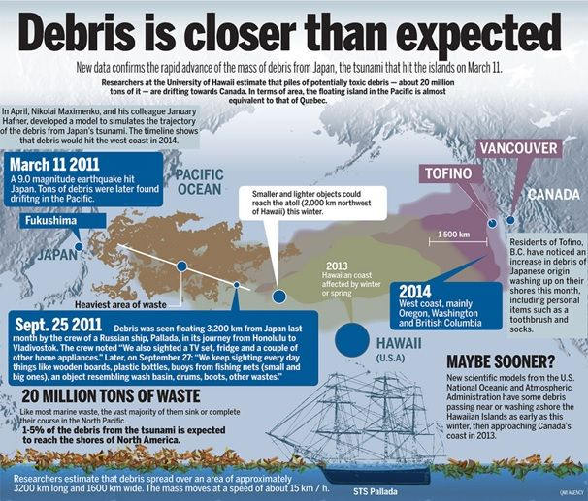
Fukushima Nuclear contamination
Notes:
Here we can also see this effect related with the nuclear pollution of the Pacific Ocean after Fukushima NPP accident in 2011.
Disasters have no borders, but States do, and Int. Law is still mainly based on a inter-state paradigm. However, regional integration and cooperation processes like in the EU or ASEAN may be a good thing in enhancing effective disaster management.

Slide 13

AIM OF DISASTER MANAGEMENT AND REGULATION:
The basic objective is (must be) the protection of the human being and the defense of its fundamental rights, along with the protection of goods and the environment
…International Law? …Disaster?
Notes:
So, considering the relevance of disasters we need to regulate this phenomenon. The basic objective of disaster management and regulation is (must be) the protection of the human being and the defense of its fundamental rights, along with the protection of its goods and the environment.
But… what is a disaster? And what it is for International Law? The latest is answered because global problems needs global solutions. State based actions cannot copr with transboundary/international phenomenon like climate change related disasters, global pandemics, etc.
Then, what international law says about that and what is its object: disasters.

Slide 14
INTERNATIONAL DISASTER LAW AND MANAGEMENT: BASIC IDEAS
Challenges when we have to define disaster:
Different words used interchangeably: crisis, disaster, emergency, catastrophe…
Different “surnames” to disaster: ecological, human, sanitary, natural, human…
Different elements: strength, casualties, economic damage, overwhelming authorities
We can track down more than 50 definitions in national and international instruments
Notes:
About the notion of disasters…

Slide 15
…a disaster is:
“An event”
vs.
“a serious disruption”
The Philippine Disaster Risk Reduction and Management Act of 2010 provide a large notion of the term:
“A serious disruption of the functioning of a community or a society involving widespread human, material, economic or environmental losses and impacts, which exceeds the ability of the affected community or society to cope using its own resources. Disasters are often described as a result of the combination of: the exposure to a hazard; the conditions of vulnerability that are present; and insufficient capacity or measures to reduce or cope with the potential negative consequences, Disaster impacts may include loss of life, injury, disease and other negative effects on human, physical, mental and social well-being, together with damage to property, destruction of assets, loss of services, social and economic disruption and environmental degradation”
Notes:
About the notion of disasters…

Slide 16
Existing definitions
Art. 1 b), Proposed draft convention on expediting the delivery of emergency relief, 1984
  Disaster: «means any natural, accidental or deliberate event (not being an ongoing situation of armed conflict) as a result of which assistance is needed from outside the State upon whose territory the event occurred or which has been affected by the consequences of the event».
2016 ILC Draft Article on Protection of Persons in the event of disasters (A/71/10)
  “disaster” means a calamitous event or series of events resulting in widespread loss of life, great human suffering and distress, mass displacement, or large-scale material or environmental damage, thereby seriously disrupting the functioning of society

Slide 17
Proposed legal concept
"The result of a process involving an event, action or the resulting situation of both, which produces a series of consequences such as the interruption of the normal functioning of society and damage to people, property or the environment, and which implies, given its seriousness, the incapacity of the ordinary means of the affected society to face it and requires the adoption of special national or international measures”

Slide 18
Covid-19 is a disaster?
According to the latest definition Covid-19 pandemic can be considered a natural/anthropogenic disaster.
The joint international team examined four scenarios for introduction:
direct zoonotic transmission to humans (spillover);
introduction through an intermediate host followed by spillover;
introduction through the (cold) food chain;
introduction through a laboratory incident.
Joint WHO-China study: 14 January - 10 February 2021, 30 March 2021 | COVID-19: Animal-human interface and food safety
Notes:
WHO REPORT ON THE ORIGINES OF THE COVID-19

Slide 19
Int. Disaster Law - International disaster management
It would include the set of measures, actions and policies dictated and applied in the different phases of the disaster process by the members of the International Community, with the aim of reducing or eliminating the effects of the disaster.
So, the role of international law (Int. Law related with Disasters): That sector of the international legal order destined to regulate the phenomenon of catastrophes and the activities related to its management in all its phases, in order to protect people, their goods or the environment.
Participants / subjects at stake: victims, States (affected and non affected), International Organisations, Financial institutions, NGO’s, private entities…
International disaster law (IDL) regulates a wide array of issues in a natural, anthropogenic or hybrid disaster: “the obligation of the States to prevent or mitigate a disaster and to appropriately give assistance, the relations between the disaster-affected State and other States or international organizations, the way of request and offer assistance, the status of relief personnel” (GUTTRY), and during all the phases of the so call disaster management cycle.
Notes:
Int. Disaster Law → International Disaster Management

Slide 20
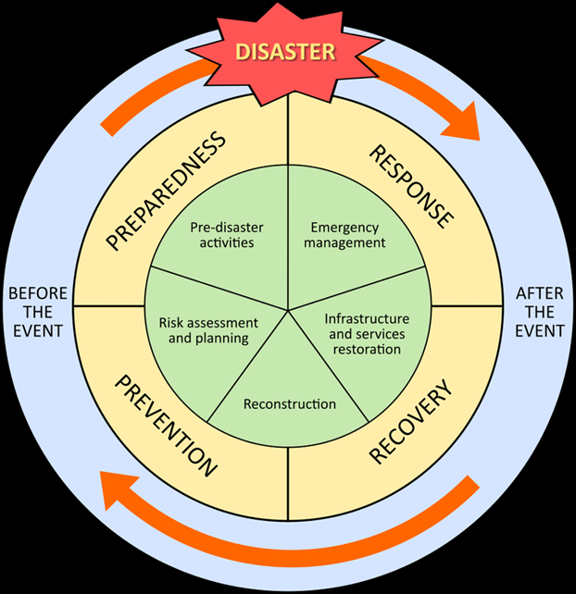
PHASES OF DISASTER MANAGEMENT
PREVENTION
PREPARATION
RESPONSE
RECONSTRUCTION

Slide 21
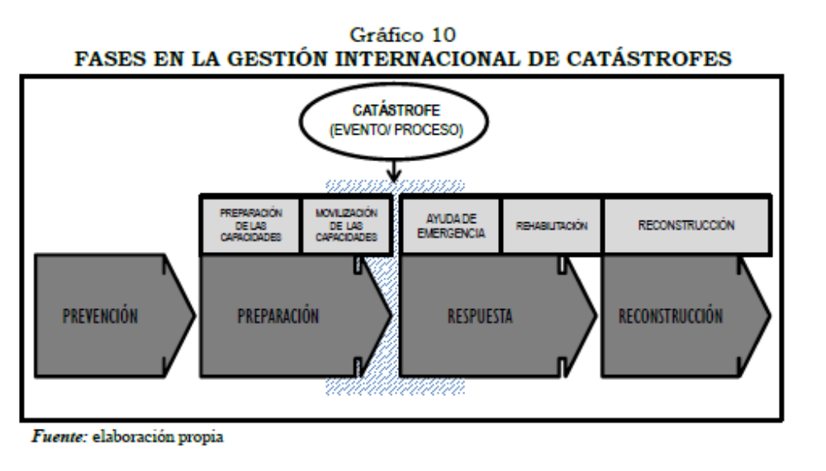
Notes:
With this formulation, disaster management acts on all elements of a catastrophic action, event or situation. This would not prevent some of the measures adopted in each of the phases from being juxtaposed. they are not watertight compartments.

Slide 22
Circular perspective: “disaster management cycle” o “disaster cycle” (FARBER)
PREVENTION:
Any action aimed at reducing risks or mitigating the adverse consequences of a catastrophe for people, the environment and property, including cultural heritage
PREPARATION:
Activities and measures taken in advance to ensure an effective response to the impact of threats, including the timely and effective issuance of early warnings and the temporary evacuation of population and property from the threatened area.
RESPONSE
Measures taken directly before, during or immediately after a disaster in order to save lives, reduce impacts. includes emergency assistance and the adoption of measures such as early warning.
RECONSTRUCTION
Measures adopted so that the affected society returns to the state before being hit by the disaster.
PHASES OF DISASTER MANAGEMENT

Slide 23
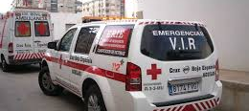

Evolution of International regulation of disasters
Sectorial
  1960 Convention on Third Party Liability in the Field of Nuclear Energy, 29 July 1960
  1963 Vienna Convention on civil liability for nuclear damage, 21 May 1963
  1969 International Convention Relating to Intervention on the High Seas in Cases of Oil Pollution Casualties, 29 November 1969
  1972 Convention on the Prevention of Marine Pollution by Dumping of Wastes and Other Matter, 13 November 1972
Global:
  1997 Tampere Convention on the Provision of Telecommunication Resources for Disaster Mitigation and Relief Operations
  2000 Framework Convention on Civil Defense Assistance, 22 May 2000 (Jordan, Libya, Tunisia and Ukraine)
Notes:
Humanitarian assistance (Sovereign Order of Malta s. XI)
ONG’s (s. XX)- Red Cross
International Humanitarian Law Instruments applicable to disaster situations (civil protection)
IV Geneva Convention, 1949
Additional Protocol I, 1977

Slide 24

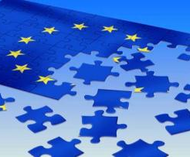
DISASTER MANAGEMENT AND REGULATION WITHIN A REGIONAL INTEGRATION CONTEXT
International disaster management would include the set of measures, actions and policies dictated and applied in the different phases of the disaster process by the members of the regional Community
Integration process of the EU → special relationship Member States and EU
Notes:
Within the European sphere, we must mention the integration process of the European Union and its effects regarding the management and regulation of disasters; and whether this integration process favors a better and more coordinated response. And, this is because we must take into account the special relationship which binds the Member State to the EU as an international integration organization

Slide 25
DIFFERENCES IN PERSPECTIVES?
EU → United in diversity
But: principle of conferral of powers limits the actions that the EU can take to those expressly attributed to it by Member States: “the EU can do what Member States specifically say”
ASEAN → to unite under One Vision, One Identity and One Caring and Sharing Community
Organisation of cooperation: main role by Member States
Notes:
EU integration model is an open process that seeks a closer union between peoples of Europe. However, it does not provide clues as to how far it can be achieved. Looking back, there are many moments in which giant steps have been taken towards the integration of different matters, some of them strictly state-owned, such as civil and criminal matters. However, the evolution will depend on the will of the Member States. That is because the principle of conferral of powers limits the actions that the EU can take to those expressly attributed to it by Member States: “the EU can do what Member States specifically say”.

Slide 26
DISASTER MANAGEMENT AND REGULATION WITHIN A REGIONAL INTEGRATION CONTEXT
Disaster management: a competence of the Union to support and complement the action of Member States, emphasizing the idea that protection in the event of disasters is a task of the States. The primary responsibility for preventing, preparing for and responding to natural and man-made disasters lies with the Member States. Consequence of State sovereignty; Guiding principles approved by the UNGA in Resolution 46/182; ILC Draft articles on the protection of persons in the event of disasters of 2016, art. 10.1:
Article 10
Role of the affected State
1. The affected State has the duty to ensure the protection of persons and provision of disaster relief assistance in its territory, or in territory under its jurisdiction or control.
2. The affected State has the primary role in the direction, control, coordination and supervision of such relief assistance.

Slide 27
DISASTER MANAGEMENT AND REGULATION WITHIN A REGIONAL INTEGRATION CONTEXT
EU disaster management is based also on the promotion of solidarity among Member States in accordance with Article 3 para. 3 of the Treaty of the European Union. This come as two mechanisms:
The Union Civil Protection Mechanism
RescEU capacities

Slide 28
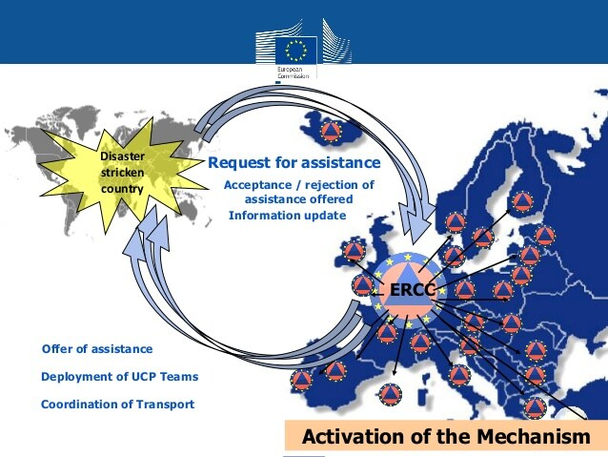
EU CIVIL PROTECTION MECHANISM
The Union Civil Protection Mechanism (Decision No 1313/2013/EU in 2013, amended in 2018, 2019 and 2021).
The Union Mechanism aims to strengthen cooperation between the Member States and the Union and to facilitate coordination in the field of civil protection against disasters
But, how is articulated this relationship between EU and Member States/Participant States?
Art. 1.3 Decision
“The Union Mechanism shall promote solidarity between the Member States through practical cooperation and coordination, without prejudice to the Member States’ primary responsibility to protect people, the environment and property, including cultural heritage, on their territory against disasters and to provide their disaster-management systems with sufficient capabilities to enable them to prevent, and cope adequately and in a consistent manner with, disasters of a nature and magnitude that can reasonably be expected and prepared for”

Slide 29
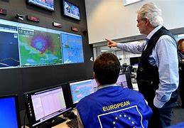
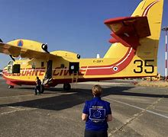
EUROPEAN MECHANISM: RELATIONSHIP EU-MS
COORDINATION→ relations between the participating States
The EU “shall support, complement and facilitate coordination of Member States’ action with respect to prevention, preparedness and response.
Emergency Response Coordination Centre (mainly on operational tasks in preparedness and response)
Common Emergency Communication and Information System
European Civil Protection Pool: voluntarily pre-committed response capacities of the Member States that are available upon request via the European Mechanism
Notes:
The EU undertake with its obligation of coordination through this European Civil protection pool by setting up the types, number, and quality of such response capacities. Also, it will monitor looking for gaps and will assist even with financial assistance (art. 11.2.2 Decision) to States to cope with these gaps.
The Union plays a “secondary” role dedicated to linking in an orderly manner the actions of the participating States in Civil Protection. The system respond to the principle of subsidiarity
The mere coordination of MS actions may not impede that they do not correctly comply with their obligations and jeopardize the achievement of European Mechanism objectives→ COOPERATION

Slide 30



Coordination with United Nations
UNOCHA
coordinaction
IASC
AFECTED STATE
NGO
NGO
ACNUR
RED CROSS
NGO
UNICEF
I.O.Migrations
UNESCO
NGO
NGO
DISASTER

Slide 31
COOPERATION→ for relations between the EU and the participating States
The Commission, will cooperate with the participating States also in matters of prevention, preparedness and response to disasters. Although it is true that outside the Union, cooperation actions are considerably reduced.
Cooperation on the part of the Union serves to improve or support the work of the Member States, for example in planning operations, but mainly through financial assistance to MS (DECISION (EU) 2019/420)
rescEU:
Improvement for accomplishing solidarity within the European Mechanism
New type of response capacities to respond to overwhelming situations where existing capacities at national level and at the European Pool are not enough
MS and the Commission may acquire, rent, lease or otherwise contract capacities (art. 12,3b Decision 1313/2013/EU)
In order to balance national responsibility and solidarity among Member States
Notes:
COOPERATION appears intended for relations between the EU and the participating States.
The EU, through the Commission, will cooperate with the participating States also in matters of prevention, preparedness and response to disasters. Although it is true that outside the Union, cooperation actions are considerably reduced.

Slide 32
FACING COVID-19 PANDEMIC:
COMMON EU RESPONSE
EU helped member states to coordinate their national responses (providing objective information about the spread of the virus, efforts to contain it and measures taken to repair the economic and social damage)
Examples: common border controls, vaccination process…
Institutional improvements: HERA

Slide 33
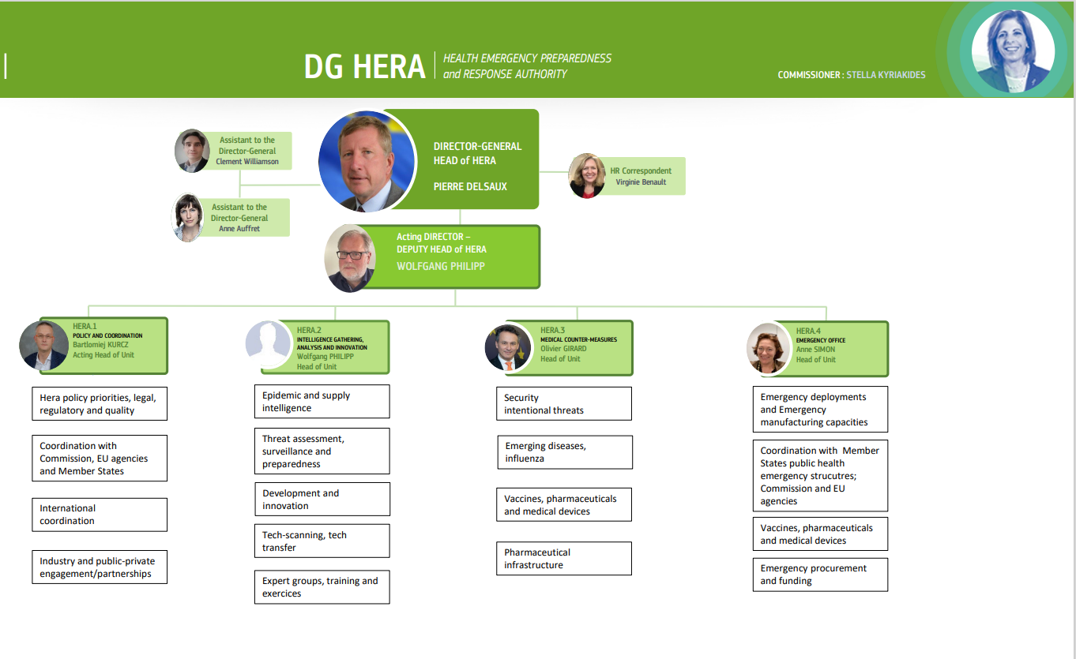
EUROPEAN AUTHORITY FOR SANITARY EMERGENCIES: A MODEL TO COPY?
The Health Emergency Preparedness and Response (HERA) department’s mission is to prevent, detect, and rapidly respond to health emergencies.
Created as a European Commission Directorate-General on 16 September 2021.

Slide 34

ASEAN Charter entered into force on 15 December 2008
10 ASEAN Member States
Political commitment: (MOTTO): To unite under One Vision, One Identity and One Caring and Sharing Community
Comunities:
  ASEAN Political-Security Community
  ASEAN Economic Community
  ASEAN Socio-Cultural Community
ASEAN COOPERATION MODEL: REAR-VIEW MIRROR OF EU PROCESS?

Slide 35
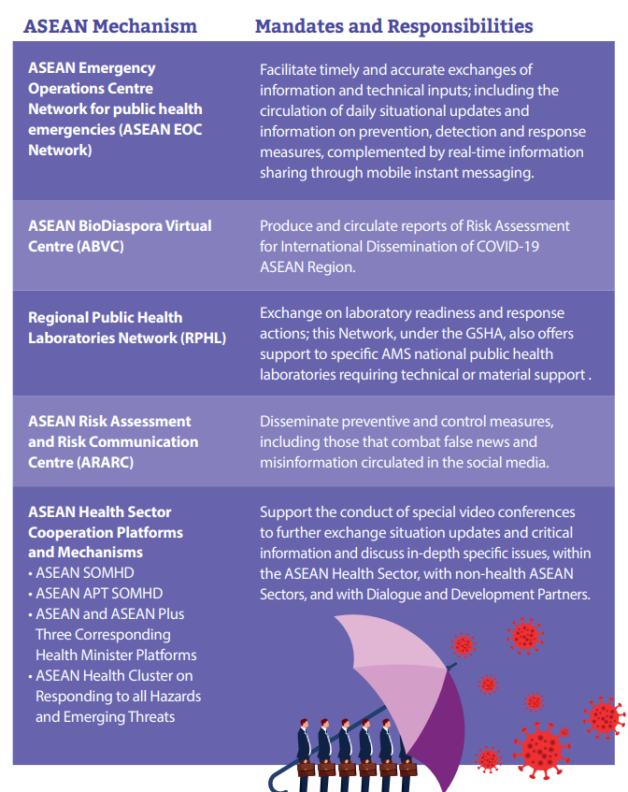
FACING COVID-19 PANDEMIC:
ASEAN RESPONSE: Common measures adopted within the Ministers sectorial meeting (also with their counterparts from China, Japan and South Korea, in an ASEAN Plus Three Health Ministers Meeting.
As a regional body, stepped up national responses and regional cooperation (public health measures on preparedness, prevention, control, detection, and response). Examples:
Adoption of commitments and recommendations (enhance transparent information about Covid, Strengthen regional cooperation in risk communication and avert misinformation, utilise digital technology for exchange of information…)
ASEAN Framework on Sustainable Tourism Development in the Post-COVID-19 Era. The framework identifies focus areas and seeks to capitalize on the work that is already being undertaken by the tourism sector.

Slide 36
CHALLENGES OF DISASTER MANAGEMENT (not only when dealing at regional level)
RIGHTS AND DUTIES OF STATES AND THE EFECTIVE PROTECTION OF VICTIMS
IDL is an underdeveloped sector. States are not prone to reduce their sovereignty status→ impact in regulation (less regulation mainly through soft-law rules, weak legal regime for victims…) and in effectively provide assistance: there is no right to assist without consent of affected State, but individual may have right to assistance by State under jurisdiction without discrimination.

Slide 37

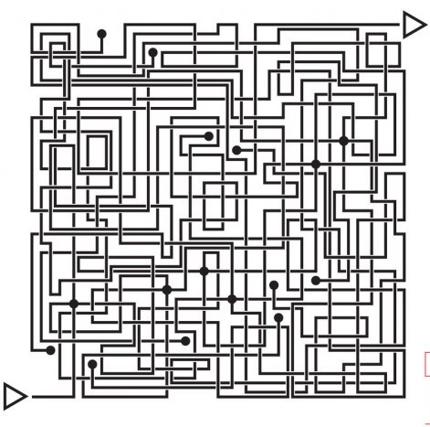
NON-BINDING MECHANISM.
If the mechanism works on a voluntary basis, the States are free to make use of it or not, and they are the ones who provide the capacities. This jeopardize also the duty to protect people within their jurisdiction.
RISK OF INCONSISTENCIES/OVERLAPPING due to OVERABUNDANCE OF INSTITUTIONS.
We have to be careful with the systems created that are integrated or inter-related. Case of European Medical Corps into the European Pool or the Commission creation of the HERA Authority do they overlap with existing mechanism?

Slide 38
CHALLENGES OF DISASTER MANAGEMENT (not only when dealing at regional level)
EFFECTIVE COORDINATION
European Mechanisms (HERA, Civil protection Mechanism…) to coordinate the MS actions
ASEAN Ministers meeting lack of binding nature per se, but relevance at high governmental level. Coordinating Centre for Humanitarian Assistance (AHA) constitutres a voluntary” liaison point
TRANSPARENCY / CRIMINALITY
Generally not covered at regional level. Mainly trough domestic criminal legislation.

Slide 39
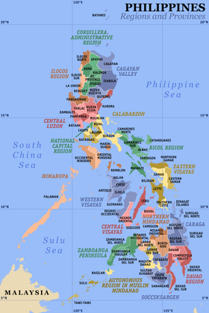
RELATIONSHIP AMONG MS IN DECENTRALISE STATES
The EU Member States and participating States are the recipients of the obligations established by the Mechanism [Article 38 of the Decision (repealed)].
Sub-regional authorities and actors are of very importance and must act in a coordinated manner within the Union Mechanism.
the Emergency Response Coordination Centre shall work in close contact with national civil protection authorities and relevant Union bodies to promote a cross-sectoral approach to disaster management.
So, it is a responsibility of States, according to their national legislation, to involve regional and local authorities within the Union Mechanism in a coordinated way.
…same perspective to be adopted in The Philippines?

Slide 40
Civil protection is as an effective instrument of international solidarity in facing disasters in the 21st century. In a regional integration context such as the EU, solidarity can find the necessary tools to make it real and effective.
Cooperation at the bilateral level can help for specific situations: transboundary forest fires. But it is slow and not very agile. Furthermore, a large number of disasters exceed national capacity or affect several States. For this reason, a coordinated response from the international level is necessary. Only with a holistic approach, the achievement of protecting people, property and the environment is achieved.
A regional instruments allows more means and a better distribution of capacities. However, mere intergovernmental cooperation limits capacities and their availability. The European mechanism, being a regional integration system, is more advanced. Despite the fact that it remains a competence to support actions of Member States, the coordination system, and cooperation at Union level with a European (not only national) capacity drastically improves the system.
However, the Mechanism remains largely dependent on the will of States. In the future…a shared competence between the Union & MS?
What role for individuals (global citizens)?
FINAL REMARKS

Slide 41
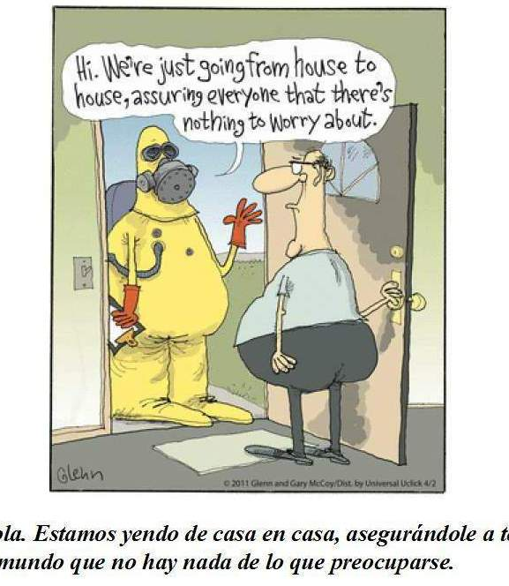
Gracias !
Thank you!
Salamat!

