Slide 1



THE QUALITY ASSURANCE SYSTEM IN EUROPEAN HIGHER EDUCATION, WHAT IS BEYOND THE REQUIREMENT?
Marian Alaez
Manila, May 2023

Slide 2



“WORKING IN THE AREA OF QUALITY IN HIGHER EDUCATION”

Slide 3
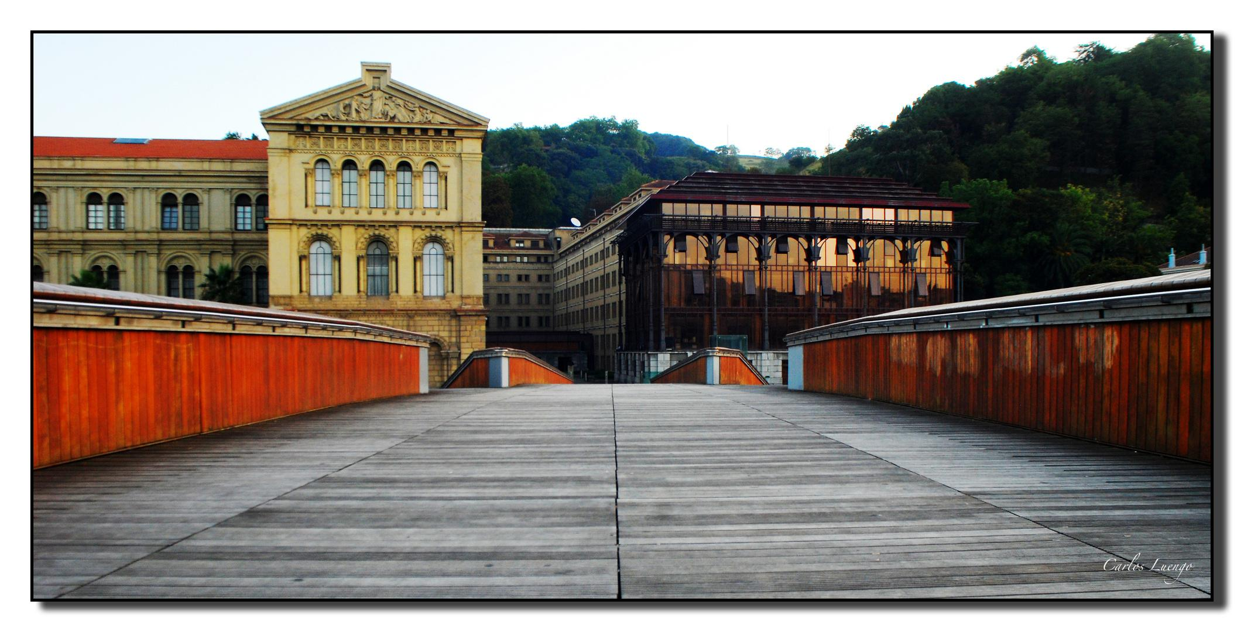


UNIVERSITY OF DEUSTO (Bilbao, SPAIN)
Marian Alaez

Slide 4

THE QUALITY ASSURANCE SYSTEM IN EUROPEAN HIGHER EDUCATION WHAT IS BEYOND THE REQUIREMENT?
Where does the European requirement for a quality assurance system in universities come from? What is a quality standard, who sets it, what are the criteria? What could a quality assurance system in teaching be like? What could be the dynamic of a quality assurance system for university degrees?

Slide 5

THE AGENDA FOR THE SESSION
9:00 – 10:15 | Presentation I. The European Quality Assurance System II. Different levels in Quality Systems The Processes as a first level Monitoring Quality in Teaching Monitoring Quality in the Degrees
10:15 – 11:30 | A little practice : time to monitor your degrees
11:30 – 12:00 | Sharing of views Conclusions

Slide 6
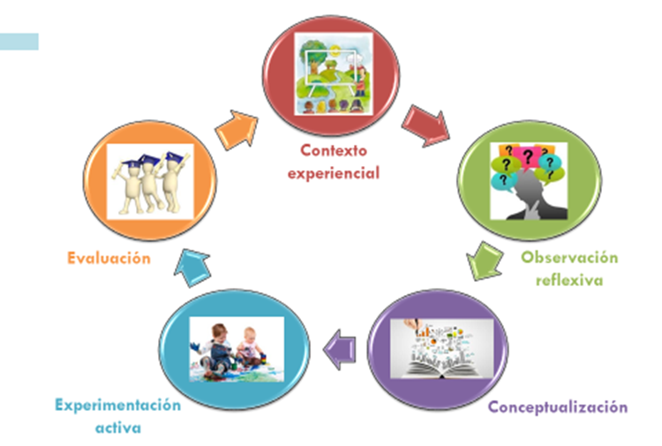
SCHEEME OF THE SESSION The context A brief reflection A little of conceptualization Some practice The evaluation
Context
Evaluation
Reflection
Practice
Conceptualization

Slide 7
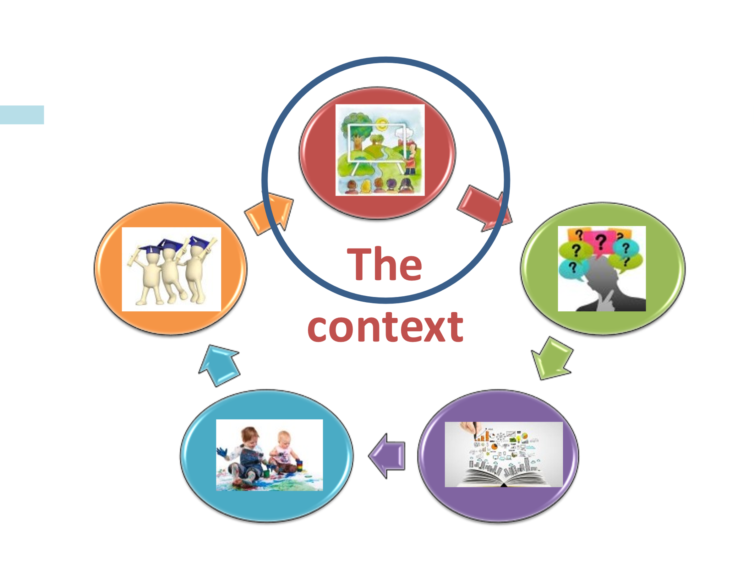
Bolonia: a milestone in European Higher Education CONVERGENCE vs. UNIFORMITY: AUTONOMY and DIVERSITY Common solution to common problems Employability Need for qualified personnel Lack of skills Mobility

Slide 8

CONCRETE OBJECTIVES OF THE BOLOGNA DECLARATION Legible and comparable degrees Adoption of a three-cycle system: Bachelor, Másters and Doctorates Adoption of ECTS credit system Promotion of mobility: students and teachers Articulation of a European quality dimension
Confidence

Slide 9
New
STRUCTURES FOR QUALITY
QUALITY AGENCIES | COUNTRY LEVEL LOCAL LEVEL
NEW STRUCTURES IN UNIVERSITIES | Vice-Rectors' Offices for Quality Technical Units for Quality

Slide 10
EUROPEAN STANDARDS AND GUIDELINES (ESTG)
PART | What it is about...
1. | INTERNAL QUALITY
2. | EXTERNAL QUALITY ASSURANCE
3. | QUALITY ASSURANCE AGENCIES

Slide 11
EUROPEAN STANDARDS AND GUIDELINES (ESG vs. 2015) -PREVIOUS REMARKS- A set of criteria and guidelines for quality assurance in higher education The criteria are compulsory: References for evaluation. Generic formulation. The required transparency fosters mutual trust and facilitates recognition and mobility within and across national borders

Slide 12
EUROPEAN STANDARDS AND GUIDELINES (ESG vs. 2015) FOR INTERNAL QUALITY ASSURANCE
CRIT | What it is about...
1 | Policy for quality assurance
2 | Design and Approval of programmes
3 | Student-centred learning, teaching and assessment
4 | Student admission, progression, recognition and certification
5 | Teaching Staff
CRIT | What it is about...
6 | Learning resources and student support
7 | Information management
8 | Public information
9 | On-going monitoring and periodic review of programmes
10 | Cyclical external quality assurance

Slide 13
EUROPEAN STANDARDS AND GUIDELINES (ESG vs. 2015) CRITERION 1. Policy for quality assurance Make this policy PUBLIC and part of its MANAGEMENT STRATEGY In this quality policy the university states Its strategic quality OBJECTIVE How it will be achieved Who is the responsible body

Slide 14
EUROPEAN STANDARDS AND GUIDELINES (ESG vs. 2015) FOR INTERNAL QUALITY ASSURANCE
CRIT | What it is about...
1 | Policy for quality assurance
2 | Design and Approval of programmes
3 | Student-centred learning, teaching and assessment
4 | Student admission, progression, recognition and certification
5 | Teaching Staff
CRIT | What it is about...
6 | Learning resources and student support
7 | Information management
8 | Public information
9 | On-going monitoring and periodic review of programmes
10 | Cyclical external quality assurance

Slide 15
EUROPEAN STANDARDS AND GUIDELINES (ESG vs. 2015) CRITERION 2. Design and Approval of programmes PROCESSES for design and approval EXTERNALLY APPROVED by a quality assurance agency PUBLISHED To involve students and other stakeholders, such as employers Designed to allow for the continuous progression of students Workload of students is defined in ECTS Include internships, where appropriate

Slide 16
EUROPEAN STANDARDS AND GUIDELINES (ESG vs. 2015) FOR INTERNAL QUALITY ASSURANCE
CRIT | What it is about...
1 | Policy for quality assurance
2 | Design and Approval of programmes
3 | Student-centred learning, teaching and assessment
4 | Student admission, progression, recognition and certification
5 | Teaching Staff
CRIT | What it is about...
6 | Learning resources and student support
7 | Information management
8 | Public information
9 | On-going monitoring and periodic review of programmes
10 | Cyclical external quality assurance

Slide 17
EUROPEAN STANDARDS AND GUIDELINES (ESG vs. 2015) CRITERION 3. Student-centred learning, teaching and assessment Teaching, learning and assessment should be STUDENT CENTRED Encourage students to ACTIVELY participate COHERENCE of the student ASSESSMENT Publish in advance the assessment methods and grading criteria Assessment linked to learning outcomes Appropriate feedback. Train teachers in assessment Adequate PROCEDURES for student COMPLAINTS

Slide 18
EUROPEAN STANDARDS AND GUIDELINES (ESG vs. 2015) CRITERION 4. Student admission, progression, recognition and certification To have ACCESS POLICIES To make them TRANSPARENT To collect, monitor and act on INFORMATION ON STUDENT PROGRESS Proper COOPERATION with other institutions

Slide 19
EUROPEAN STANDARDS AND GUIDELINES (ESG vs. 2015) FOR INTERNAL QUALITY ASSURANCE
CRIT | What it is about...
1 | Policy for quality assurance
2 | Design and Approval of programmes
3 | Student-centred learning, teaching and assessment
4 | Student admission, progression, recognition and certification
5 | Teaching Staff
CRIT | What it is about...
6 | Learning resources and student support
7 | Information management
8 | Public information
9 | On-going monitoring and periodic review of programmes
10 | Cyclical external quality assurance

Slide 20
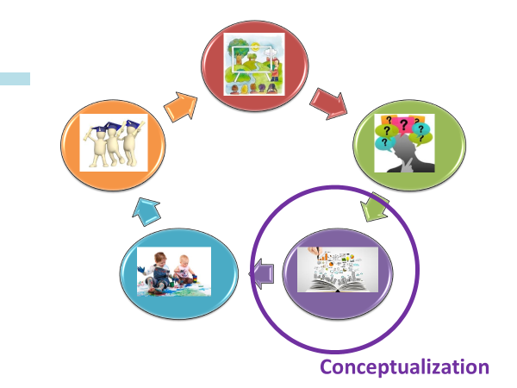
EUROPEAN STANDARDS AND GUIDELINES (ESG vs. 2015) CRITERION 5 Teaching staff Higher education institutions responsible For Teaching Staff competence For fair and transparent recruitment and development For providing an enabling environment: Opportunities for professional development Research -linked with teaching Innovation in teaching and in new technologies

Slide 21
EUROPEAN STANDARDS AND GUIDELINES (ESG vs. 2015) FOR INTERNAL QUALITY ASSURANCE
CRIT | What it is about...
1 | Policy for quality assurance
2 | Design and Approval of programmes
3 | Student-centred learning, teaching and assessment
4 | Student admission, progression, recognition and certification
5 | Teaching Staff
CRIT | What it is about...
6 | Learning resources and student support
7 | Information management
8 | Public information
9 | On-going monitoring and periodic review of programmes
10 | Cyclical external quality assurance

Slide 22
EUROPEAN STANDARDS AND GUIDELINES (ESG vs. 2015) CRITERION 6. Learning resources and student supports Physical resources Human resources Resources for diversity All resources Fit for purpose Accessible Students are informed of the services available Role of support and administrative staff… qualified

Slide 23
EUROPEAN STANDARDS AND GUIDELINES (ESG vs. 2015) FOR INTERNAL QUALITY ASSURANCE
CRIT | What it is about...
1 | Policy for quality assurance
2 | Design and Approval of programmes
3 | Student-centred learning, teaching and assessment
4 | Student admission, progression, recognition and certification
5 | Teaching Staff
CRIT | What it is about...
6 | Learning resources and student support
7 | Information management
8 | Public information
9 | On-going monitoring and periodic review of programmes
10 | Cyclical external quality assurance

Slide 24
EUROPEAN STANDARDS AND GUIDELINES (ESG vs. 2015) CRITERION 7. Information management Relevant elements: Key Performance Indicators Student profile Student progress, success rates and drop-out rates Student satisfaction with their programmes

Slide 25
EUROPEAN STANDARDS AND GUIDELINES (ESG vs. 2015) CRITERION 8 Public information Range of programmes on offer and their selection criteria, Intended learning outcomes Qualifications Teaching, learning and assessment procedures Success rates Employment information for graduates.

Slide 26
EUROPEAN STANDARDS AND GUIDELINES (ESG vs. 2015) FOR INTERNAL QUALITY ASSURANCE
CRIT | What it is about...
1 | Policy for quality assurance
2 | Design and Approval of programmes
3 | Student-centred learning, teaching and assessment
4 | Student admission, progression, recognition and certification
5 | Teaching Staff
CRIT | What it is about...
6 | Learning resources and student support
7 | Information management
8 | Public information
9 | On-going monitoring and periodic review of programmes
10 | Cyclical external quality assurance

Slide 27
EUROPEAN STANDARDS AND GUIDELINES (ESG vs. 2015) CRITERION 9 On-going monitoring and periodic review of programmes Monitoring processes Make them public

Slide 28
EUROPEAN STANDARDS AND GUIDELINES (ESG vs. 2015) CRITERION 10 Cyclical external quality assurance Takes as a reference the European and standards guidelines for quality.

Slide 29



THE ROLE OF STANDARDS OF QUALITY Subjectivity of the notion Quality by contrast: reality vs expectations The intangibility of the Education STANDARDS Create expectations Influence quality perception References to redirect reality
To design
To monitor

Slide 30


A bird’s eye view
Quality as a cicle Different levels
I. Centre level
II. Teaching level
III. Degree level

Slide 31


I. QUALITY AT CENTRE LEVEL (about PROCESSES) Sequence of tasks Responsibles Related stakeholders Documents Indicators The computer app

Slide 32
Strategic Processes
S T A K E H O L D E R S
Strategic Planning
Analysis and improvement
Stakeholder satisfaction
S A T I S F I E D S T A K E H O L D E R S
Operational processes
Degree Design
Verification and modification
of official qualifications
Student Admission
Planning and organizing
the teaching
Internationalisation
Student support
Management of
internships
Management of undergraduate
and master's degree final projects
Management of professional
guidance
Extinguishing and/or temporarily
revoking of degree
Degree accreditation
Support Processes
Personnel management
Communication and reporting
Suggestions and complaints
Resources and services
CONTINUOUS IMPROVEMENT

Slide 33
QUALITY AT CENTRE LEVEL (about processes) II. QUALITY AT TEACHING LEVEL III. QUALITY AT DEGREE LEVEL Design approval Monitoring Implementation approval

Slide 34
III. QUALITY AT TEACHING LEVEL The purpose of teaching Is that students achieve the development of the competences of the Academic-Professional profile of the corresponding degree And, to achieve this, each university will follow its own training model, which will be deeply rooted in its identity and mission

Slide 35
EUROPEAN STANDARDS AND GUIDELINES (ESG vs. 2015) FOR INTERNAL QUALITY ASSURANCE
CRIT | What it is about...
1 | Policy for quality assurance
2 | Design and Approval of programmes
3 | Student-centred learning, teaching and assessment
4 | Student admission, progression, recognition and certification
5 | Teaching Staff
CRIT | What it is about...
6 | Learning resources and student support
7 | Information management
8 | Public information
9 | On-going monitoring and periodic review of programmes
10 | Cyclical external quality assurance

Slide 36
TEACHING QUALITY SYSTEM (Requirements from the Quality Agencies) Procedures for the evaluation of teaching activity – training- development Consider the way Teachers design, plan, develop and improve TEACHING and WHAT STUDENTS LEARN

Slide 37
TEACHING STAFF AND TEACHING QUALITY IMPROVEMENT
Design and planning
Continuous improvement
(Training, improvement actions, innovation)
Teaching
Formative assessment
(Strengths, weaknesses)
TEACHING QUALITY ACREDITATION

Slide 38
TEACHING STAFF COMPETENCES (University of Deusto)
Design
And
Planning
Design
Planning
ICT Use
Collegiality
Pedagogical Management
Learning management
Time management
Leadership
Interpersonal relations
Learning climate
Institutional commitmment
Ethic engagement
Team work
Teaching innovation
Self-assessment
Quality orientation
Results orientation
Professional development orientation
Review
and Improvement
Tutoring
and Assessment
Learning assessment
Student guidance and support

Slide 39

ASSESSMENT OF TEACHERS COMPETENCES (University of Deusto) Formative Accreditative Self-evaluation Quality Agencies Students surveys Students Other colleagues Department direction

Slide 40
ACCREDITATIVE ASSESSMENT OF TEACHER COMPETENCES (University of Deusto)
LEVEL | COMPETENCE | WHAT | WHO | RENEWABLE
1. Label 1 | Design and Planning | Student Learning Guide | External Peer review Students | No
2. Label 2 | Pedagogical management, Tutoring and assessment | Portfolio | External Peer review Students | No
3. Label 3 | Review and improvement, Collegiality | Self-report | External Depart. Direct. Students | Every five years
…. 4. Label 4… | Academic approach to teaching | ??? | External ??? | ???

Slide 41


ACCREDITATIVE ASSESSMENT OF TEACHER COMPETENCES Our experience… Recognize good teaching Voluntary, with incentives
Postgraduate studies
Student participation
Teachers training
More alligned training
Define Label 4
Teachers and levels
Need for support

Slide 42
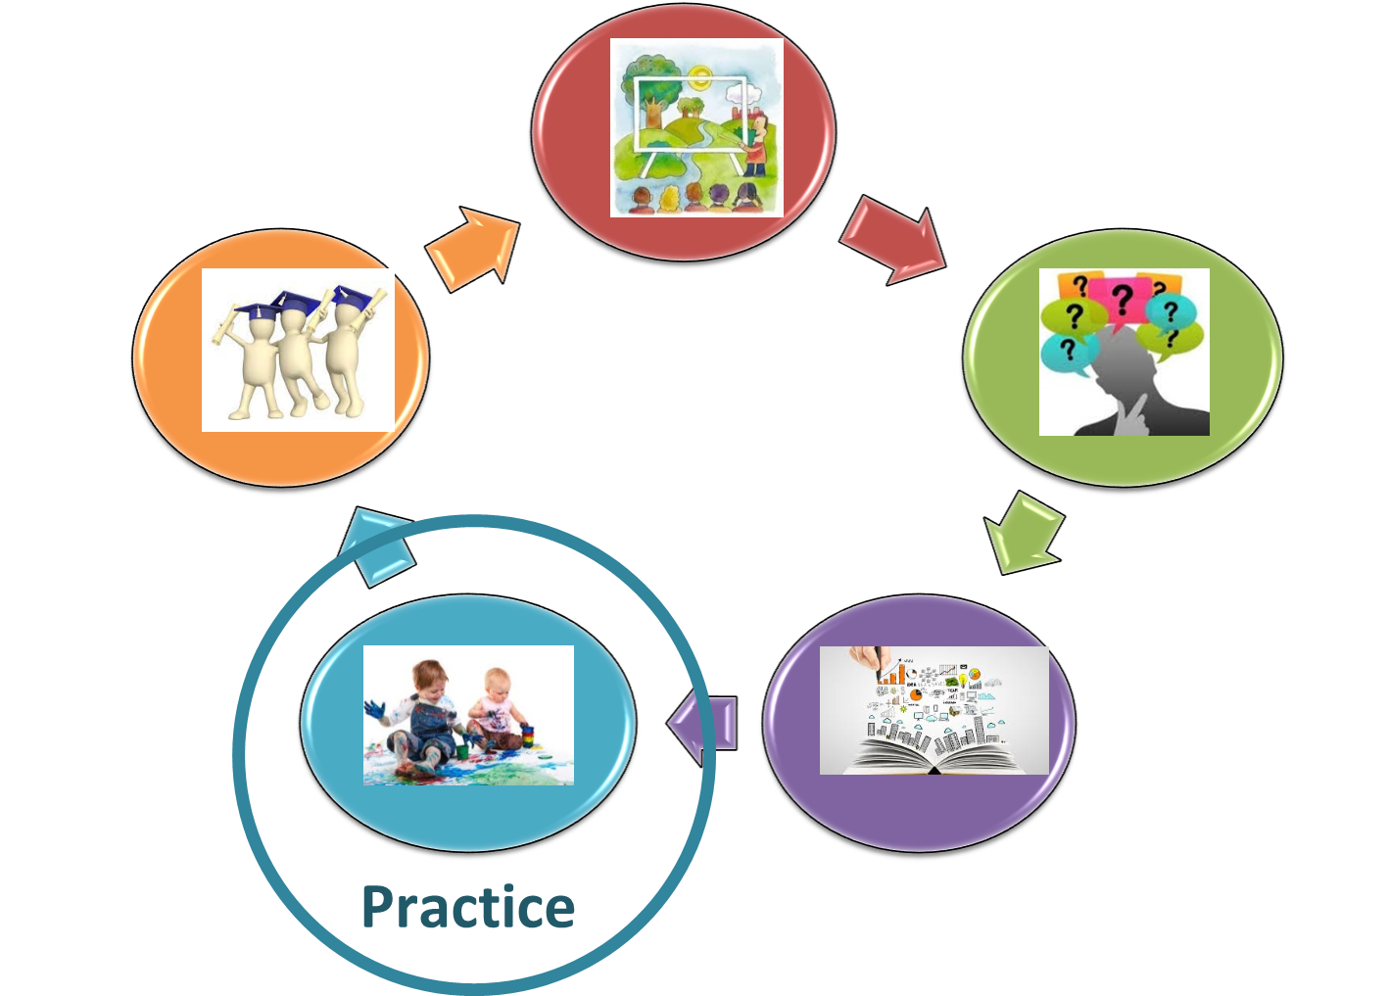





MONITORING OUR DEGREE QUALITY PRACTICE
Break
Please, put your sticker
in a visible place to form groups
You will have to sit near the ones with the same colour and size.

Slide 43

Please, sit near the ones with the same colour and size
Criterium 9
On-going monitoring and
periodic review of programmes
SOME PRACTICE
A simulation of a monitoring quality meeting
of your degree: A role play

Slide 44
QUALITY COMMITTEE:
Annual meeting
COMPOSITION OF THE QUALITY COMMITTEE
The responsible for Quality in the Faculty of Law.
The responsible for the degree
A member of the quality department of the university
Support staff in the Faculty
Employers
Teachers
Undergraduate Students
Graduate Students

Slide 45
QUALITY COMMITTEE:
Annual meeting
YOU HAVE ADDITIONAL INFORMATION
Teaching surveys (global data)
General satisfaction surveys
Final Degree Project Survey
External intership Survey
Mobility Survey

Slide 46
QUALITY COMMITTEE:
Annual meeting
THREE STEPS IN YOUR MEETING (focus on the two first, please)
The degree is assessed in relation to the academic year under análisis
Strengths, weaknesses and actions for improvement…
by consensus from all of the components
3. Modifications to be made to the initial degree design

Slide 47
QUALITY COMMITTEE:
Annual meeting
1. HOW DID IT GO IN THE COURSE?
The management of the degree
  Organization and development
  Information and transparency
  The Quality System
The resources
  Academic personnel
  Support staff, material resources and services
The results
  Learning results
  Satisfaction indicators

Slide 48
QUALITY COMMITTEE:
Annual meeting
2. STRENGTHS AND WEAKNESSES. IMPROVEMENT ACTIONS
  Strengths
  Weaknesses
  Improvement actions

Slide 49
QUALITY COMMITTEE:
Annual meeting
COMPOSITION OF THE QUALITY COMMITTEE
The responsible for Quality in the Faculty of Law. Coordinates the meeting
The responsible for the degree
A member of the quality department of the university
At least, a representant of the support staff in the Faculty
At least, a representant of the employers
At least, two representant of the teachers
At least, a representant of the undergraduate students
At least, a representant of the graduate students

Slide 50
QUALITY COMMITTEE:
Annual meeting
YOUR AIM AS A GROUP
To reach an agreement on improvement actions
when you consider them necessary
And…
To share them afterwards

Slide 51
QUALITY COMMITTEE:
Annual meeting
IMPROVEMENT AREA | WEAKNESS | IMPROVEMENT ACTION
eg.. Teaching | … | …
… | … | …

Slide 52
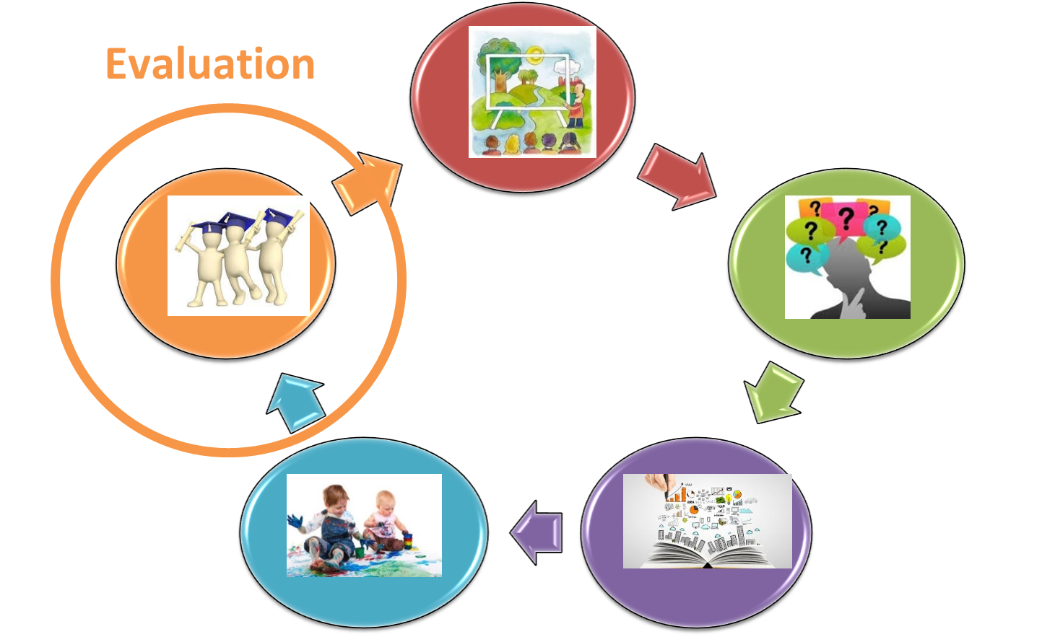
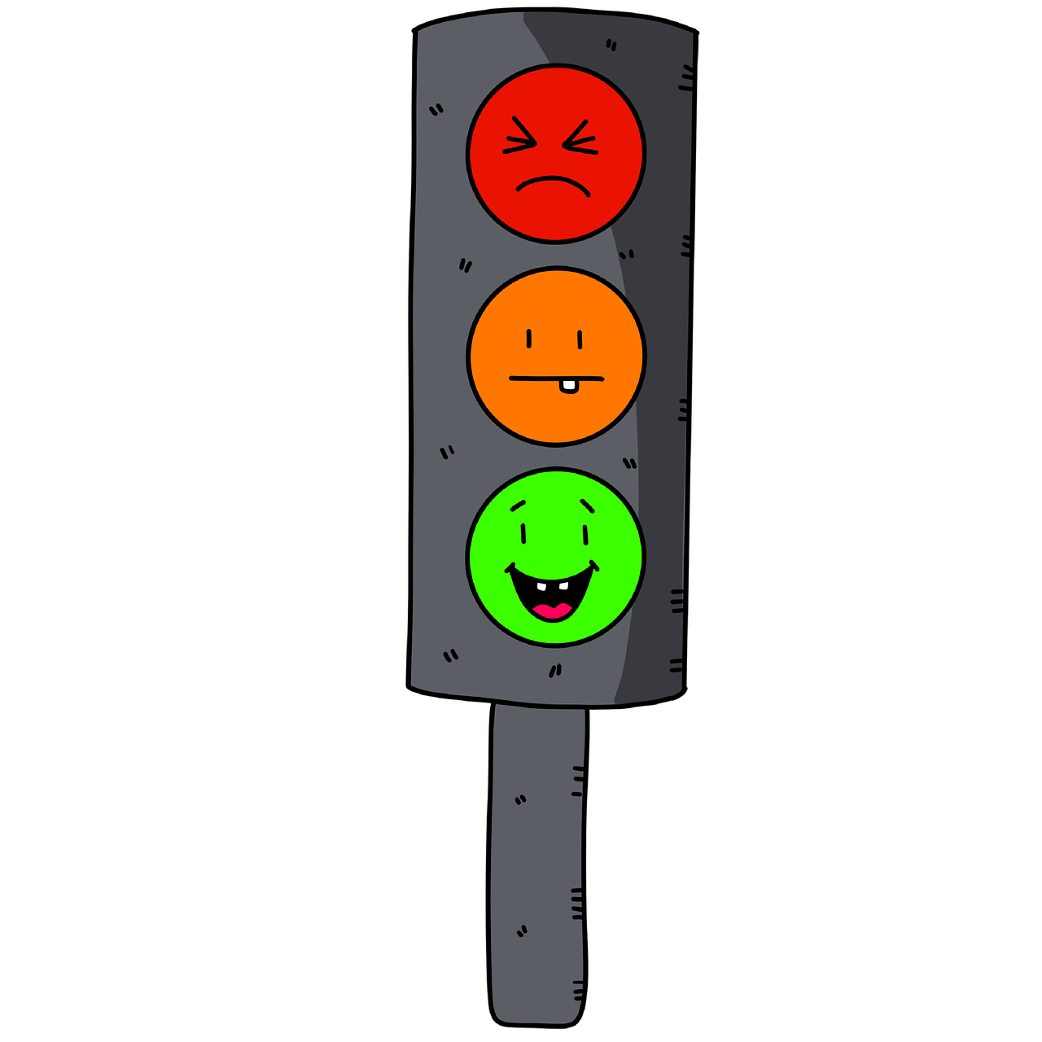

MONITORING OUR DEGREE. Our experience…
To recap
Degree designe
  First step
  Our reference
  To communicate
  To redirect
Monitoring system
Hidden issues…
Team Work and students
Problems of compliance
Students point of view
New lines based in strengths
A shift in the burden of the proof
Increase of university staff
Difficulties in the beginning
Teachers overloaded
A greater quality culture has grown

Slide 53
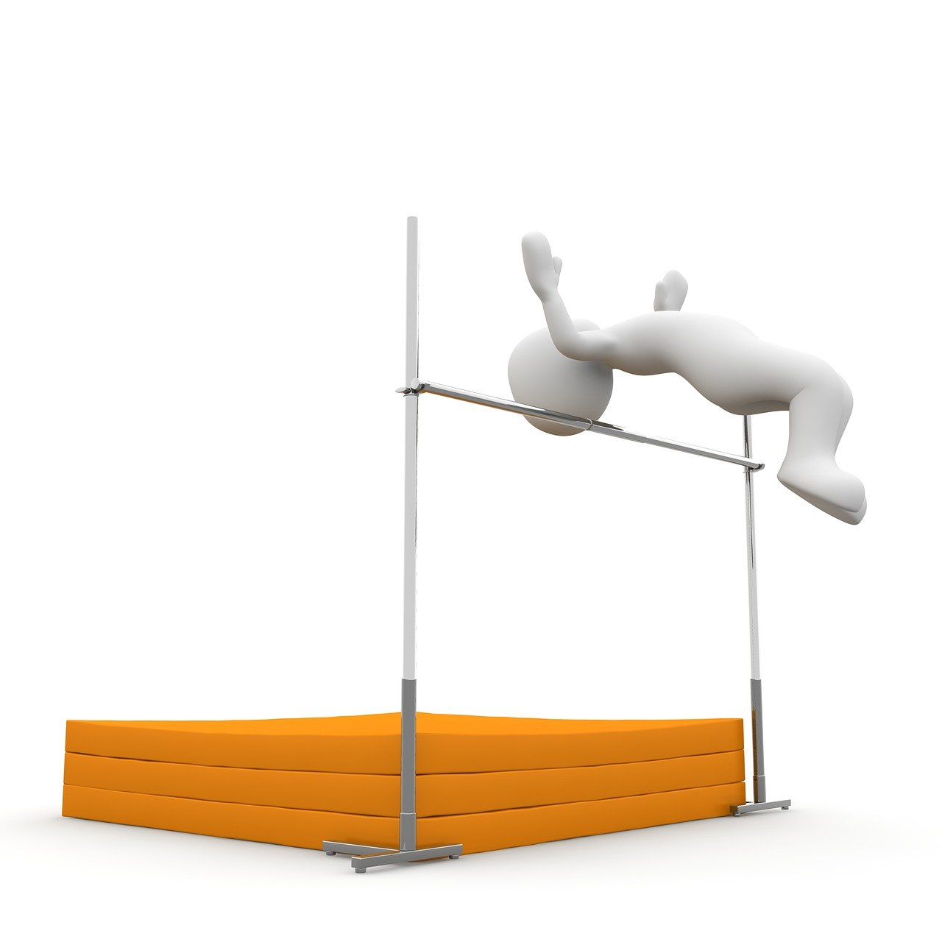

A BRIEF REFLECTION AS A FINAL EVALUATION
Determination of standards
What quality level to offer?
Very high--- to atrack our
desired public
Very low -- to increase quality
perception by
contrast

Slide 54

A BRIEF REFLECTION AS A FINAL EVALUATION
Two criteria to be considered
University’s possibilities… better adjustment
of expectations
Take into account the
high social responsibility
we assume

Slide 55
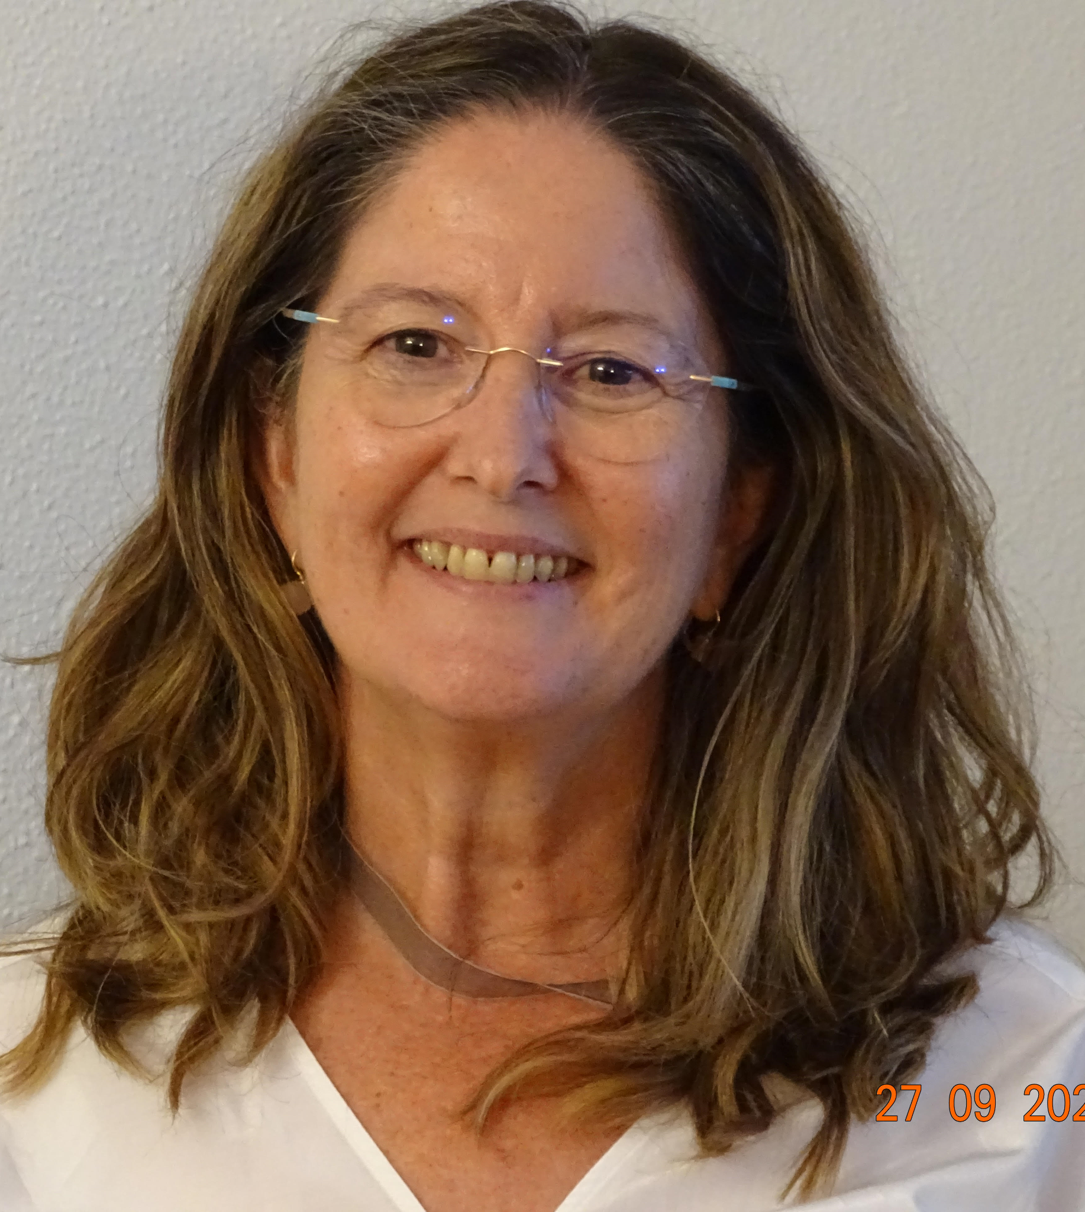
Thank you SO MUCH!
Marian
Aláez
Manila, May 2023

