Slide 1
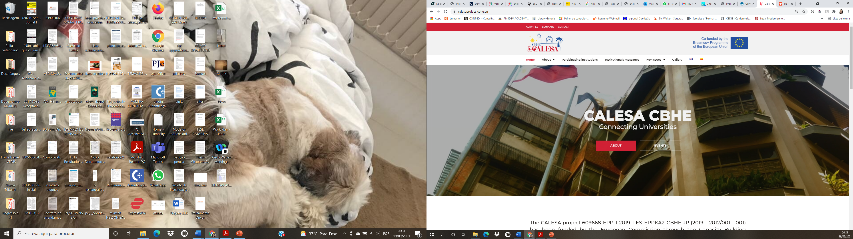










CALESA
Capacity building for Legal and Social Advancement in
the Philippines
THE PROJECT: CALESA
We plan on achieving those objectives by:
Enhancing the curricular offerings of the Partner Country HEIs through creating new subjects in the Juris Doctor/Bachelor of Laws and Master’s programs that have research components that are consistent with the Bologna process.
Enhancing the curricular offerings of the Partner Country HEIs by updating subjects in human rights and the rule of law, comparative law, and/or regional integration in their Juris Doctor/Bachelor of Laws programs and/ Master’s programs in a manner consistent with the Bologna process.
Building the multilingual research capacity of the Partner Country HEIs through interest in and facility with Spanish
LEGAL EDUCATION AS A MEANS FOR SOCIETAL TRANSFORMATION
PRELIMNARY RESULTS
Implementation Period: Jan/ 2020 – Jan/ 2024
Partner Institutions
  Universidad de Málaga – Coordinator
  Universidade Nova de Lisboa (UNL)
  University of Deusto
  University College Dublin (UCD)
  University of the Philippines (UP)
  Ateneo de Manila University (AdMU)
  University of San Agustin (USA)
  Ateneo de Zamboanga University (ADZU)
  The Philippine Judicial Academy
The alignment of partner universities´ curricula with the Bologna process will enable them to tackle some of the most challenging problems of Philippine law, which include the territorial configuration of the State, the modernization of private
and public law, the defense of human rights (rights of minorities and women included), the defense of environment and terrorism.
By creating/updating subjects in their Juris Doctor/Bachelor of Laws and Master’s programs, faculties and students will have the opportunity to pursue research-oriented legal studies that are portable internationally, while developing research and writing skills.
Research generated by these programs in the field of human rights, comparative law and regional integration will address needs and challenges faced by minorities (social-economically vulnerable, women, children, Chabacano-speaking linguistic minority), while also providing reliable and useful scientific data/studies to policymakers, improving their decision-making process.
Due to the Covid pandemic, some of the activities of the project have been adapted. However, after the initial alterations, all planned activities have been fully and successfully implemented, such as:
Online Seminar on Multilinguism (Jun/2021)
Online Seminar on Bologna Process (Mar/2021)
Four events related to Gender issues by the Gender Equality Committee
Creation of 7 new subjects within partner institutions
Development of 6 context studies on Legal modernization, human rights, education and multilinguism.
Website and social media (https://calesaproject-cbhe.eu/)
WHAT IS NEW ABOUT CALESA?
FUTURE ACTIVITIES
LEGAL SCIENTIFIC RESEARCH TOWARDS THE MODERNIZATION OF LAW
Future activities of the project include:
Seminars on the modernization of criminal, commercial, civil and family and succession law
Seminar on the Bologna Process
Seminar on Multilingualism
Seminar on Regional integration
Seminar on Global History and the Construction of Global Citizenship.
Seminar on the protection of Human rights
Seminar on International Law and Counter-Terrorism, piracy and maritime security threats at sea
Seminar on Alternative Dispute Resolution Measures and Relational Justice
Accreditation of 20 new subjects and updating of 12 existing subjects by partner HEIs
Three Conferences
Several scientific publications related to the project events/results
The incorporation of legal scientific research into partner universities´ curricula is an innovative and sustainable way of bridging the gap between Law and society and of addressing the teaching of law as an engine for the legislative change the Philippines need.
To complement the legal educational culture, which currently focuses mainly on professional development, the project will encourage the establishment of a scientific-based approach to the teaching of law, so as to highlight the scientific nature of law as a mechanism to carry out fundamental legislative reforms to improve the laws of a society
PROJECT´S OBJECTIVES
The two main objectives of the project are:
Build the research capacity of Philippine law schools.
Bring Philippine and EU law schools closer as a way of sharing the EU values of respect for human dignity, freedom, democracy, equality, the rule of law and respect for human rights enshrined in article 2 of the Treaty of the European Union
PROJECT ACTIVITIES
Project activities are divided into 5 work packages:
WP1 - Preparation
WP2 – Development
WP3 – Quality Plan
WP4 – Dissemination and Exploitation
WP5 –Management
Contact Information
José Manuel Perea: jmdetorres@uma.es | Marília Higa mariliahiga.fdunl@gmail.com

