Slide 1




Spanish and European
Commercial Law System:
History, Evolution, Current Trends and Challenges
Eugenio Olmedo Peralta (PhD)
Commercial Law Senior Lecturer
University of Málaga
olmedo@uma.es

Slide 2
Origin, evolution, concept and current content of Commercial Law in Spain and the EU

Slide 3
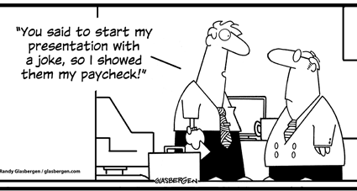
Let’s begin with some questions…

Slide 4
What is Commercial Law today?

Slide 5
Concept of Commercial Law
Special Private Law that has as its object…
Company / Business:
Organization of personal, material and inmaterial elements to perform a commercial activity
Entrepreneur:
Subject (natural/legal person) and his legal status
BUSINESS (activity) in the Market

Slide 6
Commercial Law
Corporate / Company Law
Law of the Market
Law of the «Acts of commerce»
Law of the business activity

Slide 7
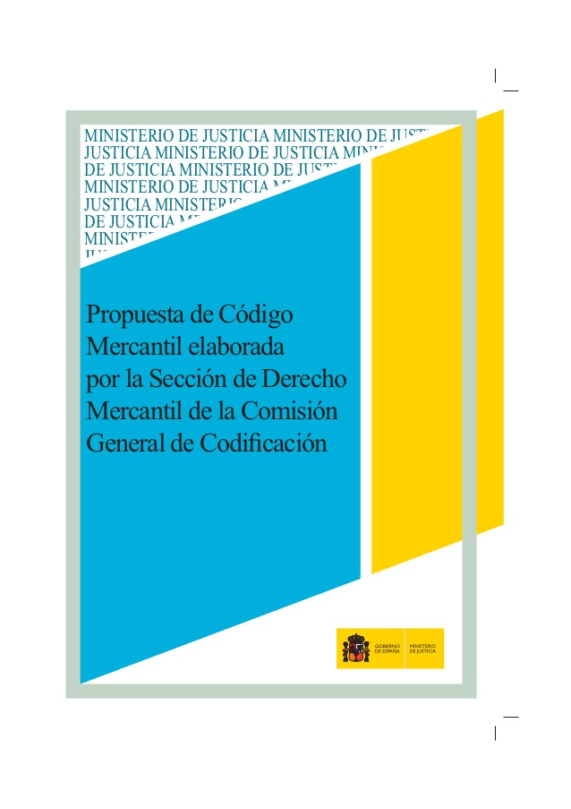
Spanish Proposal for a new Commercial Code (abandoned)
Its notion of Commercial Law
Art. 001-1 – Object of the Commercial Code
In the Constitutional framework of a Market Economy, this Code contents the commercial rules that discipline the market of goods and services in the whole Spanish territory, the legal status of the persons included in its scope and the activities performed in the Market

Slide 8
Law
Private
Special
«Historic Concept»
i.e. it changes in time

Slide 9
Distinction between Civil and Commercial Law
Is Commercial Law just a part of private Law?
Law
Private
Civil Law
Commercial Law
Public Law
Labour Law
Private Intern Law
Criminal Law
Tax Law
Constitutional Law
Ecclesiastical Law
Public Intern. Law
Administrative Law

Slide 10
“Quod gerunt mercatores, quasi publicum officium”

Slide 11
Private Law
Commercial Law
Civil Law
Business
Consumer
Consumer
Business
Consumer
Consumer
Consumer
Individual
(private)
Individual
(private)
Acts of business traffic:
commercial, industrial or services
MARKET

Slide 12
What is Commercial Law? Delimitation criteria
Subjective system
Acts or contracts made by a Company / businessman in the exercise of business
Objective system
Acts of commerce
List
Definition
Spain: objective system - Art. 2 C. of c.:
”Acts of commerce, whether performed by businesspersons or not, and whether or not they are specified in this Code (…)
The acts included in this Code (INCLUSION) and any others of a similar nature (ANALOGY) shall be considered acts of commerce”

Slide 13
What does the regulation say that Commmercial Law actually IS?
Acts of Commerce
Art. 2
C. of c.
Whether performed by businesspersons or not
Included in this Code
Any others of a similar nature

Slide 14
Concept of Commercial Law in the Proposal for a new Commercial Code
Subjective scope (art. 001-2)
Businessperson (businessman (individual), social business (corporations), comercial companies)
Objective scope (art. 001-4)
Acts and contracts of undertakings and with a comercial content
Natural persons that professionally conduct commercial activities
Acts and contracts qualified as comercial acts (because of their object or of the market in which they take place)
The concept of businessperson is substituted by “Undertaking” (operador de mercado)
Economic activity:
Entrepreneurial activity (business activity): economic organized activity consisting in the production or market of goods or services for the market, including agricultural and craft activities
Legal persons and bodies without legal personality that conduct comercial activities
Acts of competition in the market
Other comercial activity: intelectual activities, such as scientific, liberal or artistic activities, consisting in the production of godos or services for the market

Slide 15
Is it clear?

Slide 16

Not really…

Slide 17
Let’s clarify this…
Commercial Law is a «historical concept»
“Commerce” Stage
Law of the businesspersons – traders / merchants
Acts of commerce: Navigation, Sale, Credits, Accountability, Bankruptcy…
Entrepreneurial
stage
Corporate Law – Development of Companies
Development of Markets
Technological stage
E-Commerce and dematerialization of products
Capital Markets – Finantial Markets: Banks, Insurance Companies, Secondary Markets…
Relevance of competitive relations, Intellectual (and Industrial) property
Commercial communications and consumers protection
ICTs Law

Slide 18

Origin and historical development of C.L.
As an autonomous subject, Commercial Law is born in a determinate historical moment (separation from General Private Law)
There is no Commercial Law in Rome – the regulation was encompassed in general private law (Civil)
As an historical cathegory, Commercial Law is specially sensitive to political, social and economical changes

Slide 19
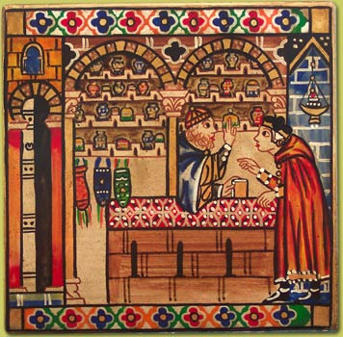
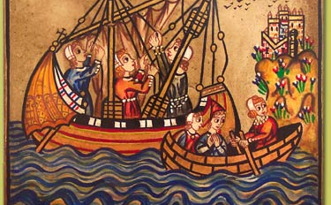
Origin of Commercial Law
Commercial Law in the Medieval
Ius Mercatorum – Development of Commerce:
  Corporative Law for businessmen / merchants (guilds, corporations)
  Customary nature
  Origin and autonomous implementation(articles of the guilds; municipal ordinances; merchants’ courts)
  Consular jurisdiction
  Substantial uniformity
Italian statutory Law(Siena, Pisa, Venice, Genoa, Florence, Amalfi, Milan)
Corporations in Europe(southern France, Spain, Flemish and Hanseatic cities)

Slide 20
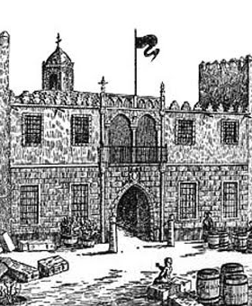
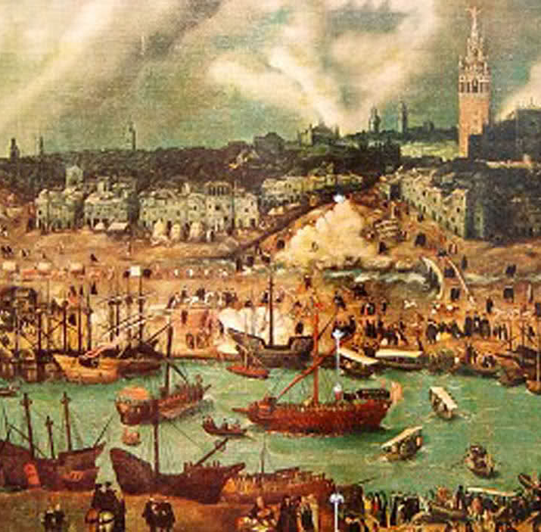
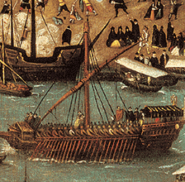
Commercial Law in the Modern Age
Objectivation:
  Acts of Commerce with disregards of the participation of a businessman
Stabilization:
  Regulation is laid down by the State:
    Drafting
    Passing of the existent rules
  Ordinances
Change in the system of sources of Law: primacy of Law at the expense of customs
French ordinances – Louis XIV:
  Land-base Commerce (trade) 1673
  Marine 1681
Spain:
  Burgos Ordinances 1495
  Llibre del Consolat de Mar (s. XVI) – Book of the Sea Consulate
  Bilbao Ordinances 1737
  (Málaga Ordinances 1825)

Slide 21
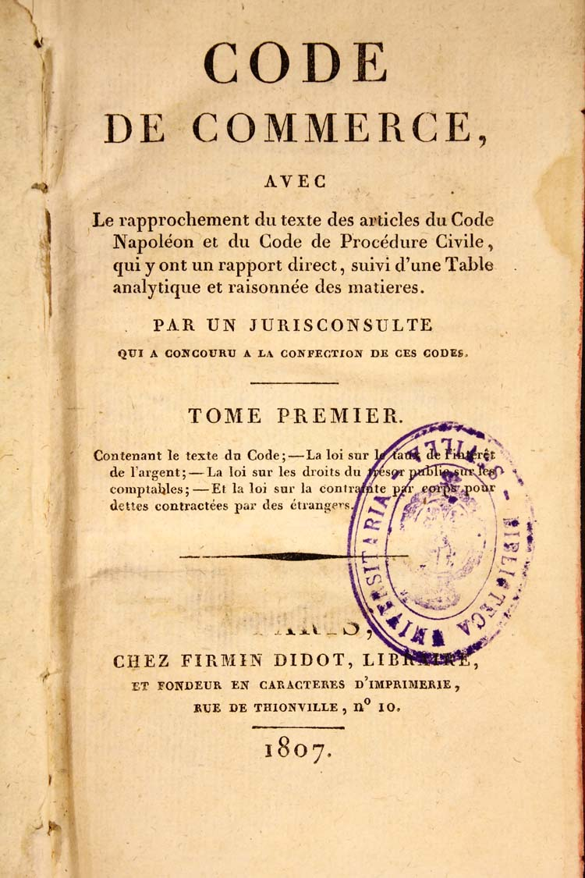
Commercial Codification (coding)
Precedents: Code de Commerce (Napoleon) – 1807 – Acts of commerce
Spain:
  Code of Commerce 1829 (Sáinz de Andino)
  Code of Commerce 1885 (Philippines royal decree of 6 August 18851)
  Proposal for a Commercial Code 2013

Slide 22
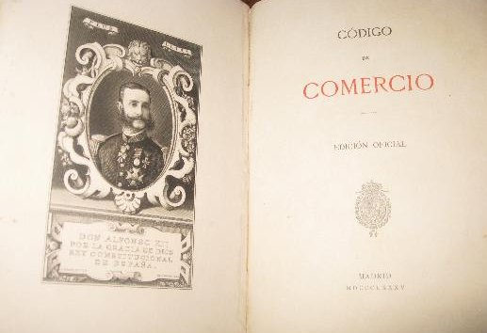
Code of Commerce 1885
955 articles. Structure:
Book I – On businesspersons and commerce in general
Book II – On special business contracts
(Some parts abolished by specific acts: e.g. Capital Companies)
Book III – On maritime commerce
(abolished by Act 14/2014 on Maritime Navigation)
Book IV – On temporary receivership (suspensión de pagos), bankruptcies and prescription
(abolished –except prescription- by Insolvency Act 22/2003)

Slide 23

What’s happening to commercial Law?
Current evolution

Slide 24
International vocation
Customary Law
Codification
De-codification
Re-codification
Influence of European Law

Slide 25
Current Commercial Law (trends)
Globalization
LEX MERCATORIA
European Union
New Instruments and contracts

Slide 26
An attempt to delineate the current content of Commercial Law
Commercial Subjects
Company Law and Businessman Law (individual entrepreneur): Legal status
Insolvency Law
Regulation of the Market and the Company
Competition Law (Antitrust)
Commercial Activity
Commercial contracts (consumers, trade regulation…)
Commercial Instruments (equities, securities, bonds,… bitcoins!)
Intellectual Property (Industrial and Intellectual)
Transports and Navigation
Unfair competition
Advertising

Slide 27
Main Commercial Acts
- Code of Commerce (Royal Decree 22nd August 1885)
- Commercial Registry Regulations (Royal Decree 1784/1996, 19th July)
- Competition Act 15/2007, 3rd July (Antitrust)
- Act 3/1991, 10th January, on Unfair Competition
- General Advertising Act 34/1988, 11th November
- Act 24/2015, 24th July, on Patents
- Act 17/2001, 7th December, on Trademarks
- Royal Legislative-Decree 1/2010, 2nd July, consolidated text Corporate Enterprises Act
- Act 3/2009, 3rd April, on Structural Changes on Corporate Enterprises
Insolvency Act 22/2003, 9 July
Act 24/1988, 24th July, on the Stock Market
Act 19/1985, 16th July, on Securities and Checks

Slide 28
Distribution of competences State- Auton. Communities
Economic Constit:
Art. 38 – Freedom of enterprise
Art. 33.1 – Private property
Market Economy / Public Interest (128)
Market Unity (139)
Commercial Law in the framework of the Spanish Constitution
Goal of the exclusive competition: ensure the Market Unity
Art. 149.1.6ª CE: (The State holds exclusive competence in the following fields:)
6ª) Commercial Law, criminal and penitenciary; procedural law, without prejudice to the singularities that in this field outcome from the particularities of the Autonomous Comunities’ substantive Law
9ª) Regulation on Intellectual and Industrial Property
11ª) Monetary system: currency, exchange and convertibility; regulatory basis for credit, banks and insurances
+ 20ª y 21ª (transports)

Slide 29
Autonomous Communities
Historic Law (Derecho Foral) – Art. 149.1.8ª - Regulation on contracts singularities (…) where they may exist.
Difficulty to separate Public and Private Law outlines. Autonomous Communities enjoy shared competences or executive competences in fields such as: domestic trade, consumers protection, cooperative societies, mutual insurance companies, transportation, free competition, intellectual property protection, tourism…)

Slide 30


Commercial Law and European Union
Regulations – Eg. Competition Law, Transports, European Company…
Directives – Eg. Directives for the harmonization of corporate Law; Consumers…
Decisions, Recommendations and Opinions

Slide 31
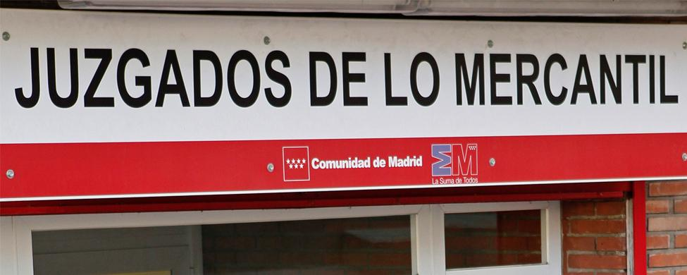
Commercial Courts
1. Commercial Courts will be competent for questions raised in insolvency matters (and related to insolvency proceedings)
2. Commercial Courts (JM) will also be competent of civil order issues relating to:
Unfair competition and advertising
Industrial and Intellectual property
Commercial and cooperative Companies
National and international Transports
Maritime Law
General terms and conditions of business
Appeals against DGSJFP on qualifications made by a Commercial Registrar
European (arts. 101 and 102 TFUE) and national (Comp. Act) Competition Law
Art. 86. Ter LOPJ
(introduced by Insolvency Law 2003)
Commercial “Jurisdiction” within the Civil order

Slide 32
Thank you!
Salamat!

