Slide 1

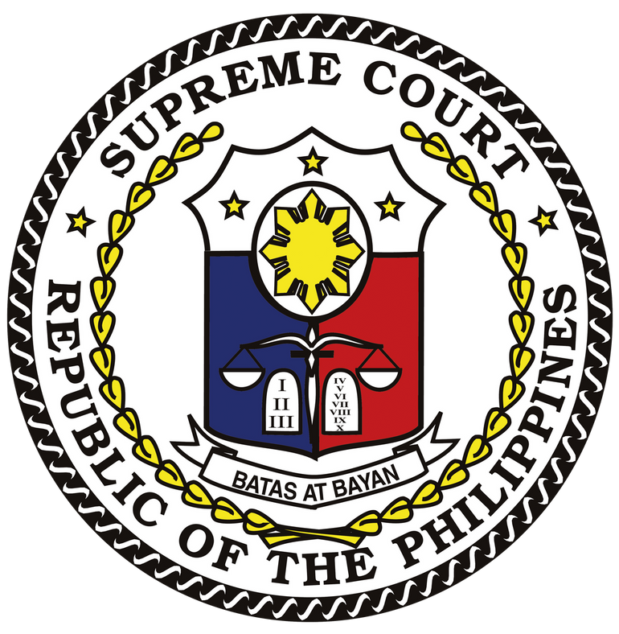

CURRENT DEVELOPMENTS IN PHILIPPINE JUDICIAL SYSTEM
NOVA SCHOOL OF LAW
LISBON, PORTUGAL
SEPTEMBER 20, 2022
ALEXANDER G. GESMUNDO
Chief Justice of the Philippines

Slide 2
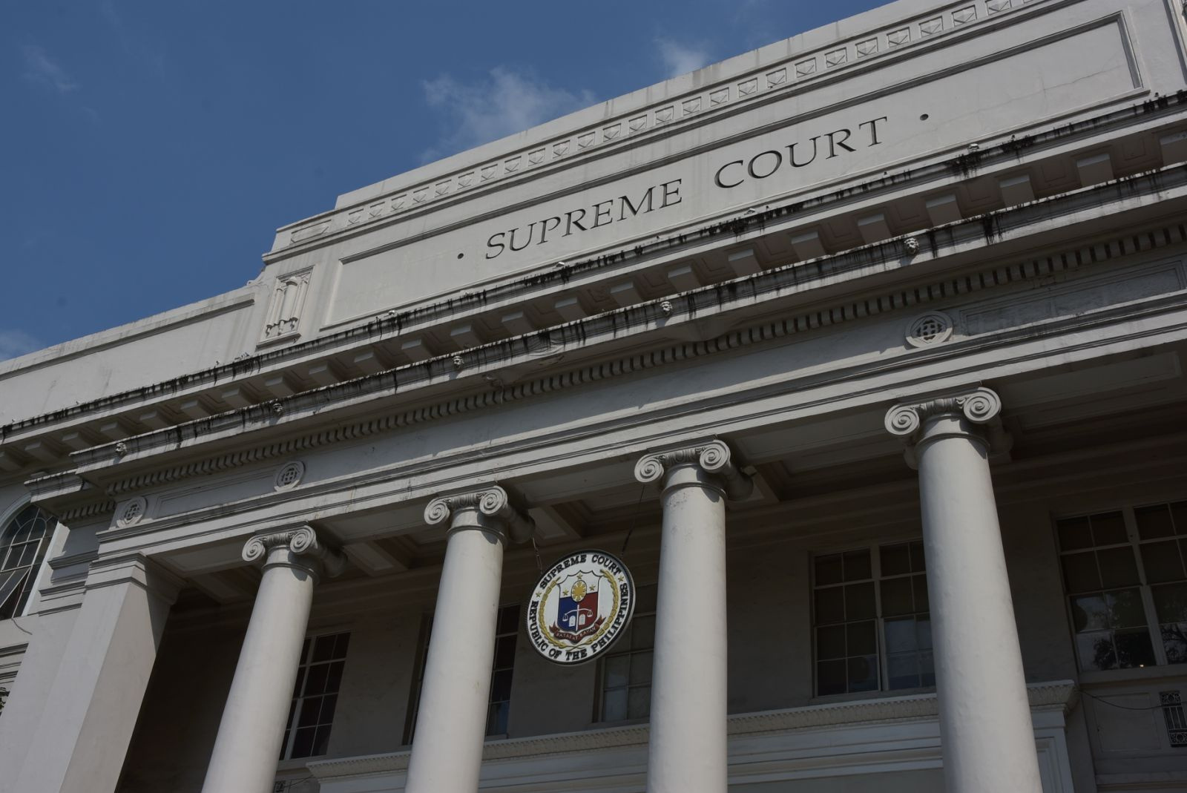
Notes:
Today, the Philippine Judiciary is at the crossroads of major shifts in legal paradigms and operational strategies, reflecting significant developments in both international law and information technologies. Reforms in legal processes have also been necessitated by a global health crisis which threatened to put to a halt, or at least suspend indefinitely, court operations. But to understand this transformation, a quick look at the irrefutable and pervasive influence of Spanish colonial rule in the establishment of the legal system in the Philippines is unavoidable.

Slide 3
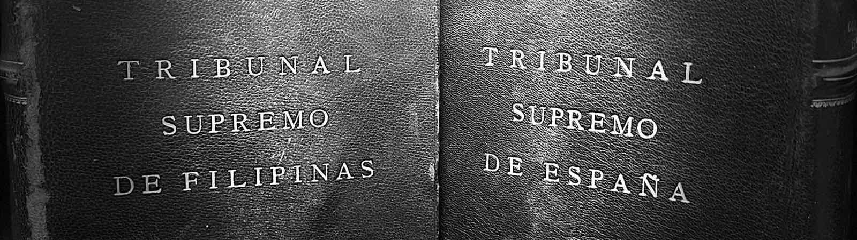
Spanish
Colonial Period
1521
American
Colonial Period
1898
Philippines (present day)
2022
Notes:
It is a fact that, when Spanish colonizers first arrived in our archipelago, our forefathers had no written laws but were governed mainly by rules based on customs, usages, and tradition that were transmitted from generation to generation. Spain established a more formal legal construct and a more structured judicial system, which later evolved into present institutions, through some changes introduced by another foreign power, the United States of America.

Slide 4

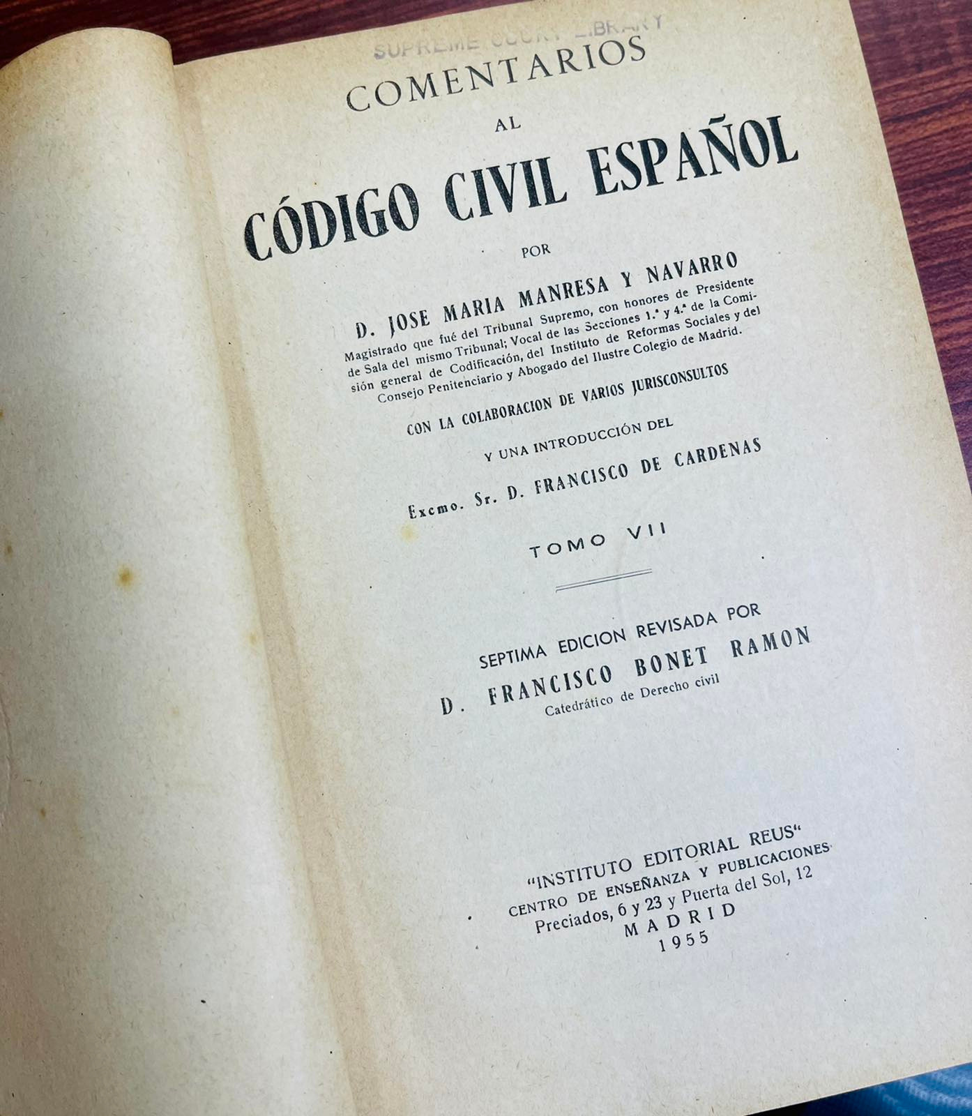
Notes:
Thus, when the Philippines enacted its own penal code in 1930 (Revised Penal Code), long after the Spaniards had ended their 333 years rule in the country, it took mainly from the old Spanish Codigo Penal of 1870. Even the Civil Code of the Philippines took its form mainly from the Spanish Codigo Civil. Indeed, so deeply rooted and far-reaching have been the Spanish influence on our legal system that up to this day, our jurisprudence still finds guidance and elucidation from commentaries of eminent Spanish scholars in their respective fields.

Slide 5
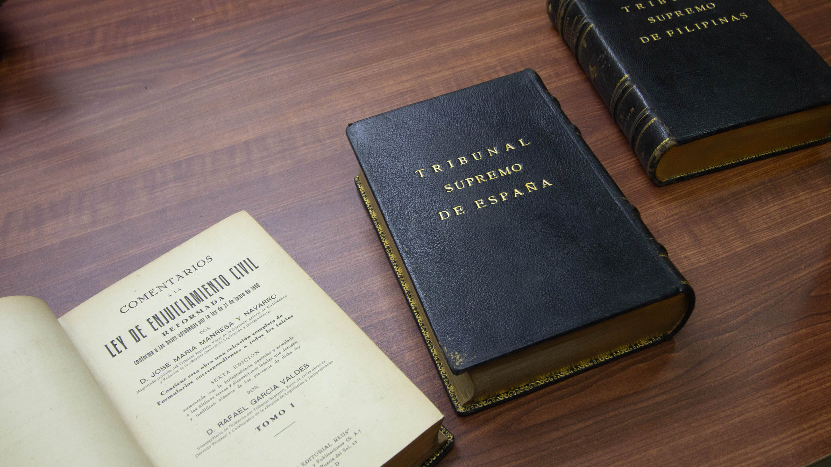
Notes:
But change is inevitable, and as people adhere to modern views and ideas, so must laws follow. Undeniably, the trend in criminal law reform has been towards liberalization and humanization, giving primary protection to the rights and freedoms of individuals as against immediately upholding the punitive and coercive powers of the State, and “reducing penalties and seeking alternatives to incarceration.” But as I had emphasized before, reforms to our laws must necessarily conform to our values and aspirations as a people, and these are embodied in our Constitution which has provided the parameters within which we may develop and restructure our penal laws to achieve the objectives of criminal justice.

Slide 6
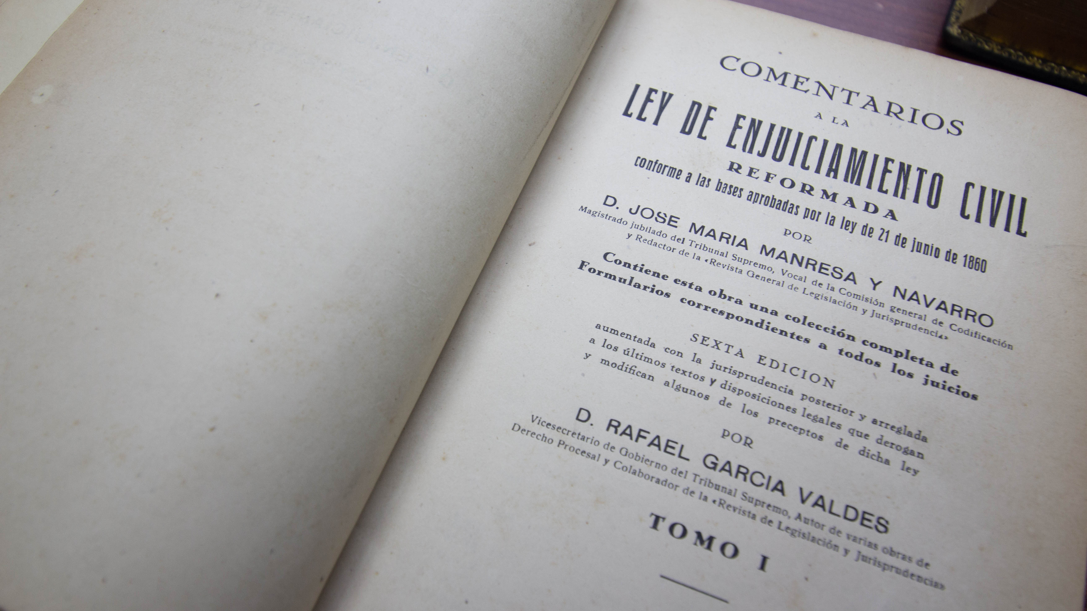
Notes:
Efforts to adapt modern views in our criminal laws are the domain of Congress, which has enacted, revised, and amended penal laws for the treatment of juvenile youth offenders, gender-based crimes, drug offenses, cybercrimes, and terrorism, to name a few. But to the Supreme Court, by Constitutional fiat, belongs the power to promulgate rules concerning the protection and enforcement of constitutional rights, pleading, practice, and procedure in all courts.

Slide 7

A.M. No. 02-2-18-SC
Rules on Juveniles in Conflict with the Law
5 Years Ago...
Notes:
Almost five years ago, the Supreme Court of the Philippines issued A.M. No. 02-2-18- SC, or the Rules on Juveniles in Conflict with the Law, with the objective of ensuring that “every child in conflict with the law is treated in a manner that recognizes and upholds human dignity and worth.” This complements our Republic Act (R.A.) No. 9344 or the Juvenile and Welfare Act of 2006 which mandates the State to apply the principles of restorative justice in laws, policies, and programs applicable to children in conflict with the law.
6
7

Slide 8

A.M. No. 21-06-08-SC
Rules on the Use of Body-Worn Cameras in the Execution of Warrants
Last Year...
Notes:
Only last year, the Supreme Court issued A.M. No. 21-06-08-SC or the Rules on the Use of Body-Worn Cameras in the Execution of Warrants, which utilizes technology, particularly body-worn cameras, in the protection of fundamental rights, as mandated by our Constitution. These rules seek to complement specifically R.A. No. 9165, or the Comprehensive Dangerous Drugs Act of 2002, and serve as a check to the possible excessive use of force by law enforcement officers in the execution of warrants.
On the same note, should a case be in the offing, it will not be that long before the Court issues similar guidelines on the use of drug-sniffing dogs as a valid law enforcement measure to curb the rising cases of drug-trafficking in the country. The guidelines would hopefully strike the balance between proactive law enforcement and the fundamental right to privacy of every citizen.

Slide 9
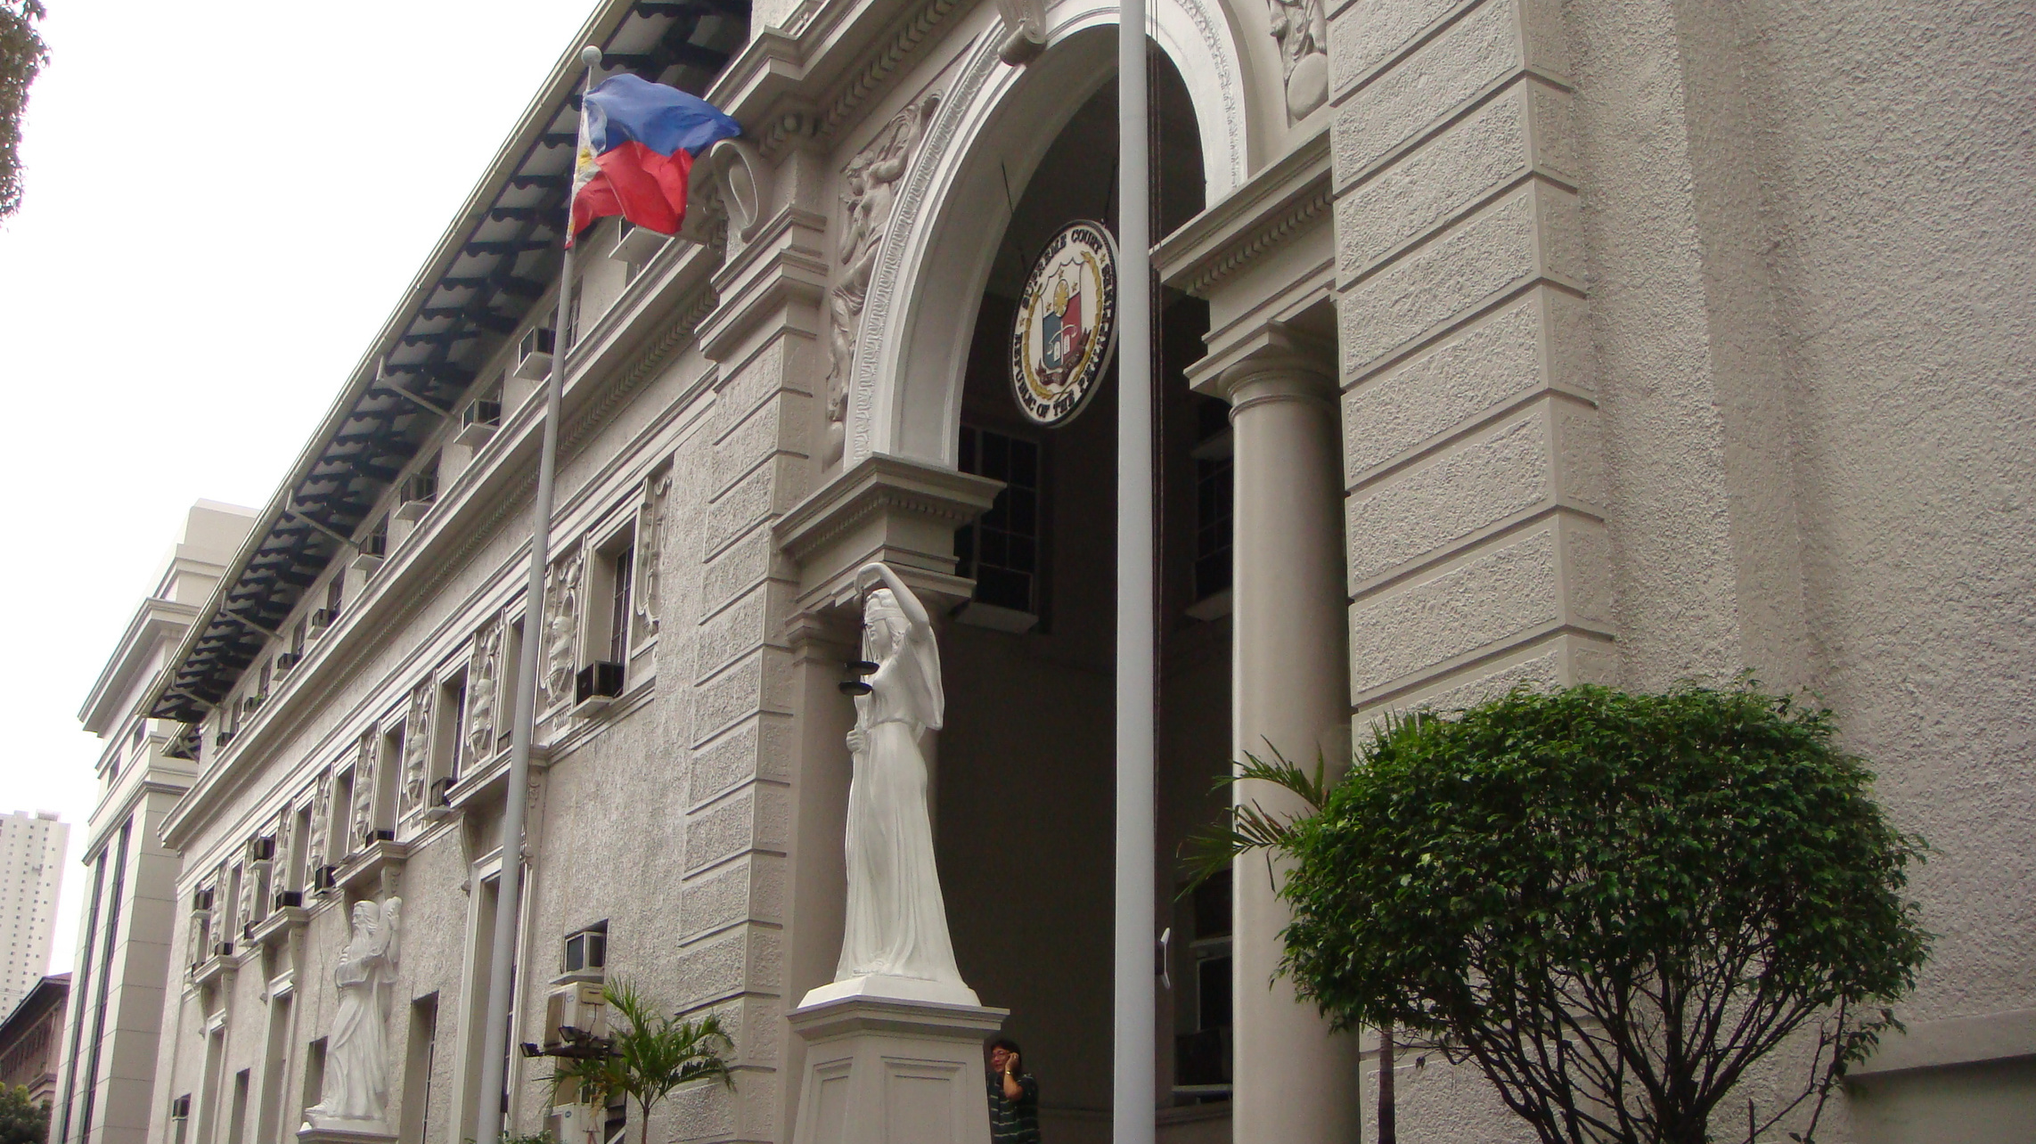




04
02
Committees and Technical Groups
On Terrorism
01
03
Gender Inclusivity and Equality
On Penalty
Notes:
The Court has also made great strides in our goal of mainstreaming gender inclusivity and equality not only in our institution but through our decisions. In this regard, we have adopted the first ever organic Guidelines on the Use of Gender Fair Language and Courtroom Etiquette for the Judiciary.
As to terrorism, the Supreme Court of the Philippines recently convened an Ad Hoc Committee for the Formulation of the Special Rules of Procedure on Anti-Terrorism Cases, consisting of multiple sectors, with the object of coming up with guidelines to complement the recently upheld R.A. No. 11479, or the Anti-Terrorism Act of 2020.
The Court has created other committees and technical working groups to review our rules and to formulate guidelines, no less important of which are the Committee on Data Privacy, Committee on Family Courts and Juvenile Concerns, Technical Working Groups (TWG) to Review the Writ of Habeas Data, to Propose the Writ of Kalayaan, to Review the Writ of Kalikasan and the Writ of Continuing Mandamus Under the Judicial Committee on Sustainability and Environmental Concerns.
As regards penalty, the Supreme Court issued A.M. No. 20-06-14-SC, approving the guidelines for the imposition of community service as an alternative penalty. This complements R.A. No. 13362 or the Community Service Act, which “authorizes the courts, in its discretion, to require community service in lieu of imprisonment for minor offenses.” to promote restorative justice and help jail decongestion.
10

Slide 10

Notes:
Significantly, in compliance with our treaty and convention commitments, the Court, in A.M. No. 21-07-22, has set a precedent by promulgating the Rule on Facilitated Naturalization of Refugees and Stateless Persons. This Rule provides an expeditious procedure for the acquisition of Philippine citizenship by refugees and stateless persons recognized by the Philippine Government This Rule, which is the first-ever judiciary led initiative of its kind at the global level, reaffirms the Philippines’ long standing humanitarian tradition of providing haven to those displaced by war and armed conflicts and fearing persecution because of race, religion, and political ideology.
11

Slide 11

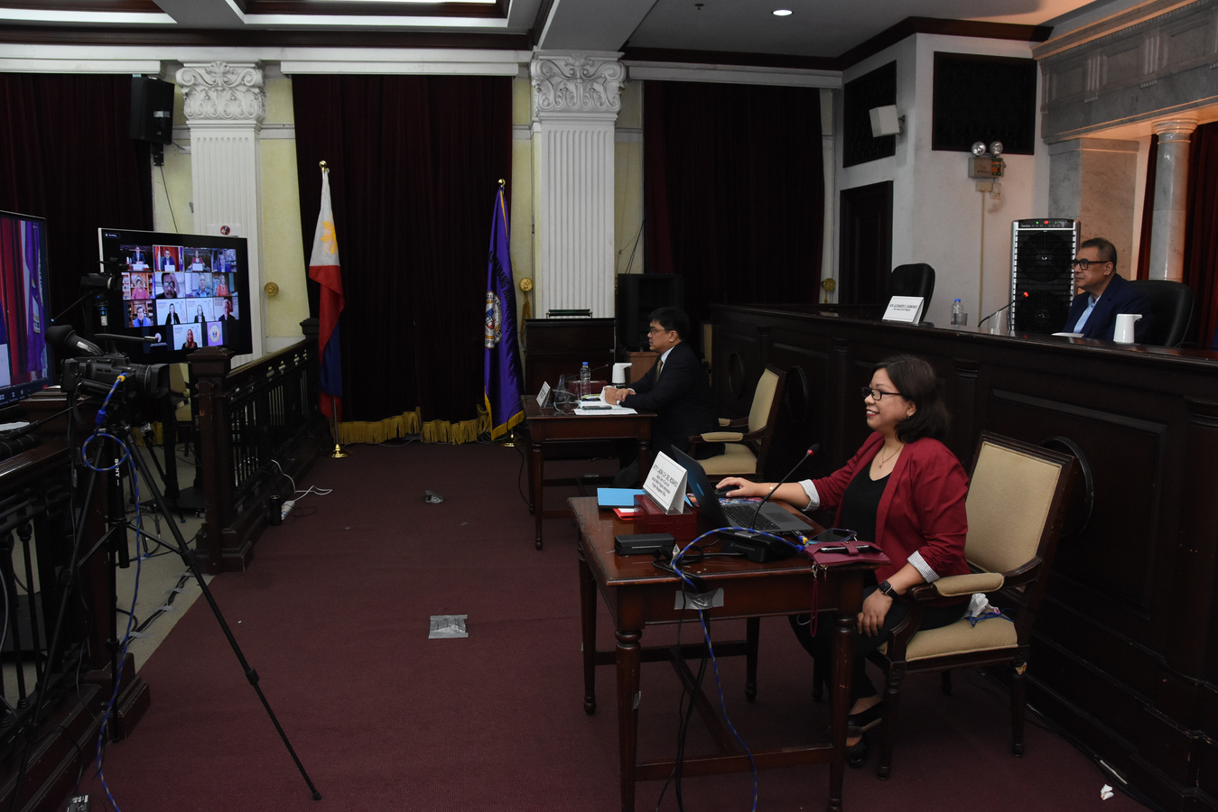
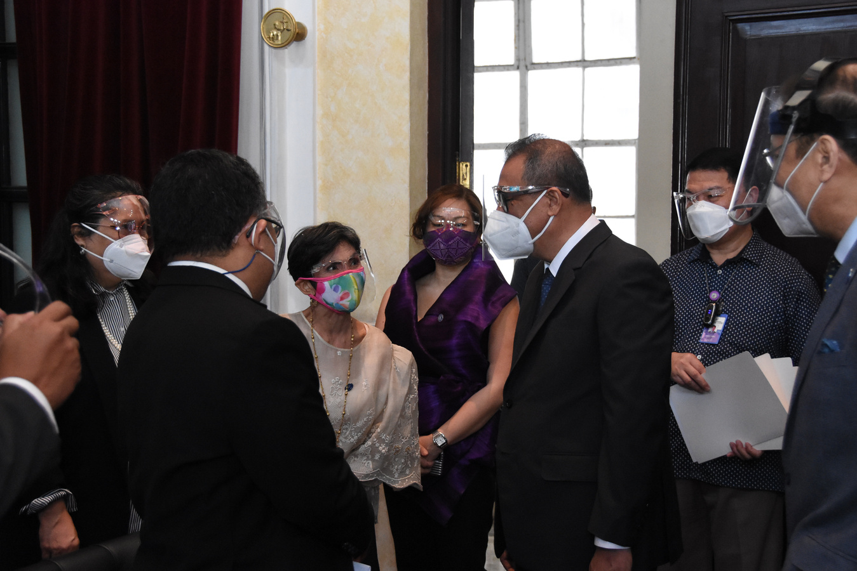
Notes:
When I assumed as Chief Justice in April 2021, it was a time of much uncertainty and anxiety as our country and the rest of the world were at the height of the Covid-19 pandemic. But we, in the Judiciary, did not allow this invisible enemy to paralyze court operations and dampen our commitment to serve the public. We took advantage of the latest technologies to continue the dispensation of justice, conducting remote court hearings and sessions via videoconferencing.

Slide 12
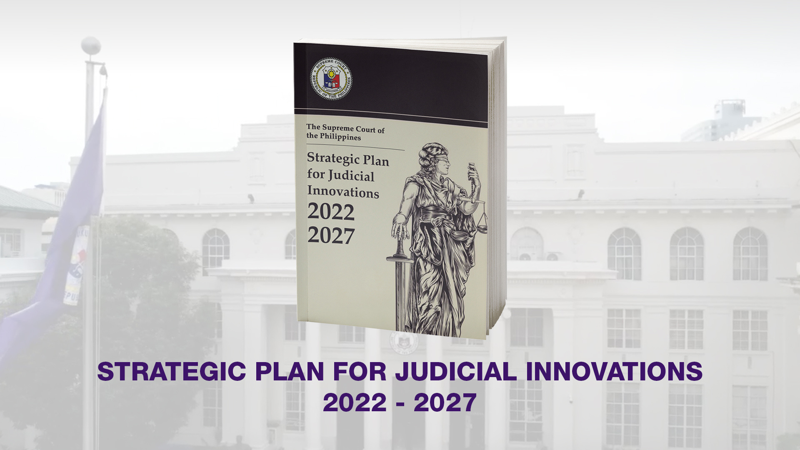
Notes:
As to reforms on the Judiciary as a whole, just recently, the Supreme Court of the Philippines approved the Strategic Plan for Judicial Innovations 2022-2027 or the SPJI. This institutional blueprint for judicial reforms is an amalgamation of ideas, aspirations, plans and proposals for the pursuit of one overarching goal: the delivery of responsive and real-time justice.
The SPJI is a plan powered by an Innovation Agenda to review and assess the organizational structure and operations of the various offices of the Judiciary, and to develop and establish an information and communication technology infrastructure for the Philippine Judiciary. It is a plan anchored on four guiding principles: Timely and Fair Justice, Transparent and Accountable Justice, Equal and Inclusive Justice, and Technologically Adaptive Management. These principles will propel us towards achieving three outcomes: Efficiency, Innovation, and Access.

Slide 13






OUTCOME 1: EFFICIENCY
Notes:
Under the first Outcome of EFFICIENCY, court systems, both adjudicative and administrative, shall be streamlined and performance of Justices, Judges, and court officials and personnel shall be effectively monitored and evaluated. Here, we will undertake a judiciary-wide organizational review and restructuring.
To drive performance excellence, we will institutionalize a socialized health insurance system for officials and employees, and mandate subsidized annual physical and mental health examinations for everyone. Mental Health Units will also be established in all court levels and in our administrative offices. Further, in recognition of the vital role of women in our court operations, we will strengthen and multiply the child-minding centers throughout our courts.
As we nurture the physical and mental wellbeing of our officials and employees, we will also step up our campaign to reinforce their ethical responsibility through the revision of the Code of Professional Responsibility under a Campaign for Ethical Responsibility.

Slide 14

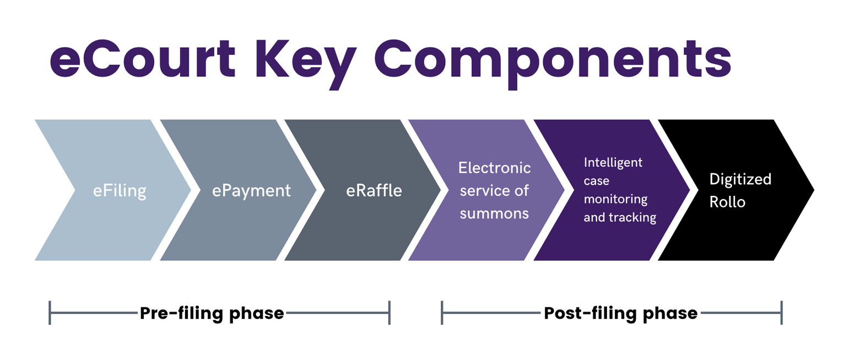

OUTCOME 2: INNOVATION
Notes:
Under the second Outcome of INNOVATION, we will shift and run all our adjudicative and administrative processes to digitalized platforms using the most appropriate and secure technologies, including artificial intelligence for legal research and court operations. Our trial courts will continue to transform as electronic courts using the much improved eCourt system version 2. All of these and more will be part of the Judiciary Enterprise ICT Governance Framework, which will be accompanied by a 5-year ICT Plan.
As our courts relied on the use of technology to be able to continue with its work of dispensing justice during the height of the pandemic, we have decided, in line with our thrust towards a technology-driven Judiciary, to allow the conduct of all court proceedings through videoconferencing even after the end of the global crisis. As such, permanent guidelines institutionalizing the conduct of virtual hearings and electronic testimony are being drafted and will soon be promulgated.

Slide 15
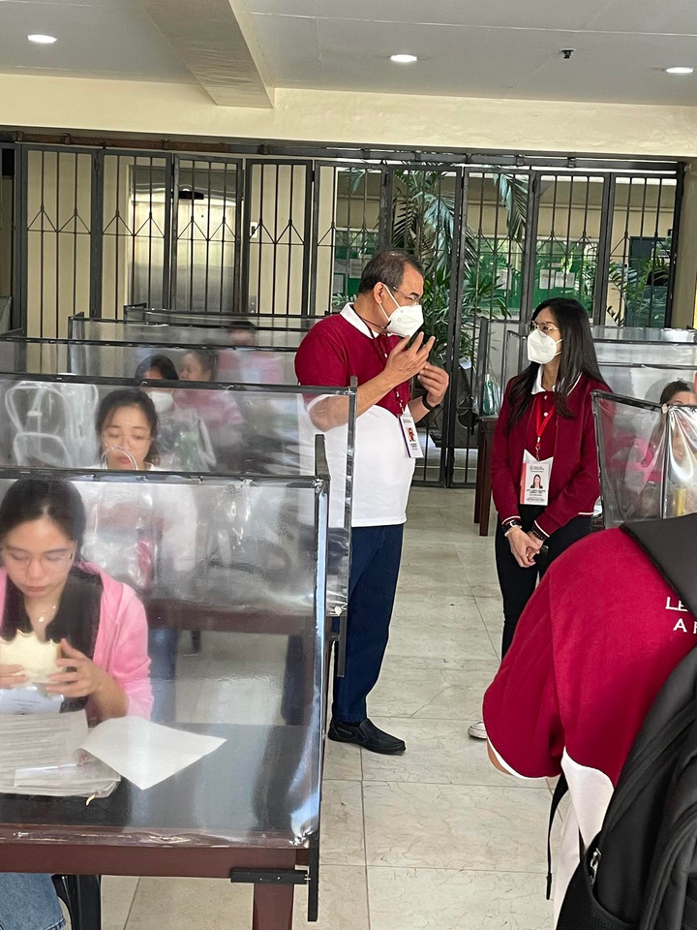
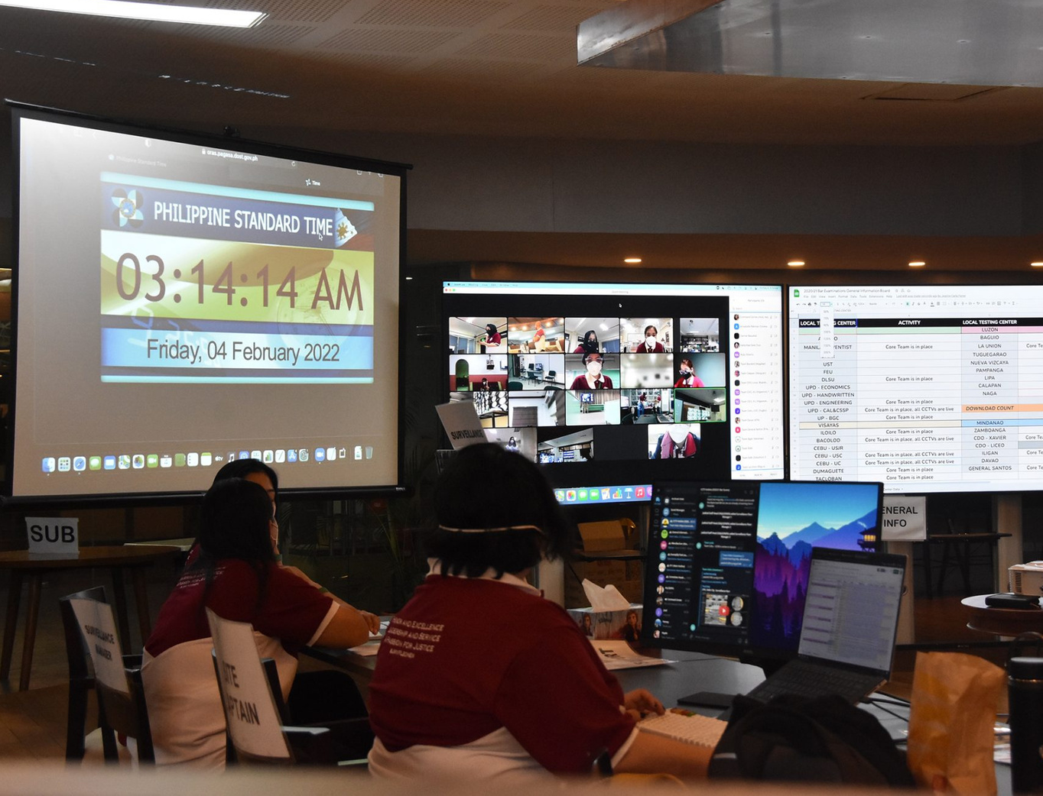
Notes:
Early this year too, we conducted the first ever localized and digitized bar examinations. In line with our Strategic Plan’s drive towards running all the judiciary’s adjudicative and administrative systems digitally, the Court has decided to pursue the conduct of all succeeding bar examinations in a digitized format.

Slide 16



OUTCOME 3: ACCESS
  National Summit on Legal Aid
Notes:
The third and final outcome is ACCESS and under this we will work towards bringing our services faster, closer, and more efficiently to the people. We will start with enhancing public access to information and legal services by strengthening our legal aid initiatives. We will spearhead a National Summit on Legal Aid which will showcase our 2-pronged approach of revitalizing the integrated bar’s legal aid program and reinforcing the Clinical Legal Education Program or CLEP under our Revised Rule 138-A. Towards enhancing CLEP, a National Summit on Clinical Legal Education will also be held.

Slide 17
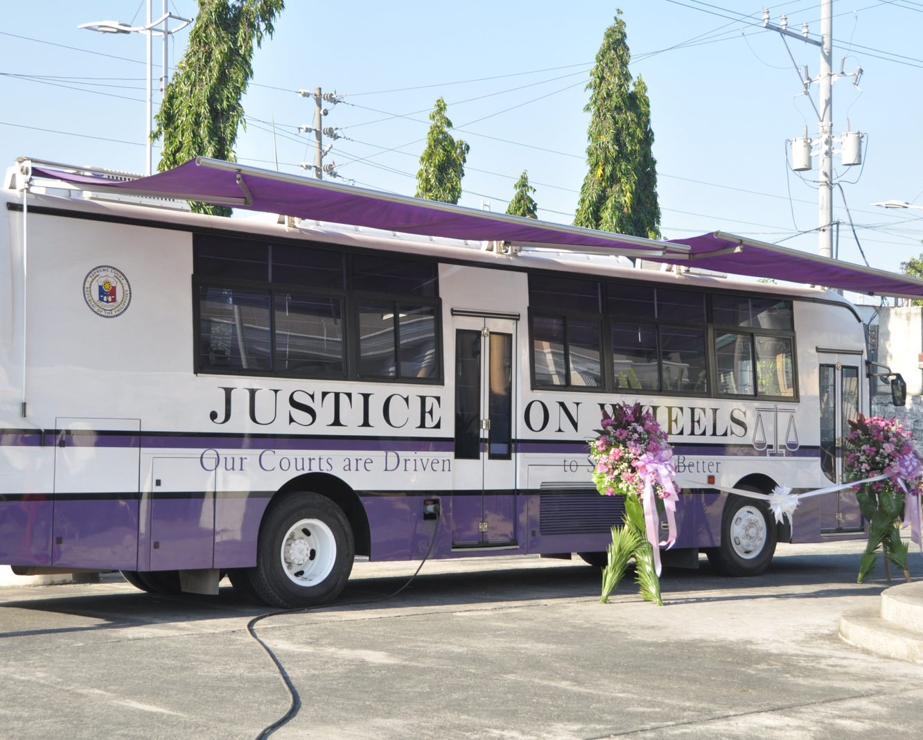
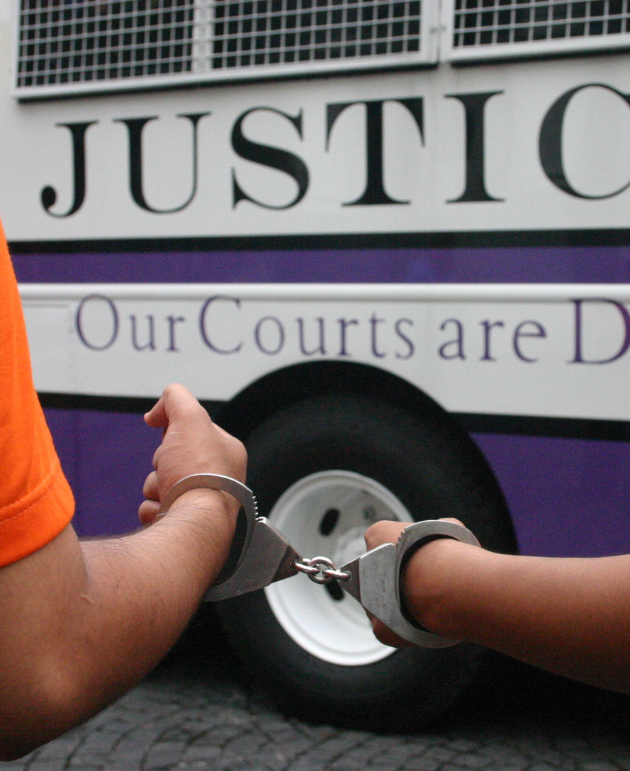
Notes:
At the forefront of bringing justice closer to those who need it most will be our Electronic Justice on Wheels Project. We will select the most congested courts and station our buses with our judges at large on duty for extended periods until the case dockets are reduced to manageable levels, all these using the most advanced technology for case processing, videoconferencing, notes transcription, legal research, and court-issued documents templating.

Slide 18

Notes:
For our Moslem brothers and sisters, we will also see to it that the foundations of Shari’ah Justice will be enhanced through an institutional review that will include the Shari’ah legal education system and rules of court.

Slide 19
Notes:
All these the Supreme Court of the Philippines plans to implement within the next five years. We hope that as the years progress, we will see greater enthusiasm and support from all stakeholders.
Let me close by thanking the Nova School of Law, the University of Malaga, and Erasmus+ for this Calesa Project. Truly, may this sharing of knowledge rekindle our understanding and appreciation of a shared tradition between our countries, but more importantly, remind us all of, despite our diversity, our oneness in our commitment for a just and humane society under the rule of law.
Thank you very much.

