Slide 1
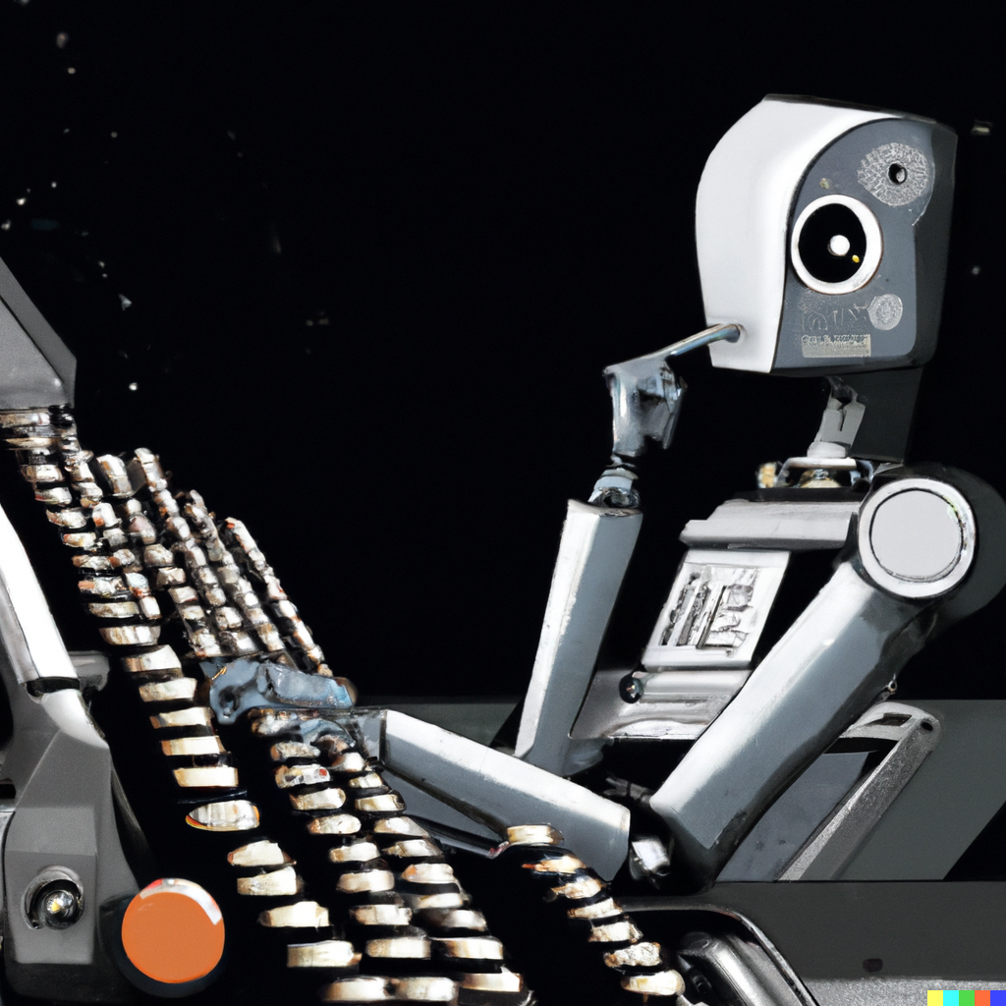

Intellectual Property and Artificial Intelligence
Prof. Dr. Giulia Priora
Assistant Professor NOVA School of Law
Director NOVA IPSI
Amanda Costa Novaes
Researcher NOVA IPSI

Slide 2


AI is a technology
Software
Big data
Business model
Marketing strategies
Decentralization of human decision-making power
Capacity to create

Slide 3



IP & (new) technologies
Through IP rights, the creation, although intangible,
becomes subject to a form of ownership
The fascinating role of IP lies in its ambition quest for balance
Parts thereof under exclusive control by some
Best technologies available for everyone

Slide 4
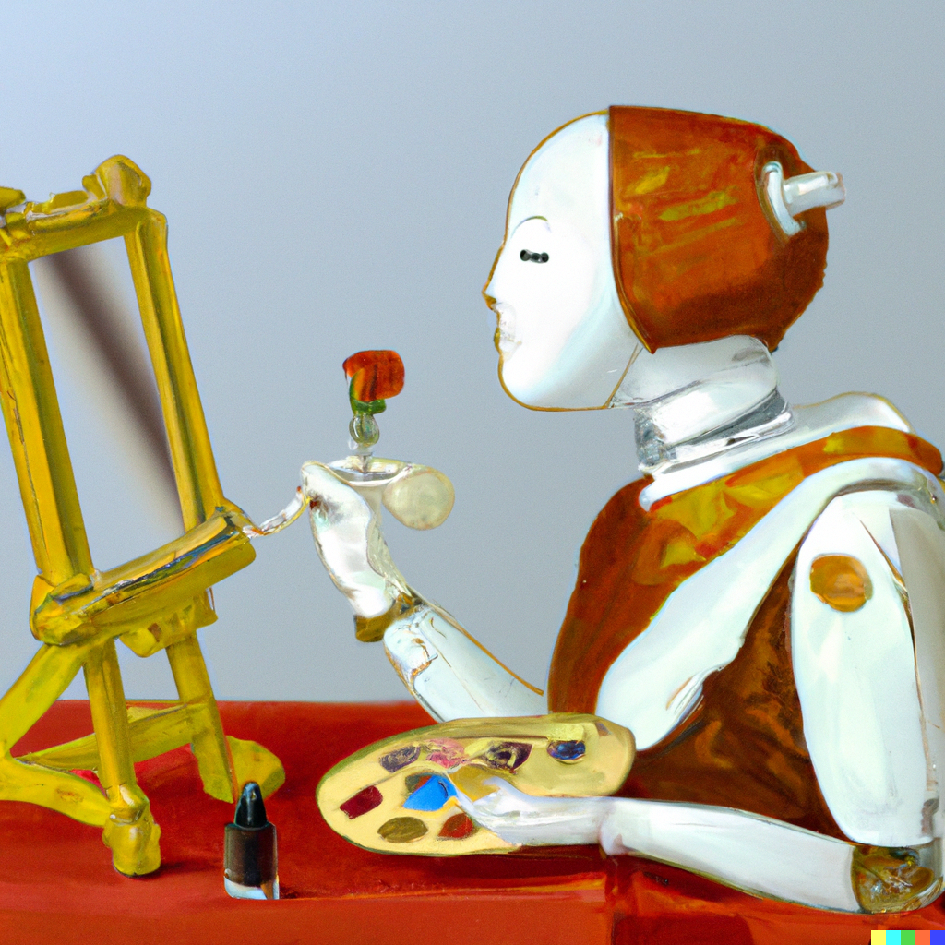




IP & AI
The issue of copyright: challenges of legal interpretation or economic concerns?
output
AI
Big lawsuits on the rise (eg New York Times vs OpenAI and Microsoft)

Slide 5





1. The problem:
output
Who is the author of a work generated by AI?
₢
₢
The answer lies in legislation and case law:
In the EU, those who made sufficiently creative and independent choices
Máquina
Pessoa (humana)
Domínio público

Slide 6
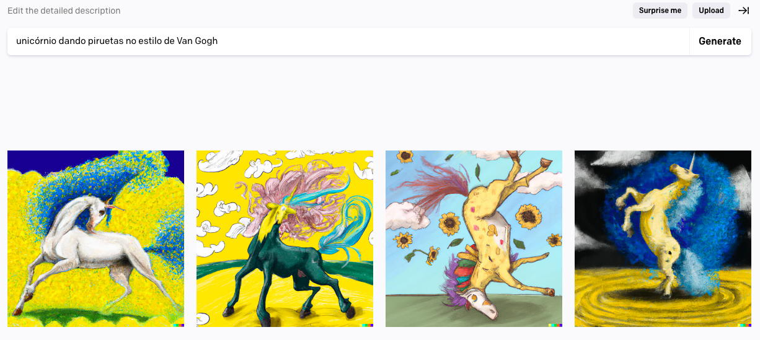
1. The problem
output
The brush of the 21st century?

Slide 7


1. The problem
output
or the brush of the 21st century?
This ‘brush’ – as many new technologies along the centuries –
is causing a lot of economic concerns to a lot of stakeholders!

Slide 8
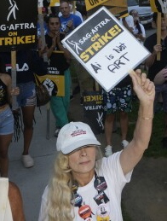
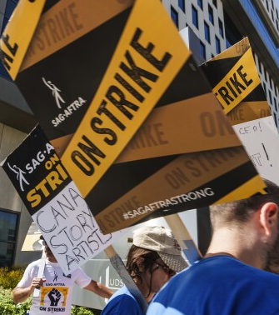
2. The input problem:
©
©
IA
©
Works used to train AI may be protected by copyright (and most likely are)

Slide 9
2. The input problem:
Legal or economic?
Text and data mining exceptions in the EU
Artt. 3 and 4 CDSM Directive 2019/790
Encourage and facilitate scientific research
Some opening for commercial development of AI, too...
... unless authors disagree (ex ante and effectively)

Slide 10
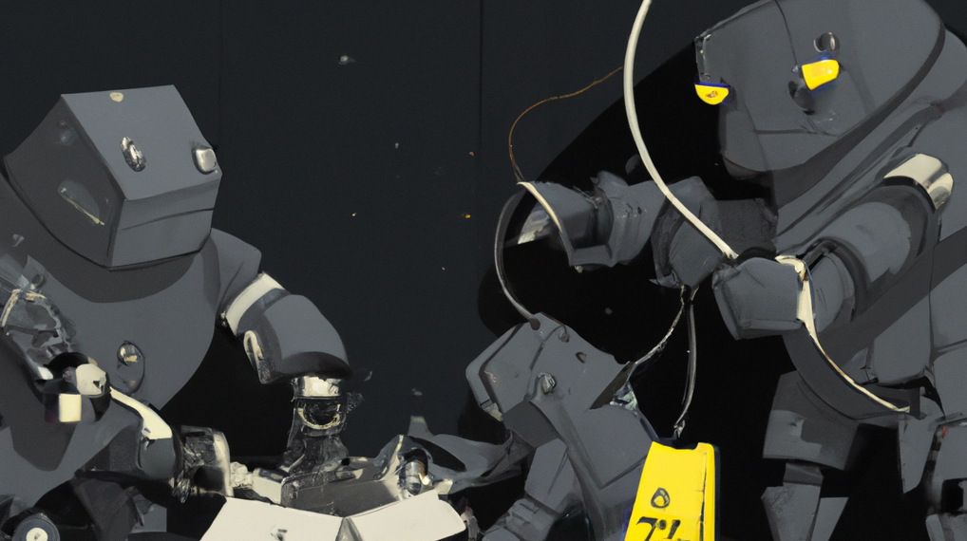
IP & AI: A policy opportunity, more than a legal problem?

Slide 11
Duration
Education
Flexibility
Remuneration
Reuse
Training

Slide 12
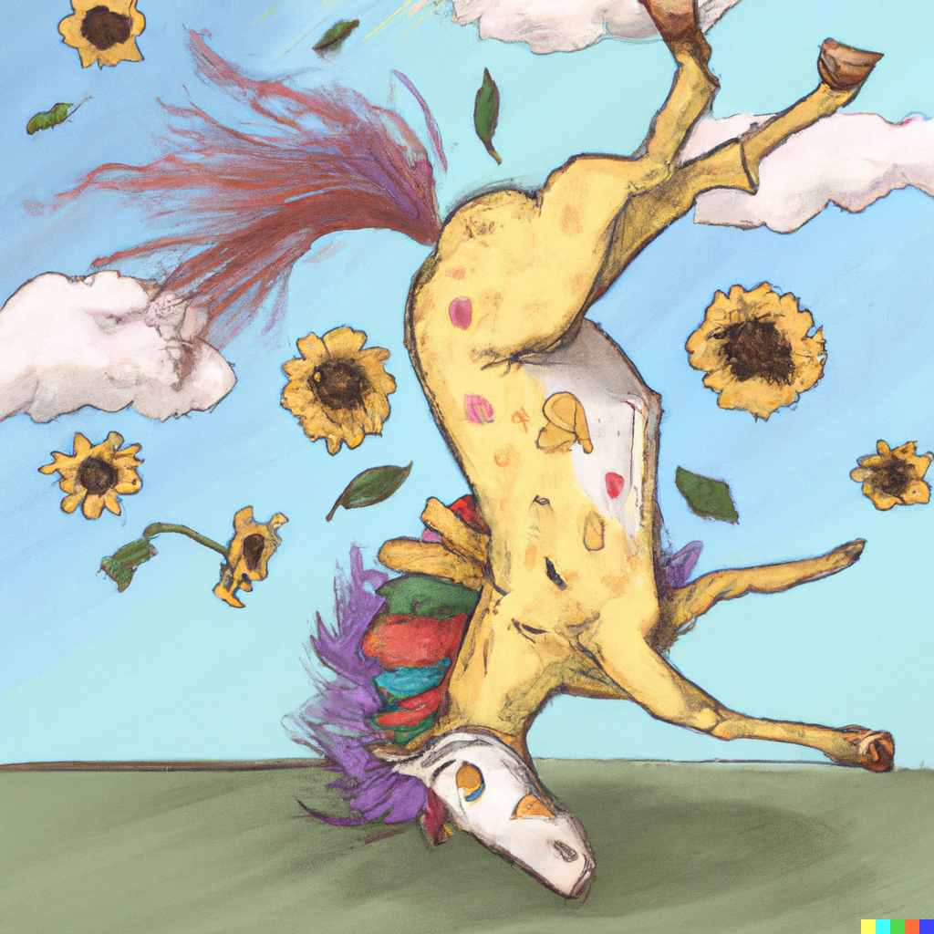
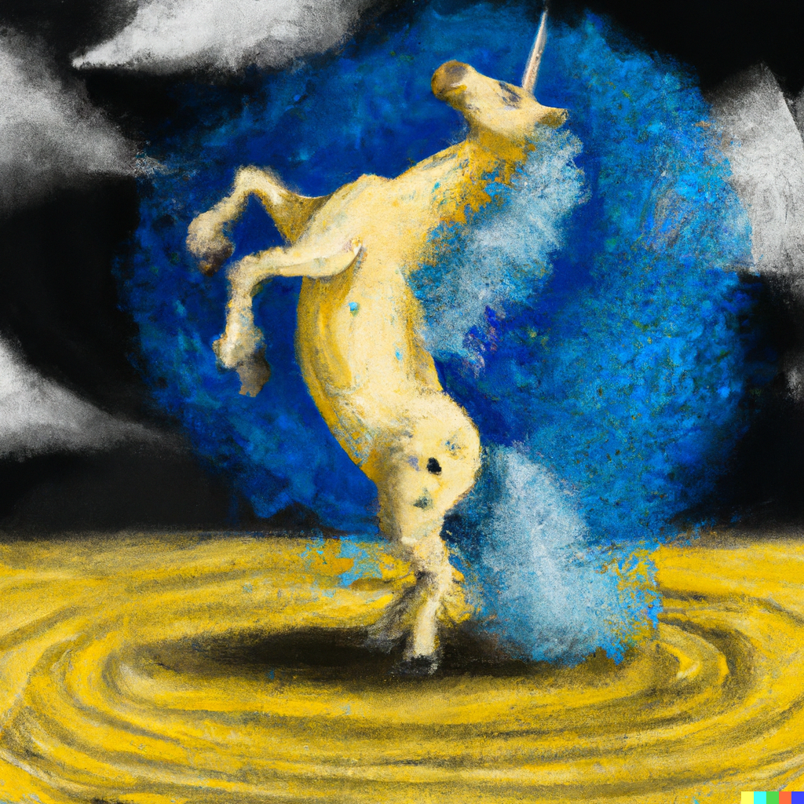
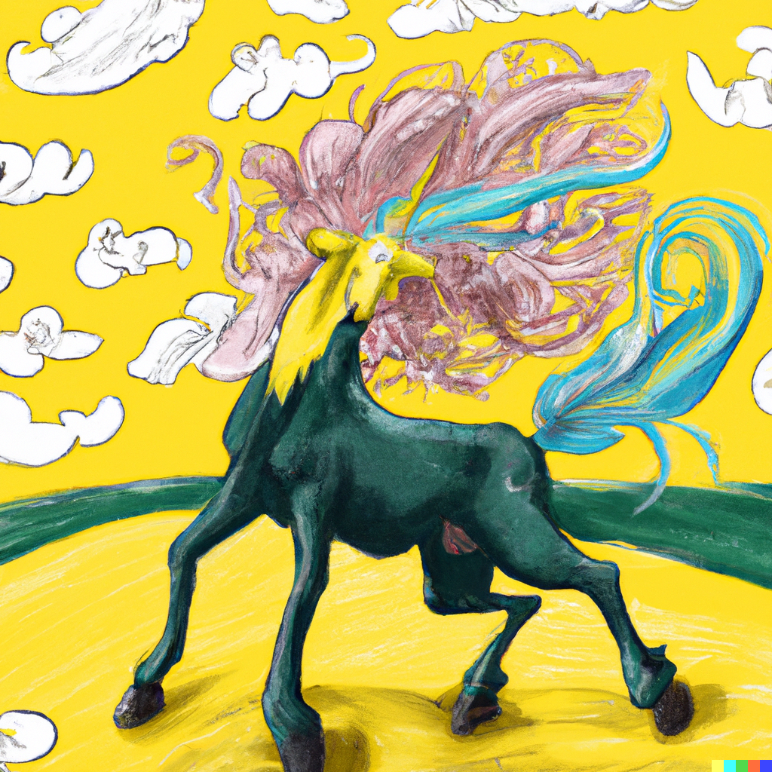
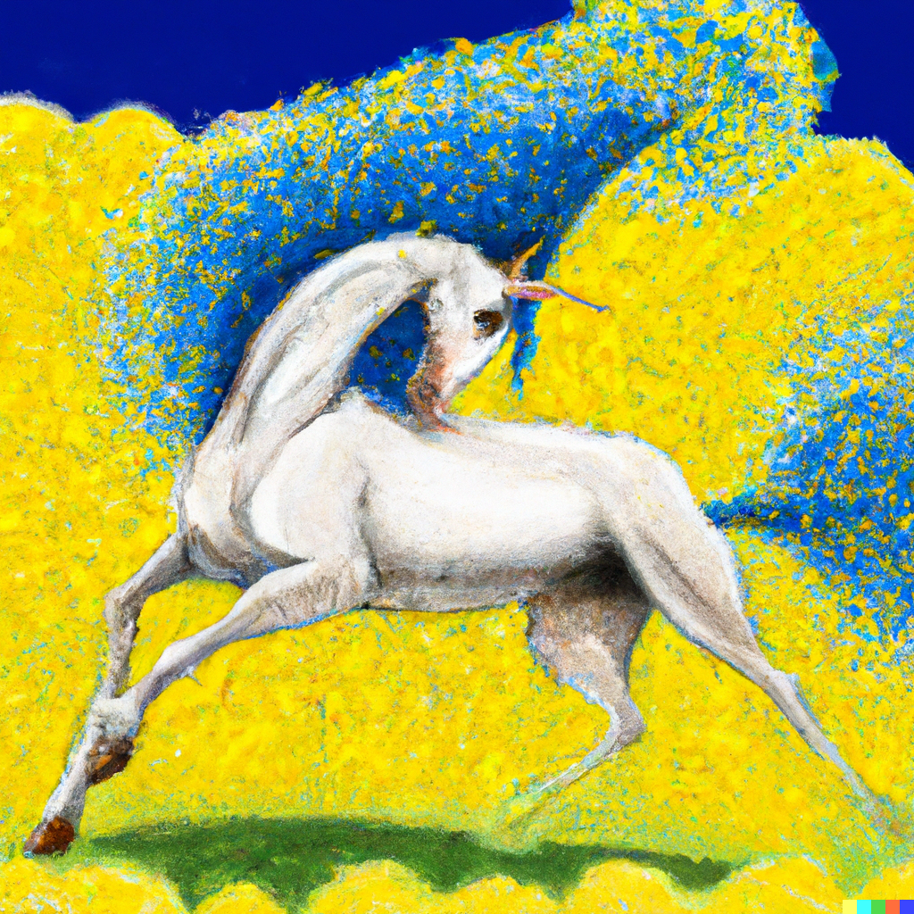

Thank you
giulia.priora@novalaw.unl.pt
amandacostanovaes@gmail.com

